Slide 1
CUSTOMER SERVICE

Slide 2

Customer Service
before, during and after the Sale
Want to talk to a real person? Our staff of 27 Customer Service Associates – with 11 plus years average tenure – are waiting to help you with any questions you might have. Simply call the best group of Customer Service Associates in the industry
Calls are answered
in 30 seconds or less
Make Atrium your one-stop shop
for all your window and door needs
(Phone)
800-846-9556
(Fax)
800-522-3981
(Email)
service@atriumwindows.com

Slide 3
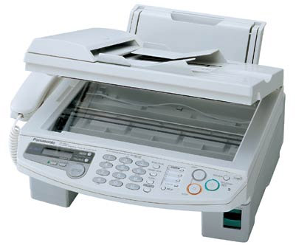

Customer Service
from Order Receipt through Delivery
Once orders are received by WindowWizard
or by fax, you’ll receive a return fax confirmation
the same day. If ordering by WindowWizard,
you’ll receive your confirmation
within 15 minutes of placing the order.
Your order will be planned for production based
on your cut-off day. Changes to your order can
be made up until 9 a.m. Eastern Time for faxed orders, or 1 p.m. Eastern Time for Wizard orders
on the day of your cut-off.
Your products will be produced and shipped
within 1 week.
NOTE that extended lead times may apply
for certain specialized products.

Slide 4
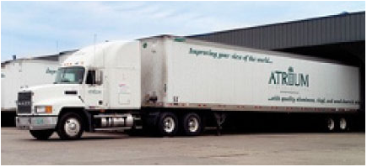
Customer Service
consistent delivery to your location
7 Day delivery from cut-off day
Consistent throughout the year
On-site dedicated carrier
– Salem Leasing
100 Loads per week
98% on-time delivery within 2 hours
of scheduled appointment
with no backorders, no damage
GPS (Global Positioning System) equipment allows truck location 24 hours a day

Slide 5
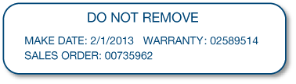
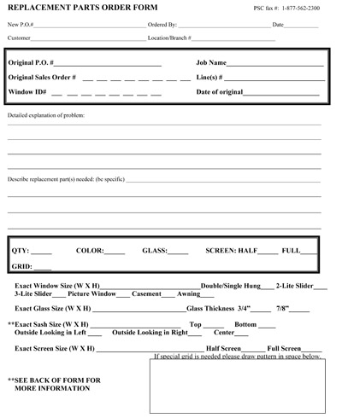
Customer Service
Product ID and Parts Assistance
Each product we produce
contains a product ID label
that is placed in the header
of the windows and doors
Need to order a screen?
Need to order a replacement part,
glass, a sash? Simply fill out and fax our Replacement Parts Order Form to us @ 1-800-522-3981
Providing the product ID number
will ensure 99.9% accuracy

Slide 6
Customer Service
Job/Project Quotes & Sub Account Pricing
Job/Project Quotes
Have a large job or project? Receive special quotes for large order jobs or projects expected to be complete in 6 months.
Sub Account Pricing
Special sub account quotes are available for jobs or projects with completion dates greater than 6 months.
Contact your Atrium Sales Representative
for more information!

