Slide 1




MADE IN USA
FIELD SERVICE

Slide 2

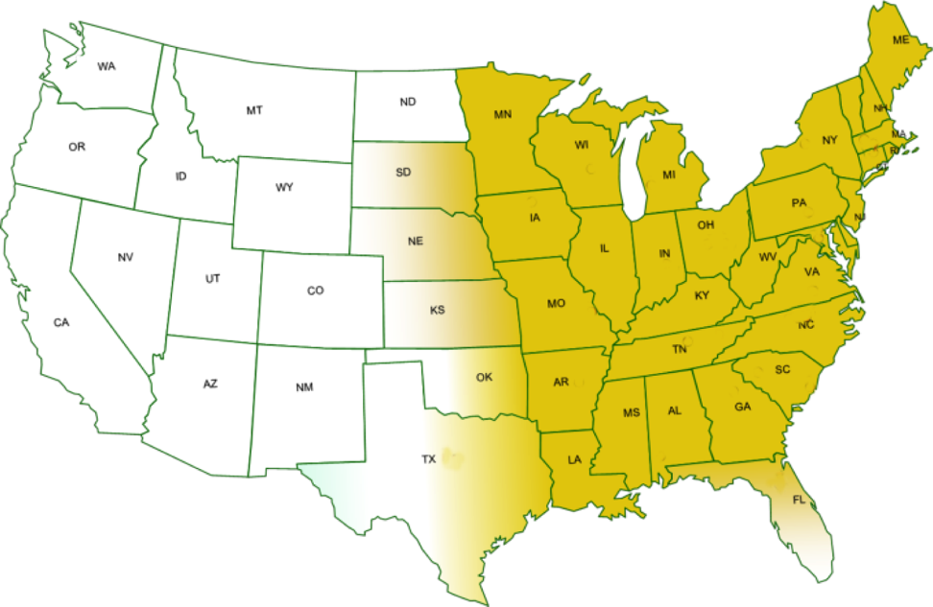

MADE IN USA
Complete coverage in 37 states
Full-time service technicians enable 2-3 week response time
All field service personnel
are registered with AAMA
Certified AAMA on-site trainer

