Slide 1

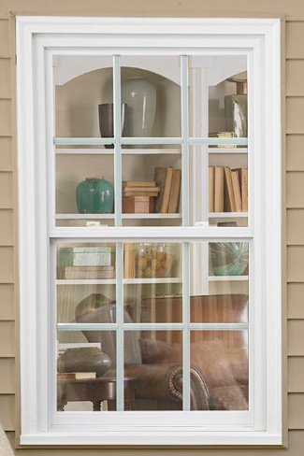
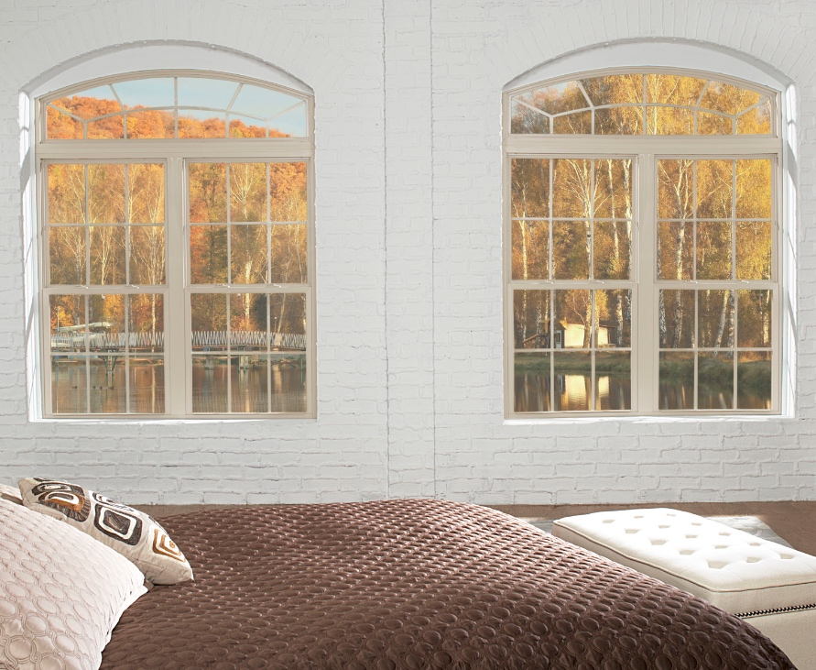

MADE IN USA
ATRIUM’S REPLACEMENT WINDOW OFFERING
A GOOD INVESTMENT

Slide 2
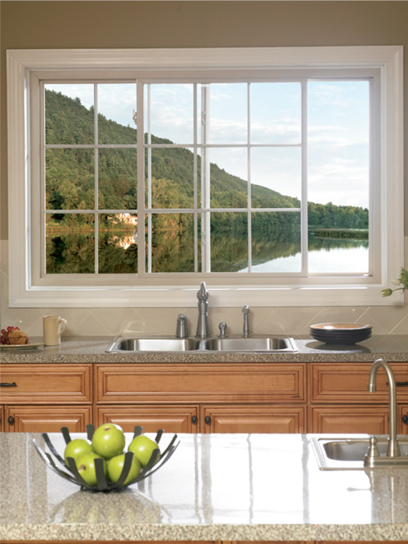
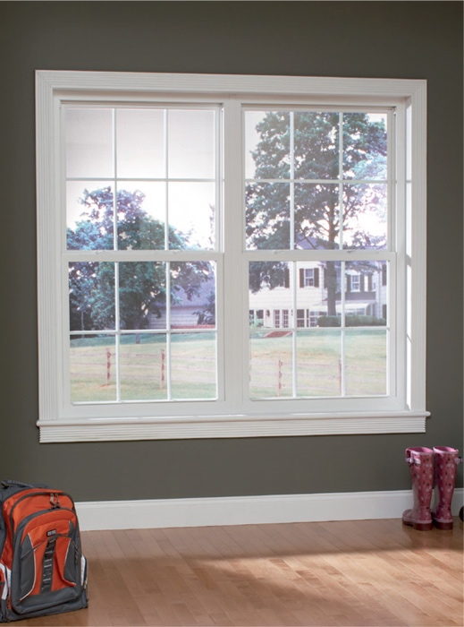
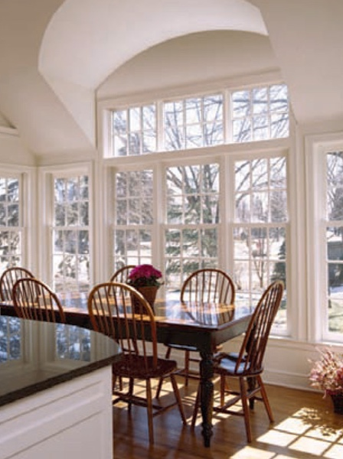
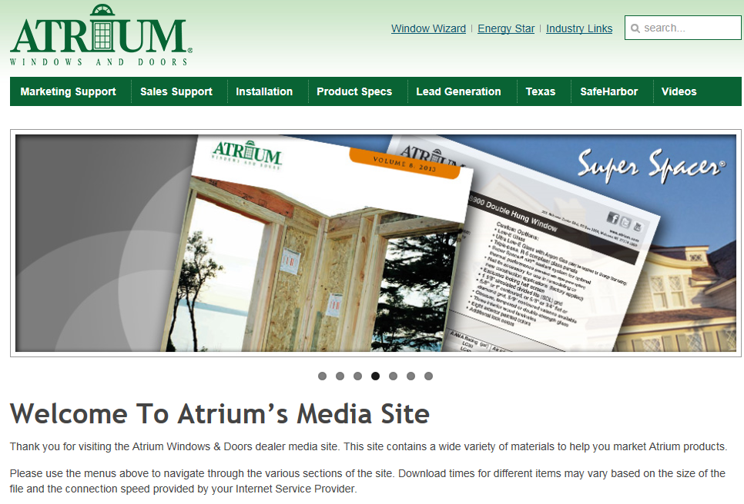

MADE IN USA
For easy to use marketing collateral with Series specific information
see our media site at
marketing.atrium.com
In the following slides
we provide you with links
to specific assets
for your convenience.
Atrium Media Website

Slide 3
MADE IN USA
Atrium’s Double Hung
Replacement Window Offering
Series 8900
Our Ultimate Replacement Double Hung window features Low-E Argon, a DP-60, Exclusive InsulKor™ sash reinforcement for superior thermal and structural performance and Lifetime Glass Breakage Warranty
Series 8700
Our Advanced Replacement Double Hung window features a great value without a premium price,
Low-E Argon, 25-Year Glass Breakage Warranty and has optional DP-50 and Bronze exterior laminate
Series 8300
Our Premium Replacement Double Hung window is priced right and looks great with Low-E Argon standard,
a transferable limited lifetime warranty and an optional lifetime glass breakage warranty

Slide 4
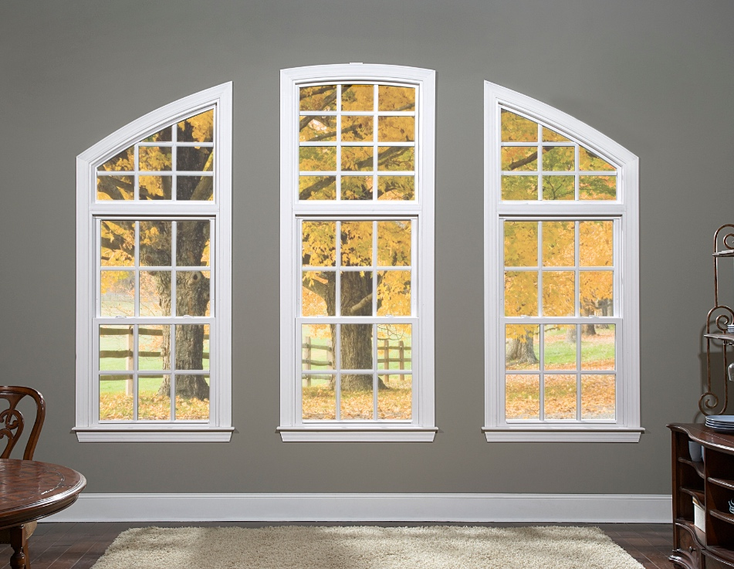
MADE IN USA
The BEST of our product offerings…
Series 8900

Slide 5
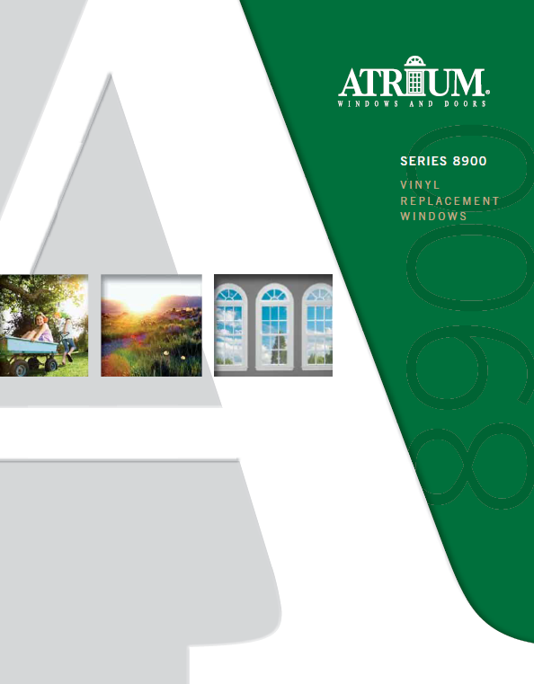
MADE IN USA
Low-E Glass with Argon Gas
for enhanced thermal efficiency
Exclusive InsulKor™ for superior thermal
and structural performance
DP 60 rating (window size 36 x 74)
Lifetime glass breakage warranty
ensures the longevity of your windows
Industry Leading .08 cfm/ft Air Infiltration Rating
Extruded Full Screen
Sound Transmission Control (STC) Technology Glass, 8 painted colors, 3 interior wood laminates
and 1-1/8” Simulated Divided Lite Grid
are among the many options available
Series 8900
* see brochure for full details

Slide 6

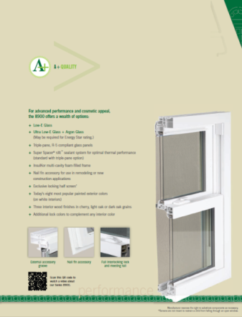
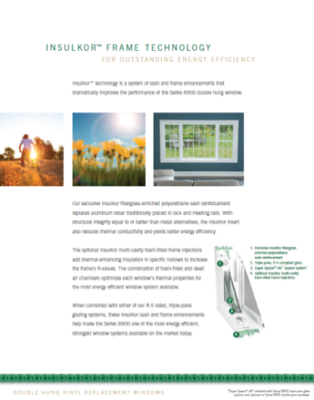

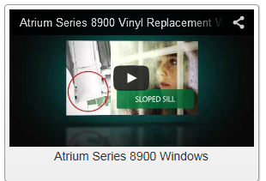
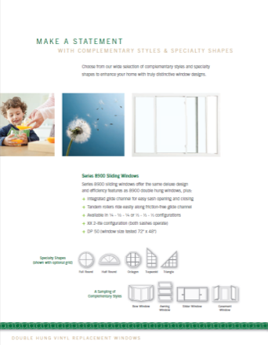
MADE IN USA
brochure
product videos
Series 8900
* to view video proceed to next slide

Slide 7
MADE IN USA
Series 8900 Overview Video

Slide 8
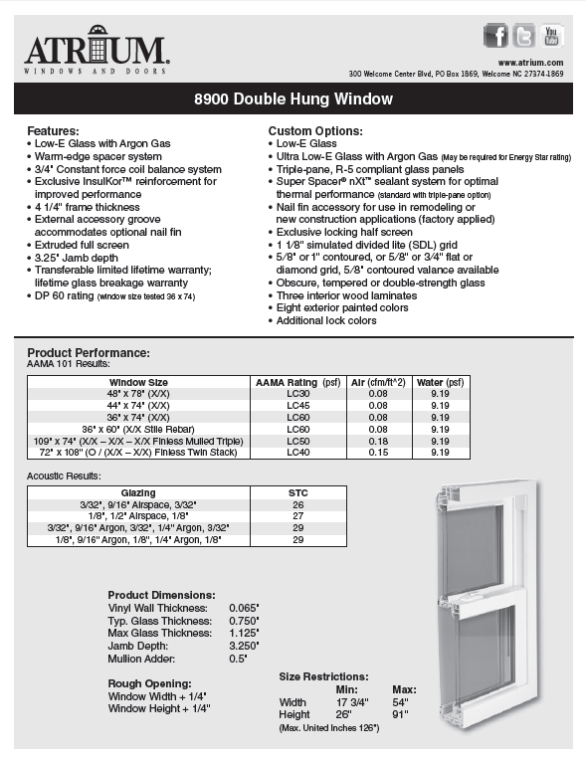
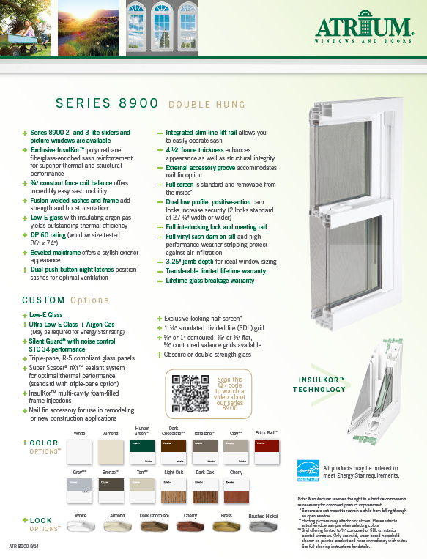
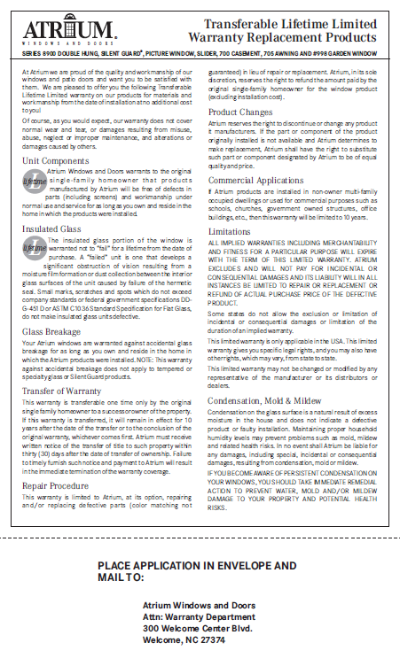
MADE IN USA
warranty
technical data sheet
(slider sheet also available)
feature sheet
(slider sheet also available)
Series 8900

Slide 9


MADE IN USA
Sound Transmission Control (STC) Glass
This option is specifically manufactured with our noise-reducing technology to provide the optimum performance.
STC glass offers advanced noise control performance for the majority of annoying sounds that routinely affect us all.
Sounds are measured in decibels (dBs). An STC rating is assigned to a window to designate its capacity to block sound.
The higher the decibel the higher the STC rating needed. Typical windows have STC ratings in the 25-28 range.
From loud lawn mowers to barking dogs, the STC 34 rated option is designed to control these most common nuisances.
Sound Transmission Control Option

Slide 10
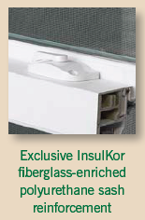
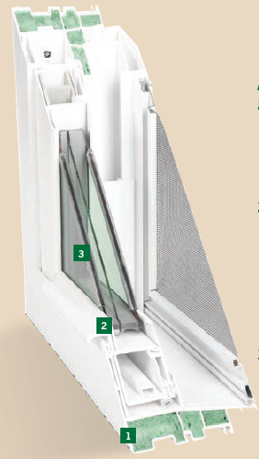
InsulKor™ Technology
InsulKor technology is a system of sash and frame enhancements that dramatically improves the performance of the Series 8900 double hung window! Our exclusive InsulKor fiberglass-enriched polyurethane sash reinforcement yields better energy efficiency while maintaining the structural integrity of the traditional metal reinforcement.
Also available to further enhance your Series 8900 windows is the InsulKor foam injections that add additional thermal insulation in specific hollows of the frame.

Slide 11
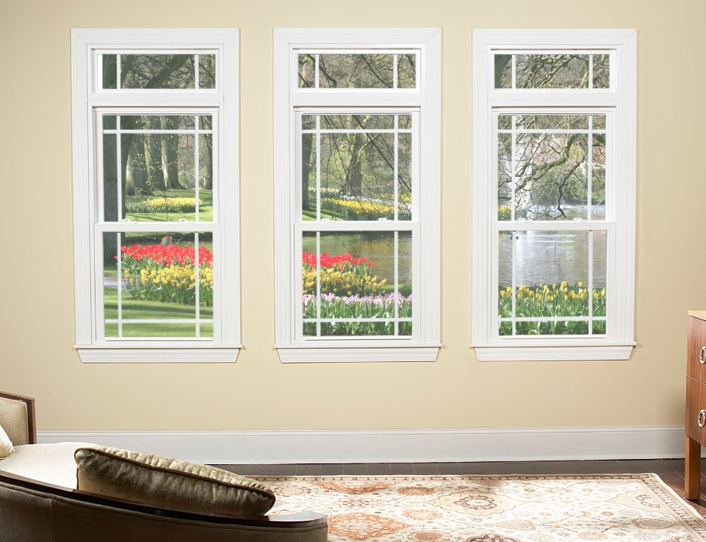
MADE IN USA
Great Value and Great Price…
Series 8700

Slide 12
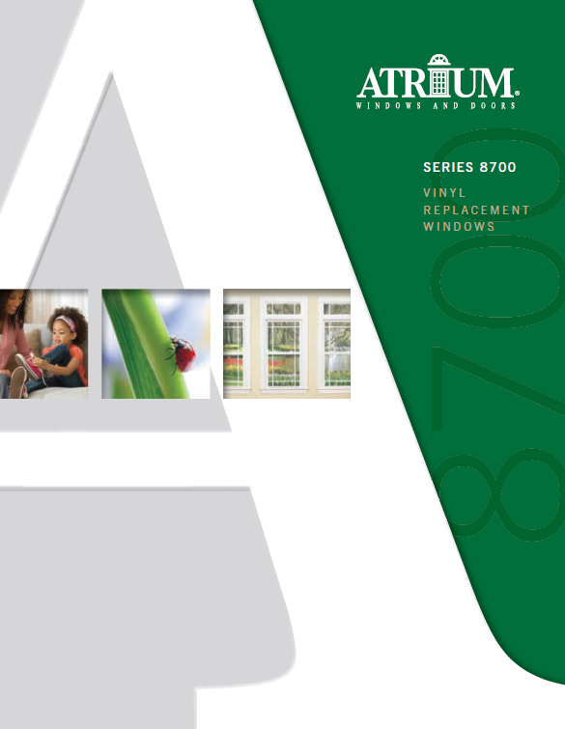
MADE IN USA
Low-E Glass with Argon Gas
for enhanced thermal efficiency
25 Year Glass Breakage
Warranty – standard (lifetime optional)
½” Constant Force Coil Balance
DP 50 rating is optional
Bronze Exterior Laminate is optional
Ultra Low-E Glass with Argon Gas,
flat, contoured & SDL grids
are also available
Series 8700
* see brochure for full details

Slide 13
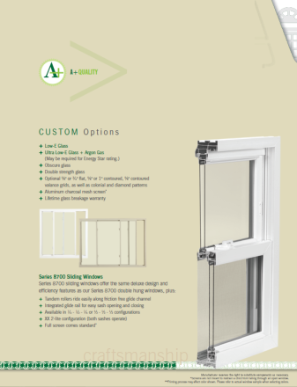
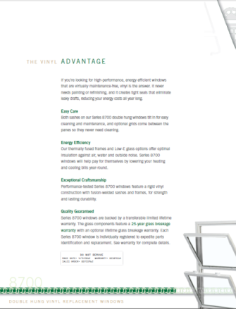
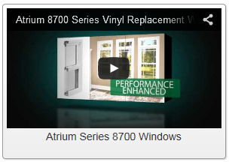
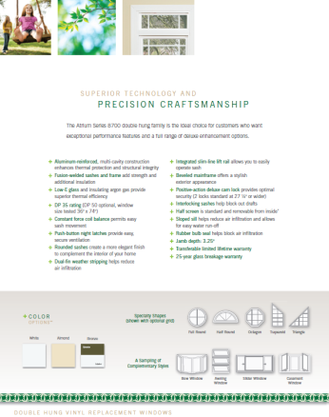
MADE IN USA
brochure
product videos
Series 8700
* to view video proceed to next slide

Slide 14
MADE IN USA
Series 8700 Overview Video

Slide 15
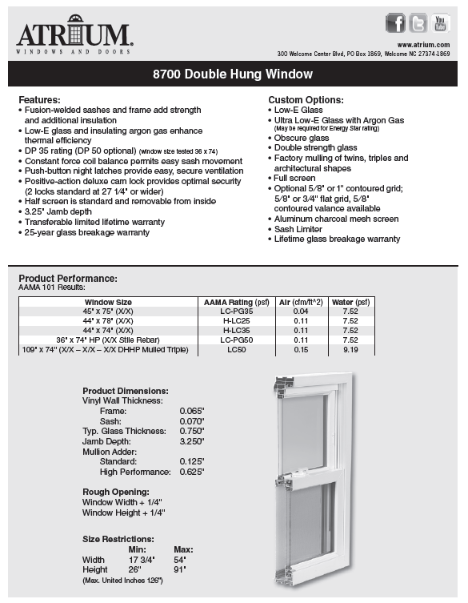
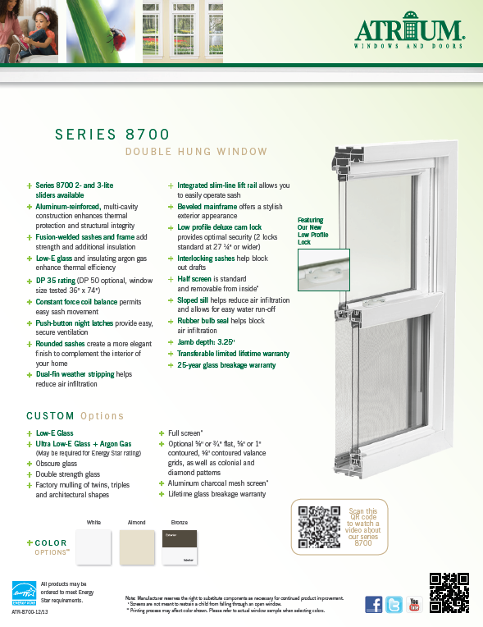
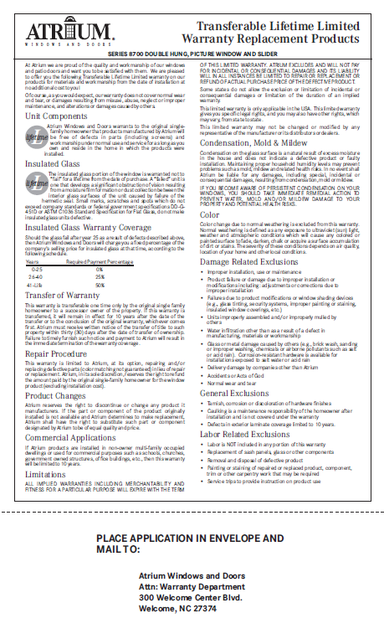
MADE IN USA
warranty
technical data sheet
(slider sheet also available)
feature sheet
(slider sheet also available)
Series 8700

Slide 16
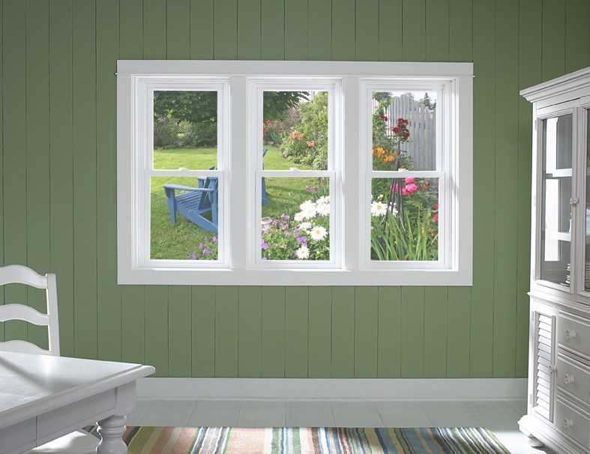
MADE IN USA
priced right and looks great…
Series 8300

Slide 17

MADE IN USA
Low-E Glass with Argon Gas
for enhanced thermal efficiency
Transferable Limited
Lifetime Warranty
½” Constant Force Coil Balance
Half Screen
Ultra Low-E Glass with Argon Gas,
flat and contoured grids, almond vinyl and 8 painted exterior colors are also available
Series 8300
* see brochure for full details

Slide 18

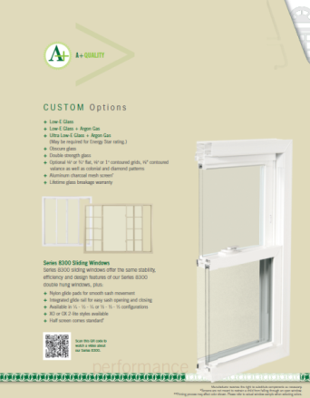
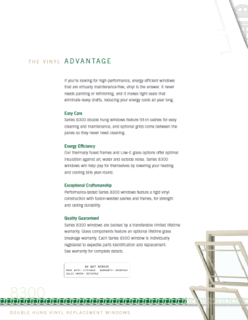
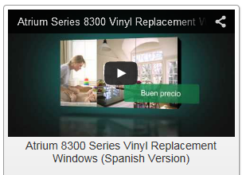
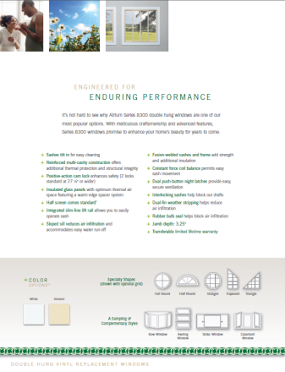
MADE IN USA
brochure
product videos
Series 8300
* to view video proceed to next slide

Slide 19
MADE IN USA
Series 8300 Overview Video

Slide 20
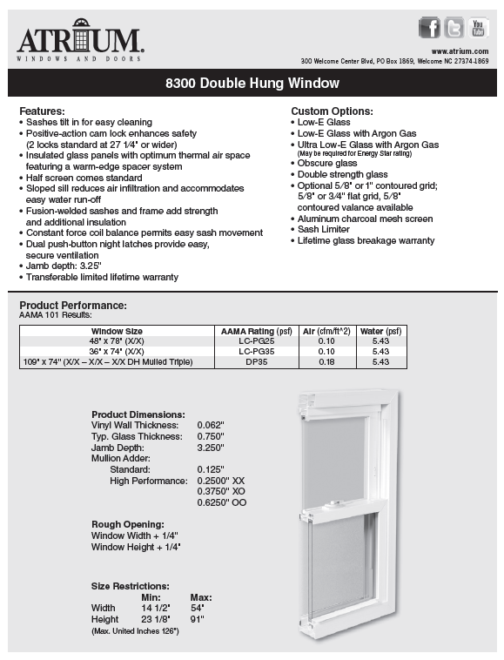
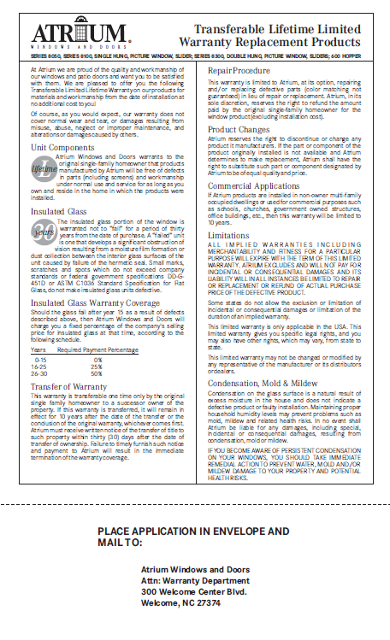
MADE IN USA
warranty
technical data sheet
(slider sheet also available)
feature sheet
(slider sheet also available)
Series 8300

Slide 21
MADE IN USA
Atrium’s Single Hung
Replacement Window Offering
Series 8100
It’s Back to the basics with this Single Hung window featuring a Block & Tackle Balance System,
Factory applied wrap-around foam, Beveled exterior frame and sash,
a transferable Limited Lifetime warranty and an optional lifetime glass breakage warranty
Series 8050
Our Only Side-Load Single Hung window is priced right and looks great with a removable bottom sash,
an industry leading .01 cfm/ft. air infiltration performance, Block & Tackle Balance System,
a transferable limited lifetime warranty and an optional lifetime glass breakage warranty

Slide 22
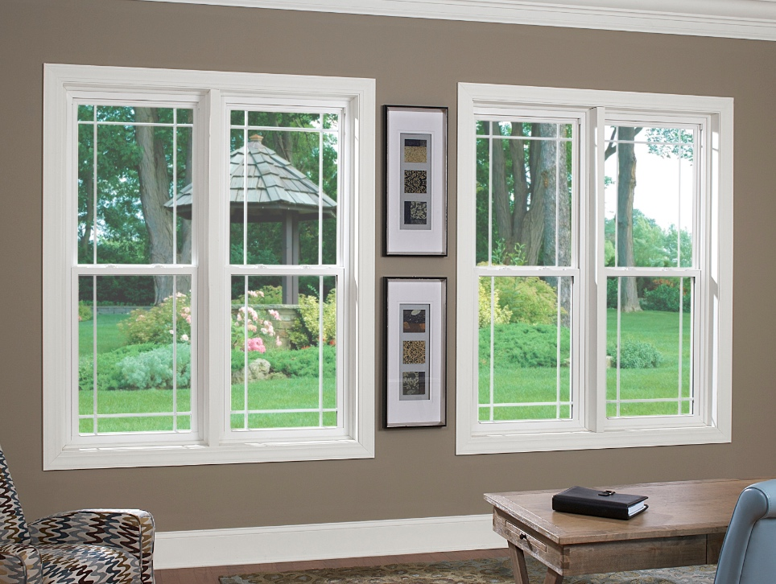
MADE IN USA
for Quality & Value choose our…
Series 8100

Slide 23
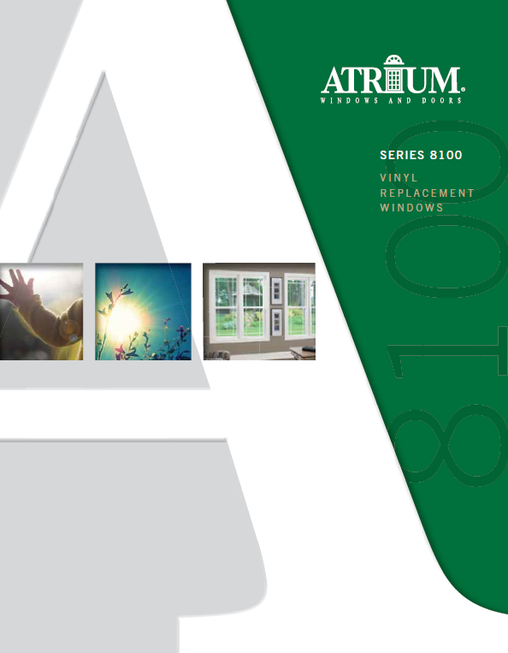
MADE IN USA
Block & Tackle Balance System
Factory applied wrap-around foam
Beveled exterior frame and sash
Transferable limited lifetime warranty with Lifetime glass breakage warranty optional
Sloped Sill for easy water runoff
Low-E glass, Low-E glass with argon gas, Ultra Low-E glass with argon gas,
flat and contoured grids
and double strength glass
are among the many options available
Series 8100
* see brochure for full details

Slide 24
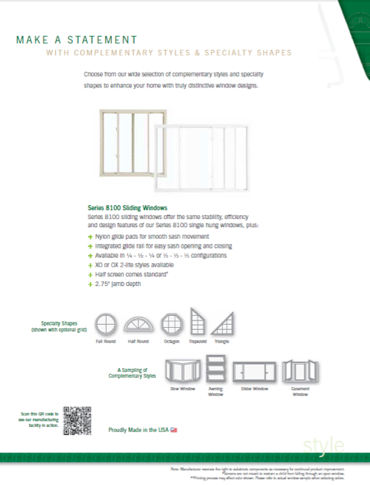
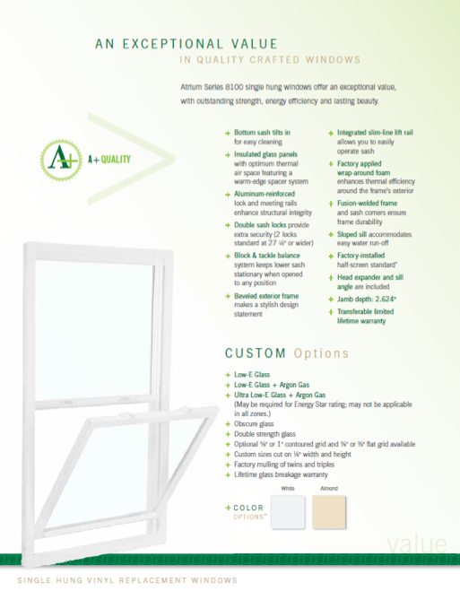
MADE IN USA
brochure
Series 8100

Slide 25
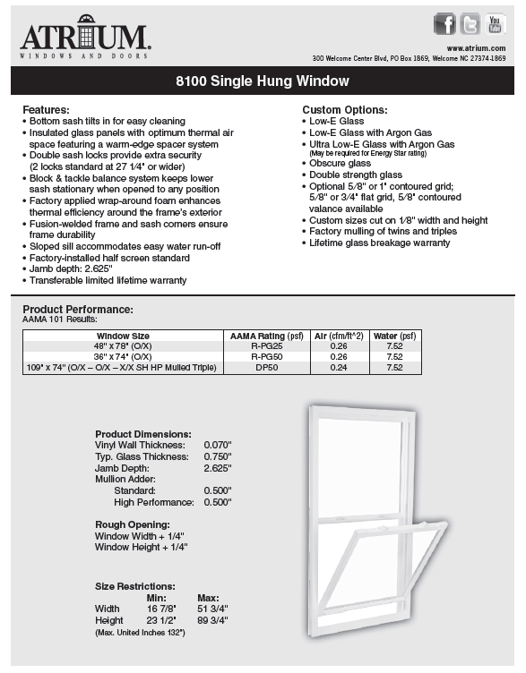
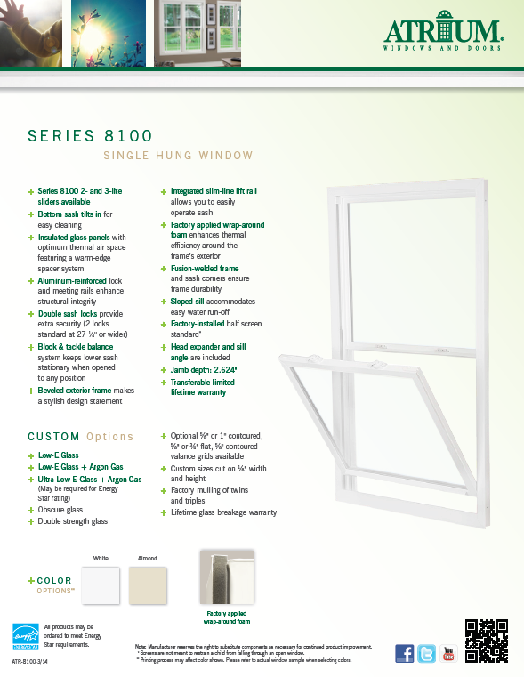
MADE IN USA
warranty
technical data sheet
(slider sheet also available)
feature sheet
(slider sheet also available)
Series 8100

Slide 26
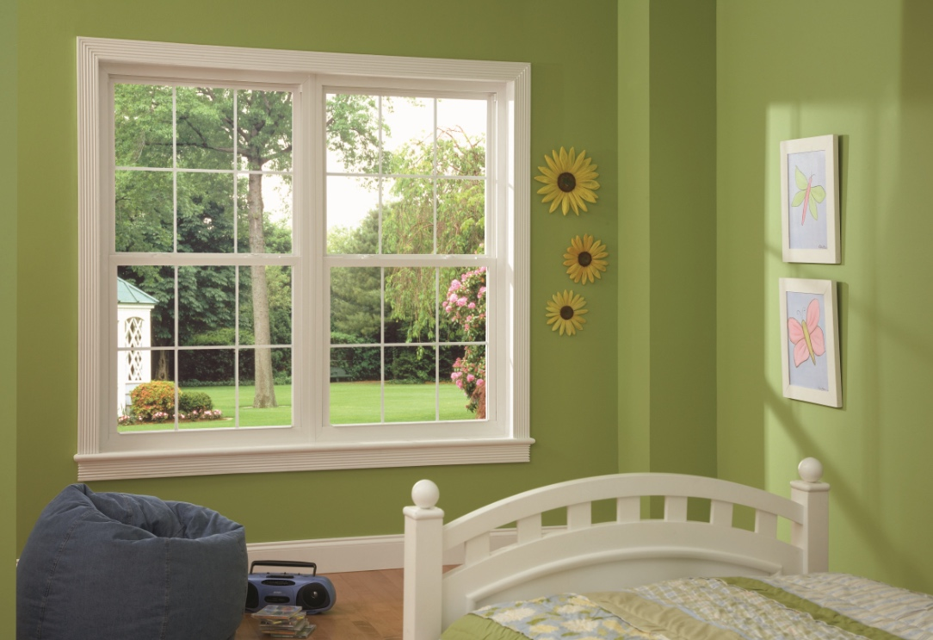
MADE IN USA
priced right and looks great…
Series 8050

Slide 27
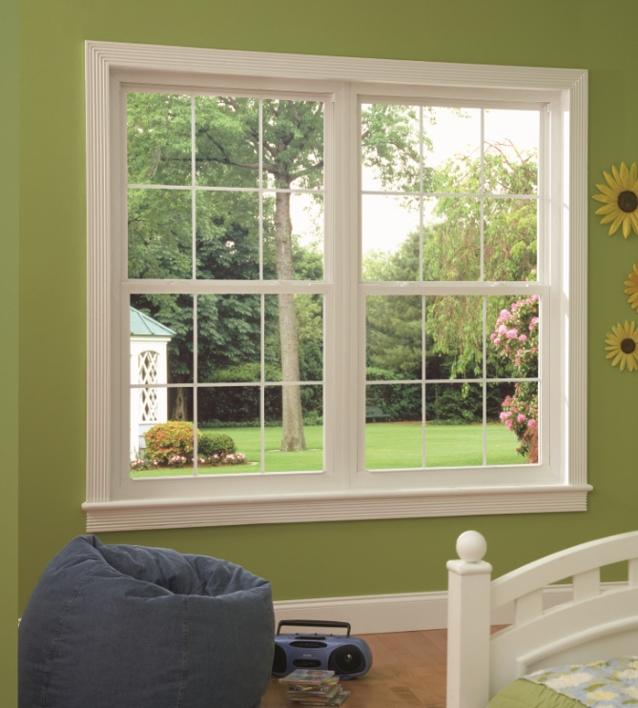
MADE IN USA
Side-Load with removable bottom sash
Industry leading .01 cft/ft.
air infiltration performance
Block & Tackle Balance System
Sweep lock helps
provide a weather-tight seal
Transferable limited lifetime warranty with Lifetime Glass Breakage warranty optional
Ultra Low-E Glass with Argon Gas,
flat and contoured grids
are also available
Series 8050
* see brochure for full details

Slide 28
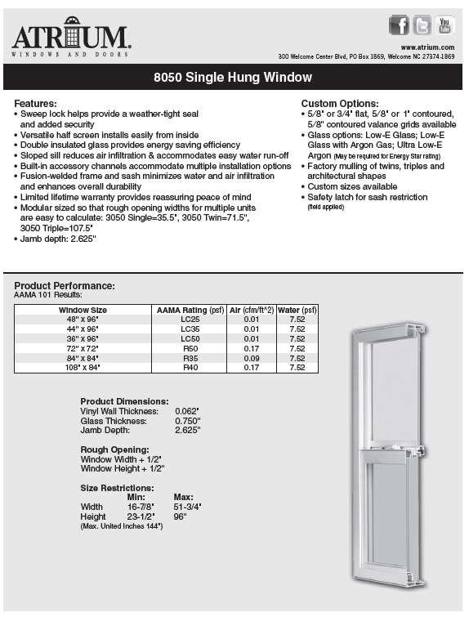
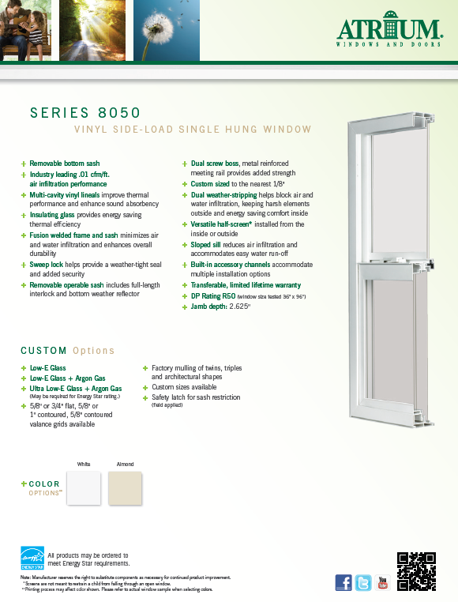
MADE IN USA
warranty
technical data sheet
(slider sheet also available)
feature sheet
(slider sheet also available)
Series 8050

Slide 29
MADE IN USA
Atrium’s Additional Styles
Replacement Window Offering
Sliders & Picture Windows
Each of our Double Hung and Single Hung windows have slider and picture windows
that complement them and complete the family
Casement, Awning & Hopper
Casement and awning windows crank open to the outside. The Casement window opens a full 90 degrees
and casement windows are a popular option over a kitchen sink. Hopper windows crank open
to the inside and are most commonly used in a basement or any room underground.
Bay / Bow & Garden (Projection Windows)
Bay and bow windows create a window seat adding more dimension to a room and providing a larger viewing area. These windows are available in 3-5 lite styles and you can select hung or casement flankers for ventilation.
Garden window depth provides a generous area for plants, picture frames and simply adds space to the room

Slide 30
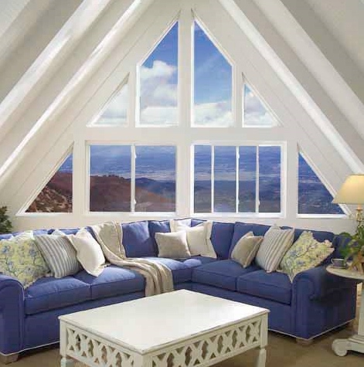
MADE IN USA
Horizontal sliding windows provide for scenic viewing and needed ventilation…
Sliding Windows

Slide 31
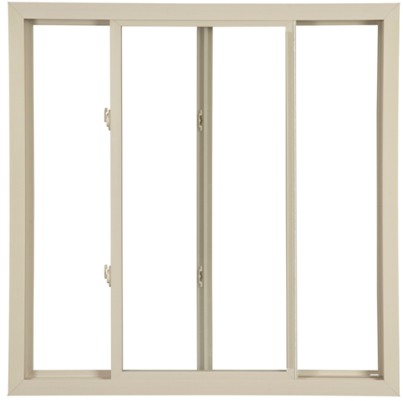
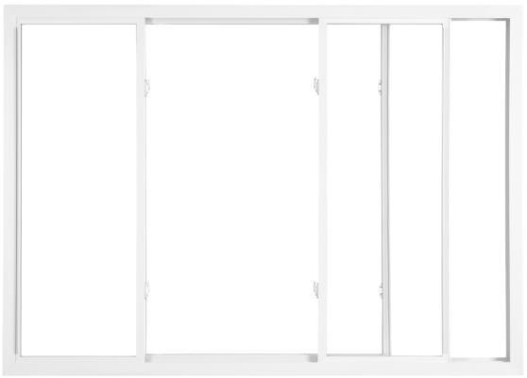
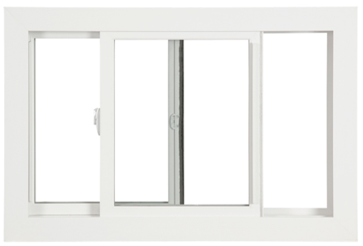
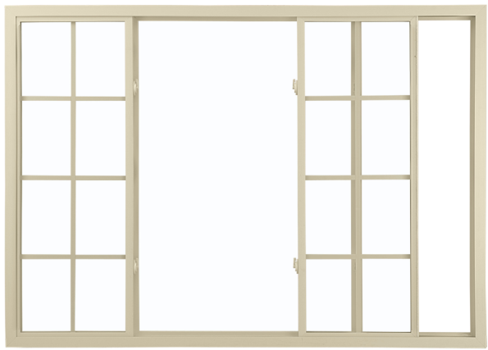
MADE IN USA
Integrated glide channel for easy sash opening and closing
Tandem rollers ride easily along friction-free glide channel
Available in 1/4-1/2-1/4 or 1/3-1/3-1/3 configurations
XX 2-lite configuration
(both sashes slide; Series 8900 & 8700);
XO or OX 2-lite configuration
(one sash slides; Series 8300, 8100 & 8050)
Full screen standard (Series 8900 & 8700);
Half screen standard (Series 8300, 8100 & 8050)
Low-E glass, Low-E glass with argon gas,
Ultra Low-E glass with argon gas,
flat and contoured grids and double strength glass
are among the many options available
Sliding Windows
* see brochure for full details

Slide 32
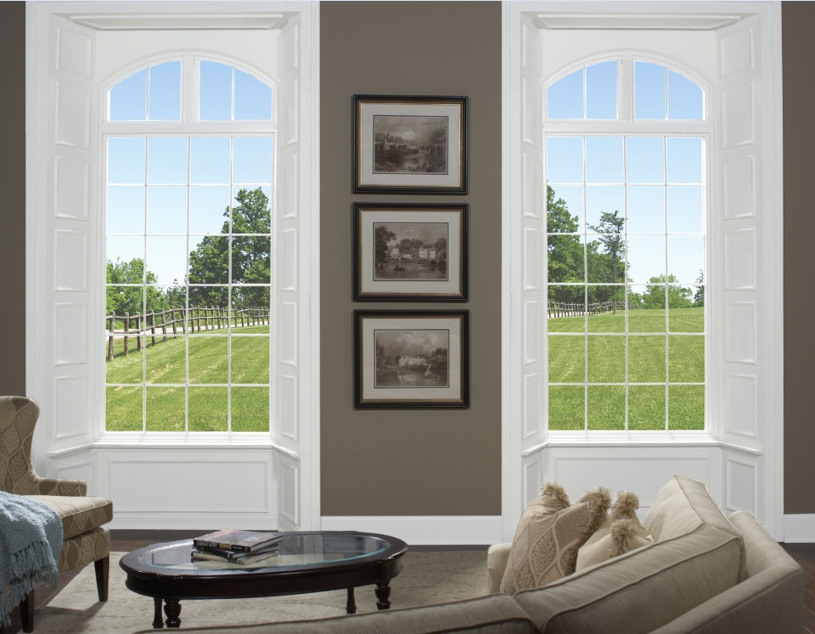
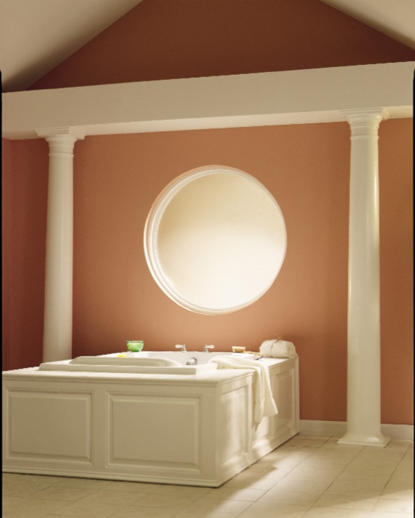

MADE IN USA
Picture windows or architectural shapes add a little more style…
Picture Windows & Shapes

Slide 33

MADE IN USA
Reinforced, multi-cavity construction provides additional thermal performance and structural integrity
Fusion-welded frame adds strength
and boost thermal performance
Transferable limited lifetime warranty with Lifetime glass breakage warranty optional
Double Strength Glass
Low-E glass, Low-E glass with argon gas, Ultra Low-E glass with argon gas,
flat and contoured grids
are among the many options available
Picture Windows & Shapes
* see brochure for full details

Slide 34



MADE IN USA
Casement and Awning windows provide clean,
sleek lines and are found in many upscale homes.
The Hopper window allows the ability
to have an operable window even in the basement…
Casement, Awning & Hopper

Slide 35


MADE IN USA
Low-E Glass with Argon Gas
Beveled exterior frame perimeter
Low profile handle folds in
and provides a popular aesthetic appeal
Narrow profile permits expanded viewing area
Opens 90 degrees for better ventilation
Tandem locks standard over 34” in height
Low-E glass, Ultra Low-E glass with argon gas,
flat and contoured grids
and 2” simulated meeting rail
are among the many options available
Casement Windows
* see brochure for full details

Slide 36

MADE IN USA
Low-E Glass with Argon Gas
Beveled exterior frame perimeter
Low profile handle folds in
and provides a popular aesthetic appeal
Narrow profile permits
expanded viewing area
Low-E glass, Ultra Low-E glass with argon gas, flat and contoured grids
are among the many options available
Awning Windows
* see brochure for full details

Slide 37


MADE IN USA
The all-welded Hopper Window
is available in white with clear glass
and features dual tilt latches.
The window is available in three stock sizes:
32” x 15 ½”
32” x 19 ½”
32” x 23 1/2
Hopper Windows
* see brochure for full details

Slide 38



MADE IN USA
Bay & Bow windows whether you’re trying
to create another seat or add dimension
to the room and the garden window features
a 17 ½” depth for plants or added room space…
Bay / Bow & Garden Windows

Slide 39


MADE IN USA
Bay & Bow windows are available
in 3, 4 and 5 –lite styles or can be
ordered with double hung or casement windows to flank a middle picture window. Flankers open to provide ventilation.
These windows arrive completely assembled and are simple
to install and customize.
The are available in white or almond, Bronze exterior laminate (Series 8700)
and interior wood laminate
and 8 painted colors (Series 8900)
Bay & Bow Windows
* see brochure for full details

Slide 40



MADE IN USA
A 17 ½” garden window depth
provides a generous area for plants,
picture frames or added room space.
The roof glass panel features safety
laminated glass for added protection.
There is a hand-sanded 1 ¼” birch veneer surround and 7/8” insulated glass for maximum thermal performance. Side casement vents provide easy ventilation.
A multi-point locking system and corrosion-resistant hardware enhances window security
Available in white or almond; 5/8” flat grid,
oak hardwood surround and sill muffler complete the available options
Garden Windows
* see brochure for full details

