Slide 1




MADE IN USA
LEAD GENERATION

Slide 2





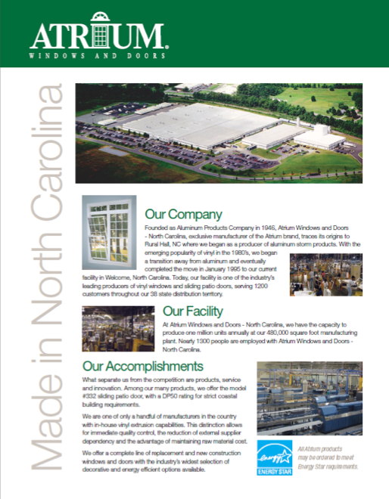

MADE IN USA
LEAD GENERATION
Powerful tools designed to help you generate new business.
View them all at the Lead Generation menu on the marketing media site:
Lead Generation Tools
On-line window sales guide
Made in the USA Flyer
Door Hangers
Job Site Signs
…and, much more!

