Slide 1




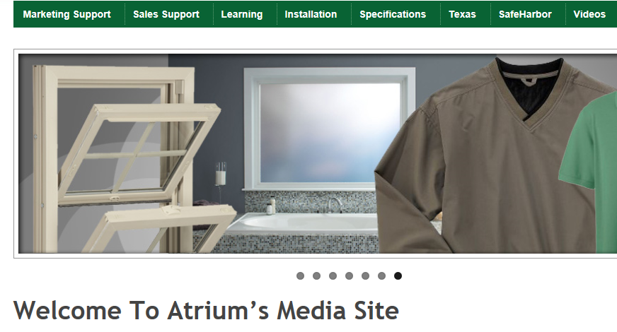

Marketing Tools Web Site
MADE IN USA
seven easy access folders
For immediate, open and online
access to the marketing materials
needed everyday to sell
Atrium Windows and Doors
branded products, we offer the
Atrium Marketing Tools media site.
This website and the powerful tools
located here are designed for the
Atrium associate and the Atrium customerassociate and the Atrium customer. From brochures and feature sheets to price lists, warranties and in-home sales presentations,
this site is designed for the salesperson and building or remodeling professional.
And, our dynamic learning center is located on the site!
Please take the needed time to surf thoroughly through the menu and folders.
Each marketing asset has been developed to fill some void in the selling process somewhere in the supply chain. Not every item will be needed everyday,
but you will be surprised at the depth of the Atrium marketing program
and the easy access to what you may need someday!

Slide 2
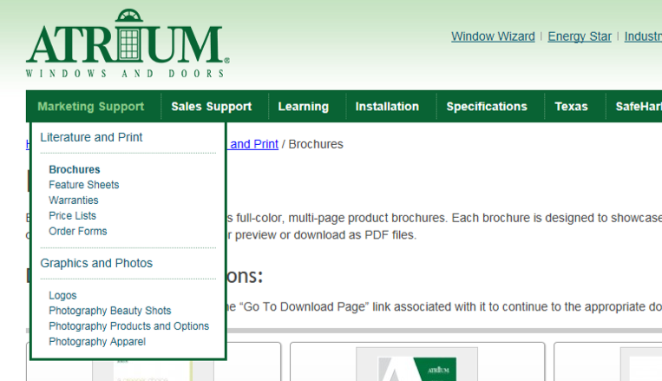
Marketing Tools Web Site
MADE IN USA
Marketing Support
Our most commonly
accessed collateral materials;
photography of products,
features and options
in-depth information and photography
of entire product line
Product Brochures
for creating presentations
and showing available styles
Photography
1- or 2-page summaries of each product’s
features, benefits and available options;
comparison sheets, flyers and more!
Feature Sheets

Slide 3
Marketing Tools Web Site
MADE IN USA
Marketing Support
Our most commonly
accessed collateral materials;
photography of products,
features and options
PDFs of each Dealer Price List; as well as
Excel versions for customizing net or selling prices
Price Lists
PDFs of actual warranties listed
by series and category
Warranties

Slide 4
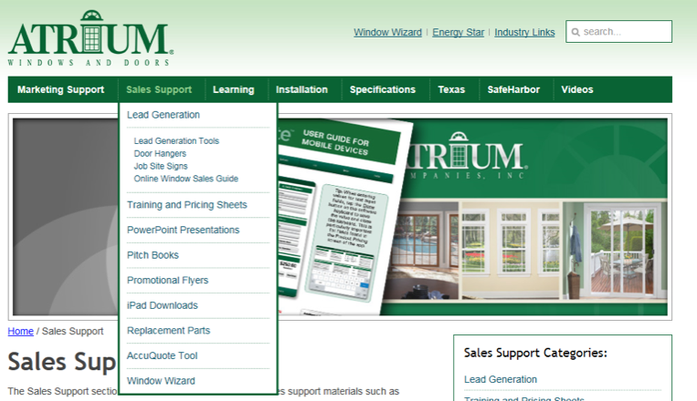
Marketing Tools Web Site
MADE IN USA
Sales Support
Tools designed
for the replacement window
sales professional
and loyal Atrium customer
easy download of in-home quoting program
AccuQuote Tool
in-home quoting program
customizable, in-home pitch books that can include
licenses, before/after photography, references, etc.
Pitch Books
a complete offering of miscellaneous
sales flyers and program attributes
Promotional Flyers

Slide 5
Marketing Tools Web Site
MADE IN USA
Sales Support
Tools designed
for the replacement window
sales professional
and loyal Atrium customer
pdf and excel sheets designed to help you sell
on the go and in the home
Training and Pricing
Sheets
pitch books and in-home quoting programs
designed for the iPad user
iPad Downloads
learn more about the industry’s
first and still its best online quote and order system
Window Wizard

Slide 6
Marketing Tools Web Site
MADE IN USA
Sales Support
a head start for getting the home improvement specialist canvassing
and marketing support
Lead Generation
ready-to-go and available in quantities
of 200 per dealer – at no charge!
Door Hangers
Marketing 101!
a Job Site Sign should be in the yard
of every project’s home!
Job Site Signs
the in-home sales guide offers a summary
of the a’la carte materials available
for professional, in-home presentations
Online Window
Sales Guide

Slide 7
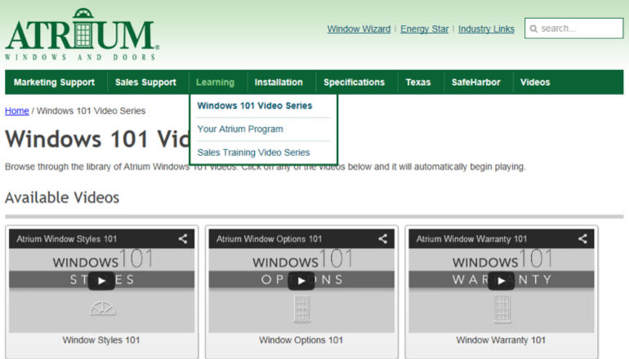
Marketing Tools Web Site
MADE IN USA
Learning
Dynamic learning center
that provides training and videos
for Atrium associates!
videos that explain the basics of pertinent
information about Atrium products and FAQ’s
Window 101 Videos
a selection of videos that demonstrate how
to sale products in home
Your Atrium Program
a variety of training powerpoints that focus
on all collateral available to Atrium associates
and product information
Sales Training Videos

Slide 8
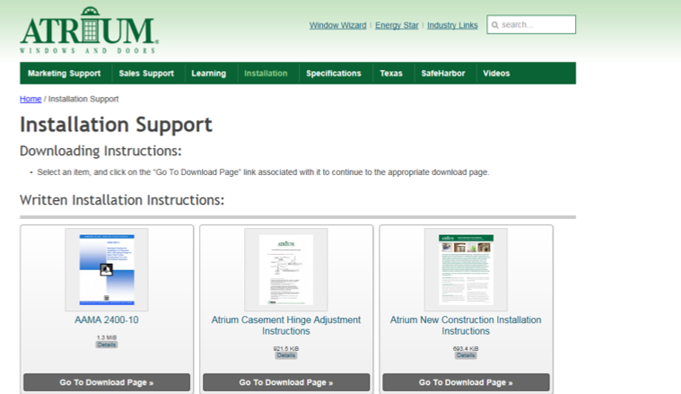
Marketing Tools Web Site
MADE IN USA
Installation Support
Written and video
installation instructions
in up to 5 languages
assistance for how to measure,
how to install, how to flash, etc.
Installation Support

Slide 9
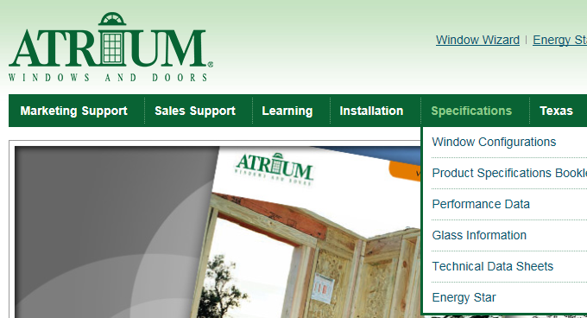
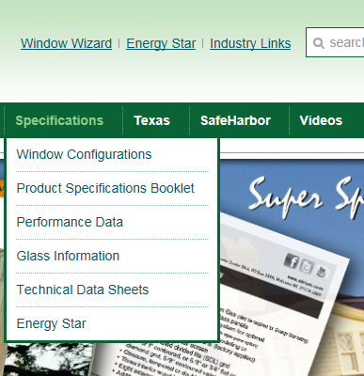
Marketing Tools Web Site
MADE IN USA
Specifications
Technical and various
data-specific materials designed
primarily for the pro
highlights the atypical styles
Atrium Windows and Doors offers
Window Configurations
available for thermal, structural, egress
and miscellaneous technical information
– easy to reference!
Performance Data
offers a single page reference for each series
with a slant toward the professional
Technical Data Sheets

Slide 10
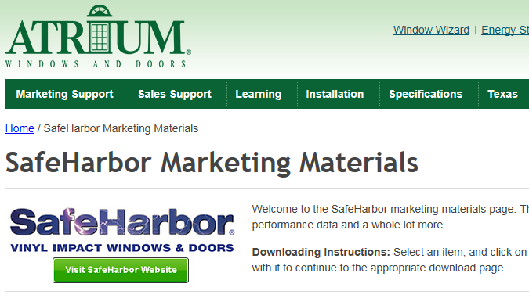
Marketing Tools Web Site
MADE IN USA
SafeHarbor
a dedicated area for the most
complete hurricane debris brand
of vinyl windows and patio doors
Take the time to check out all the support…
literature, feature sheets, price lists, warranties…
it’s ALL here in one folder!
Marketing Materials

Slide 11
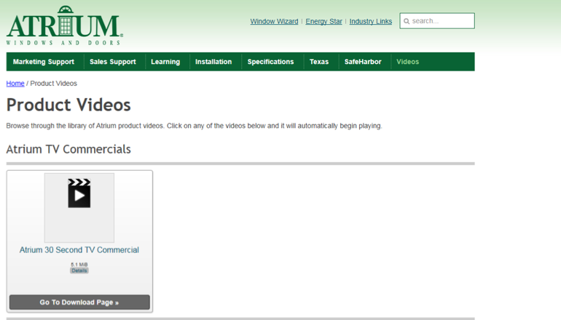
Marketing Tools Web Site
MADE IN USA
Videos
numerous videos are available
for quick, dynamic
presentations and overviews!
Low-E Argon Glass, Condensation 101,
product promotions, 2-minute plant tours…
they’re all here!
Product Videos

