Slide 1
MADE IN USA
MARKETING OFFERINGS

Slide 2
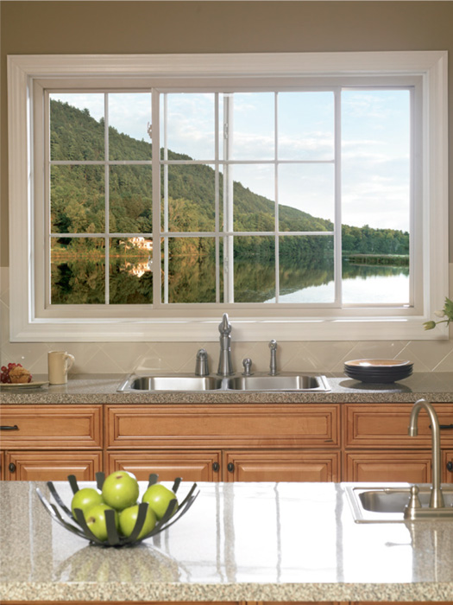
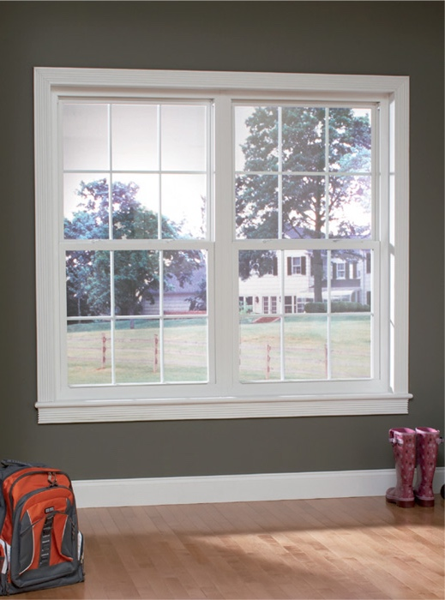
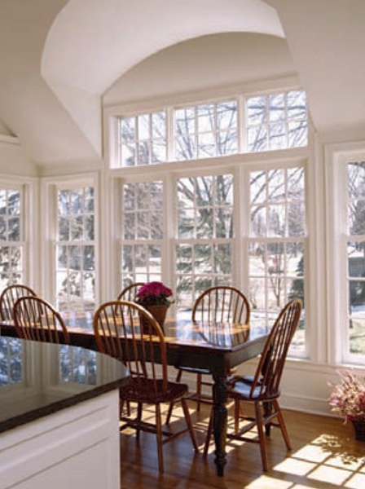
MADE IN USA
PRODUCT BROCHURES
Brochures are available for each replacement window product line from the Series 8900 to the Series 8100, with an all inclusive brochure that covers all replacement windows. For builders, we have a new construction brochure that covers all products and a patio door brochure that showcases our three sliding patio doors. All of these brochures are available for download from the Atrium media site or can be ordered via the literature request form:
Brochures
Replacement
New Construction
Patio Door

Slide 3
MADE IN USA
about Atrium & Marketing Program Brochures
Made in North Carolina
This sheet references Atrium’s start to finish in North Carolina
(available in PDF format on media site only)
Atrium Associate Product Training
Pocket sized for easy accessibility with at-a-glance information on our entire product line

Slide 4
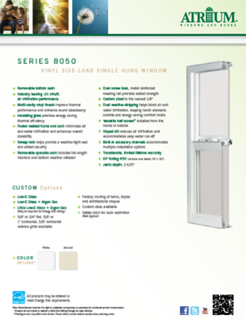
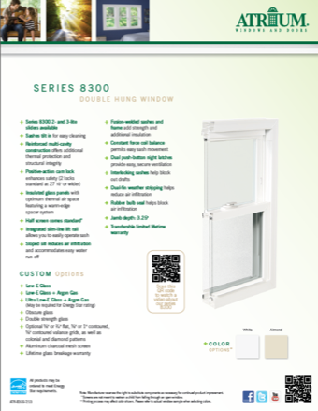
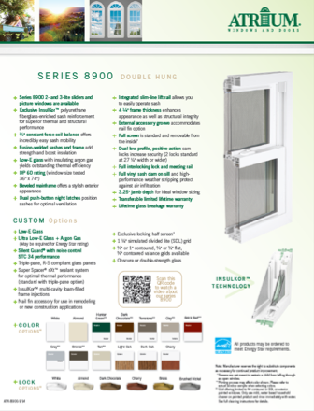
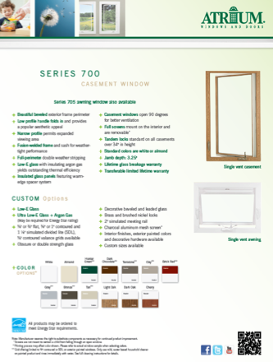
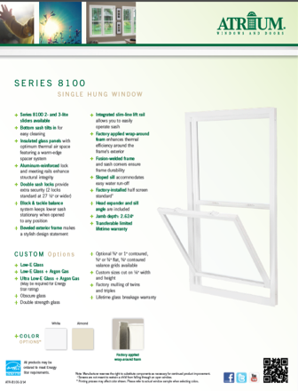
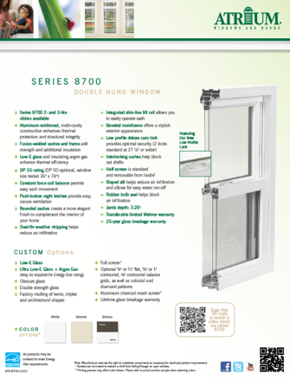
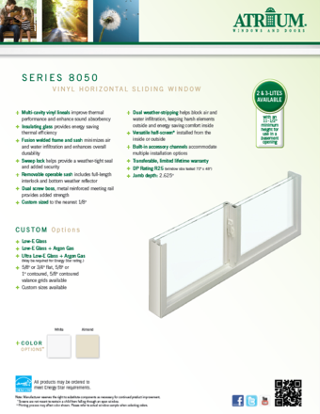
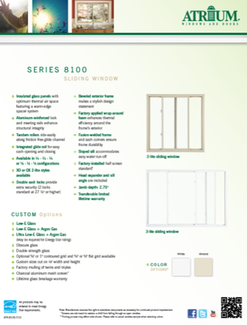
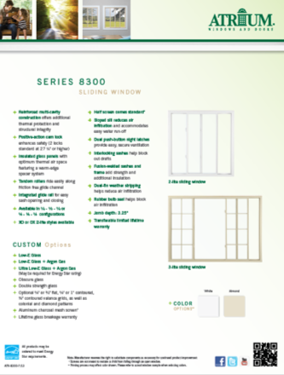
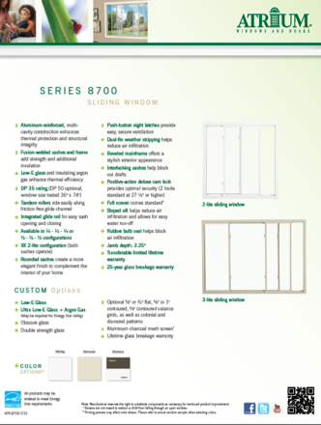
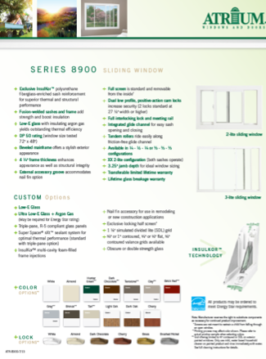
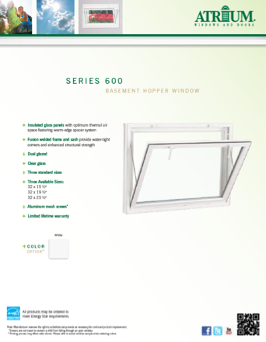
MADE IN USA
PRODUCT FEATURE SHEETS
1 or 2 page summaries of each product’s features and options available for download in PDF format (English and Spanish versions) from the Atrium media site:
Replacement

Slide 5
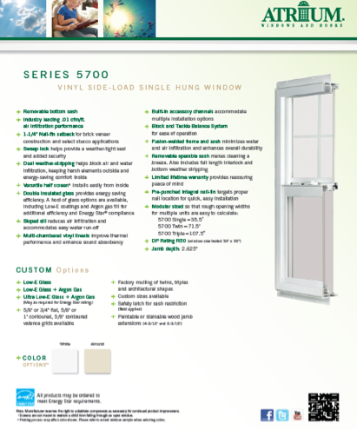
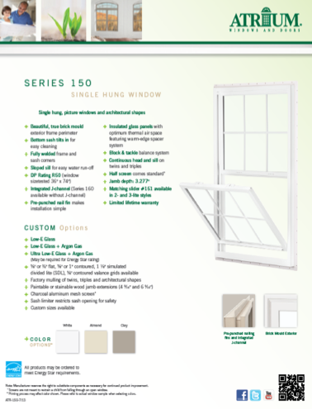
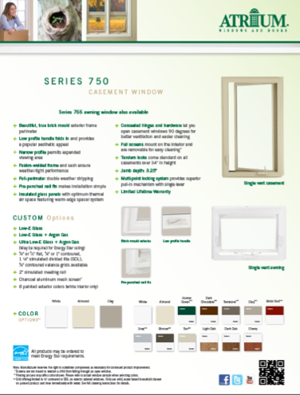
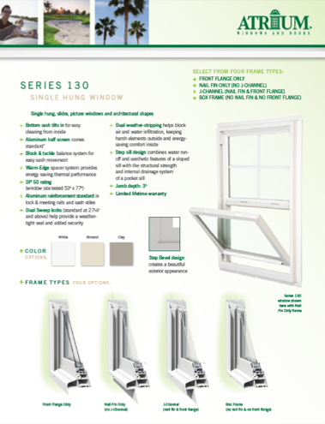
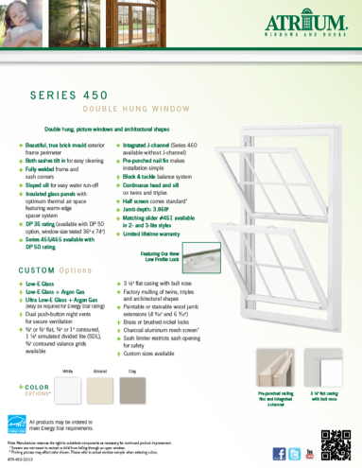
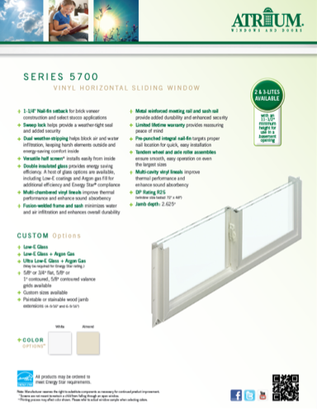
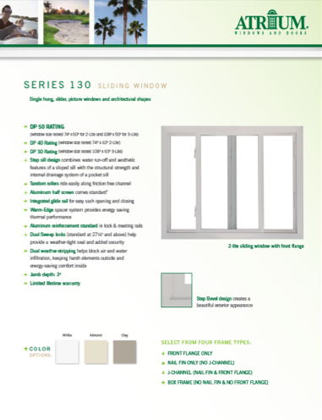
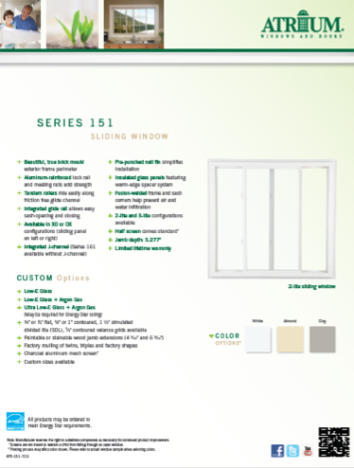
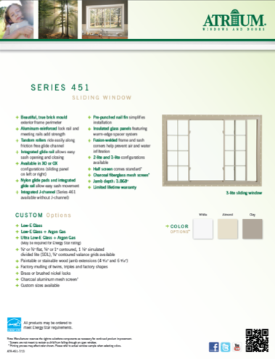
MADE IN USA
PRODUCT FEATURE SHEETS
1 or 2 page summaries of each product’s features and options available for download in PDF format (English and Spanish versions) from the Atrium media site:
New Construction

Slide 6
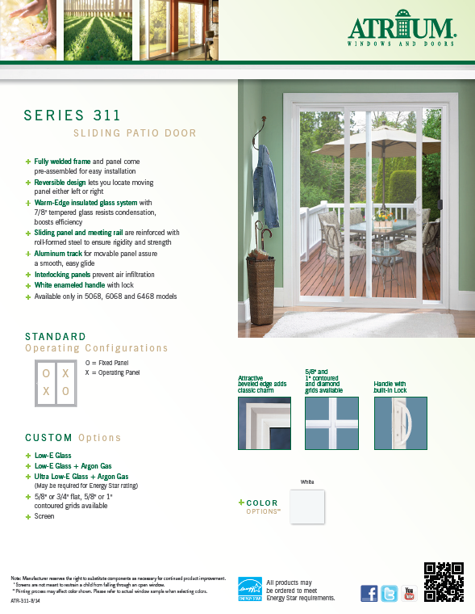
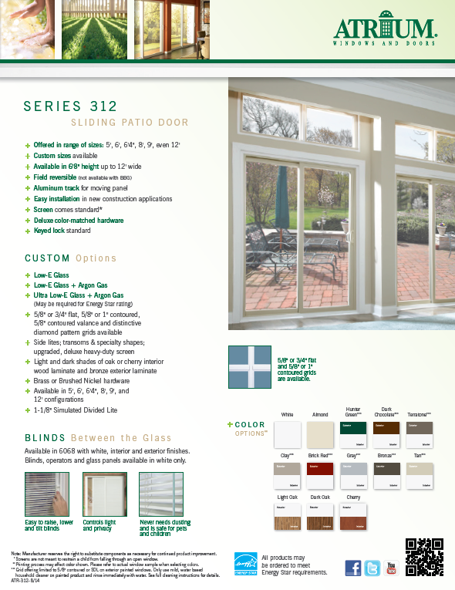
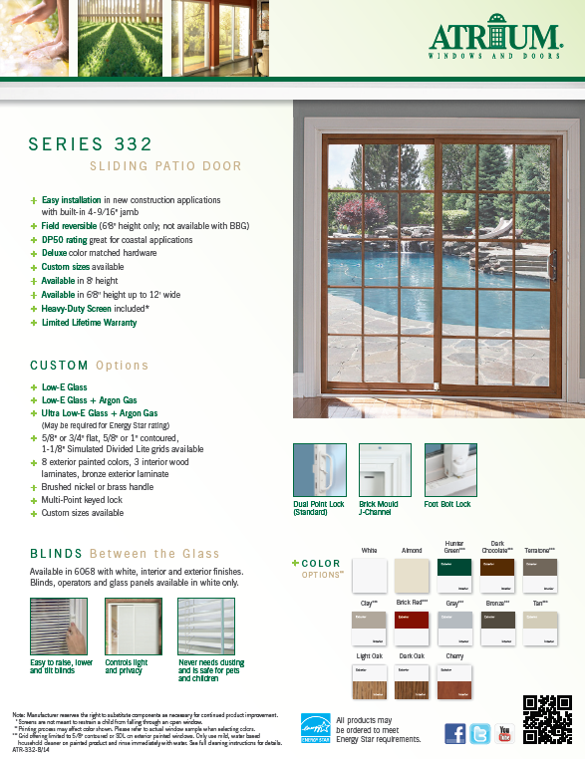
MADE IN USA
PRODUCT FEATURE SHEETS
1 or 2 page summaries of each product’s features and options available for download in PDF format (English and Spanish versions) from the Atrium media site:
Patio Doors

Slide 7
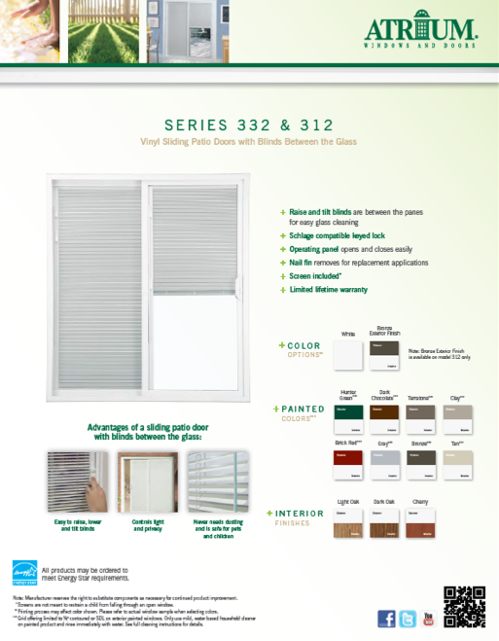
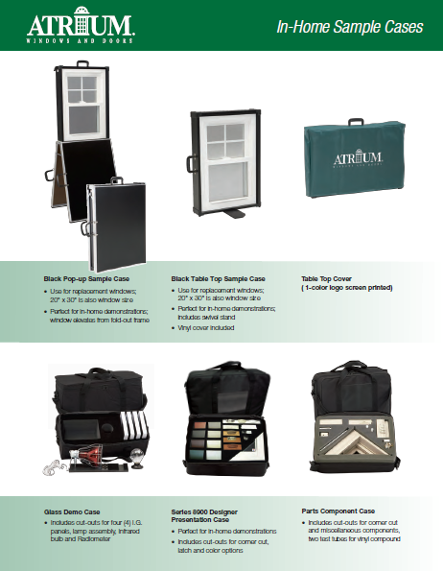
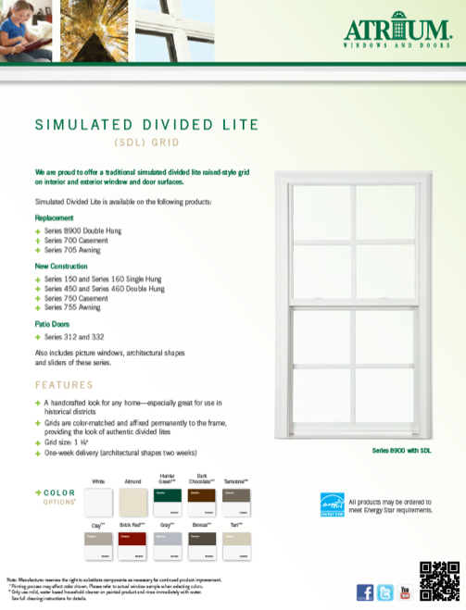
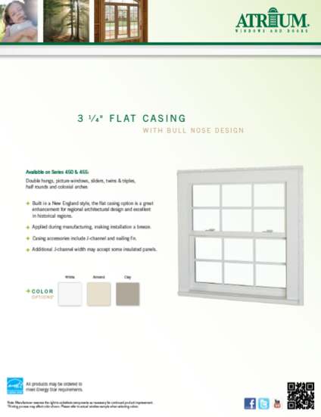
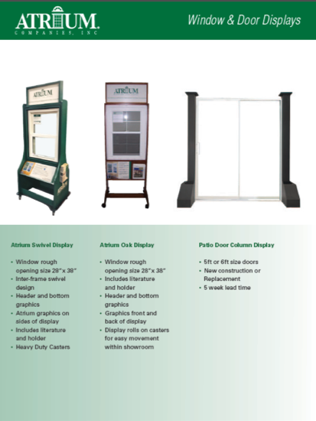
MADE IN USA
PRODUCT FEATURE SHEETS
1 or 2 page summaries of each product’s features and options available for download in PDF format from the Atrium media site:
Options & Samples

Slide 8
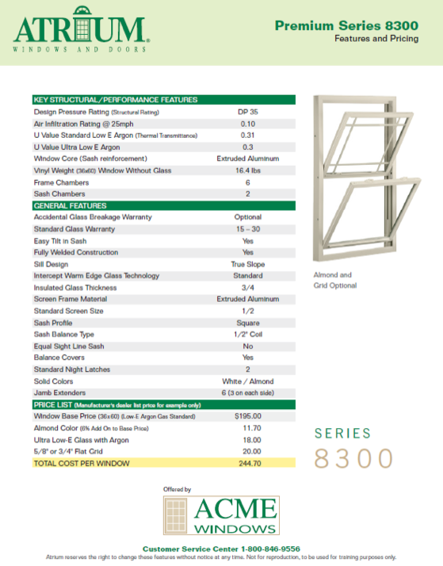
MADE IN USA
ATRIUM & MARKETING PROGRAM FEATURE SHEETS
1 page summaries of marketing programs to help you sell Atrium are available for download in PDF format from the Atrium media site:
Marketing Programs

Slide 9
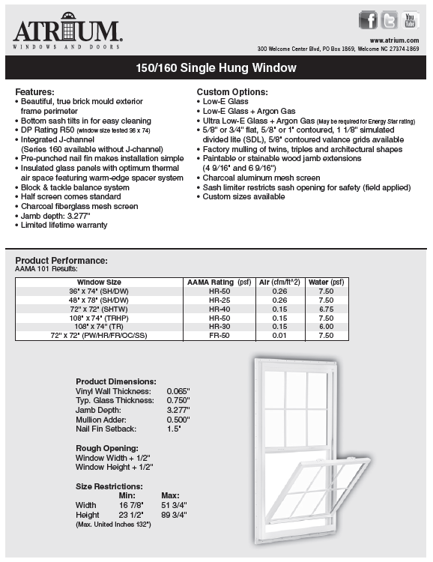
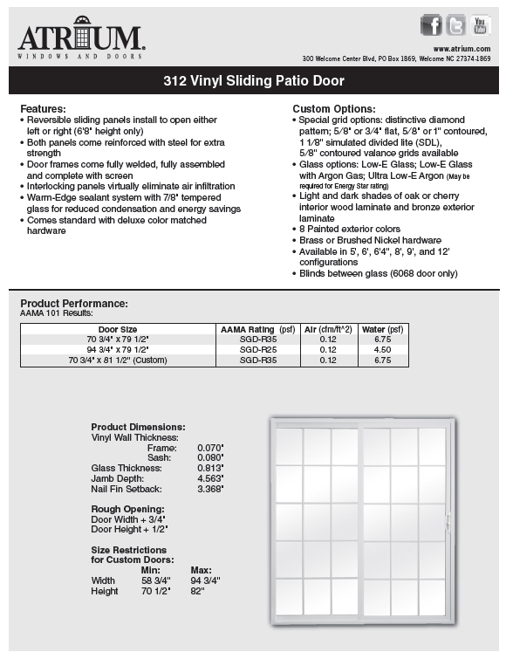
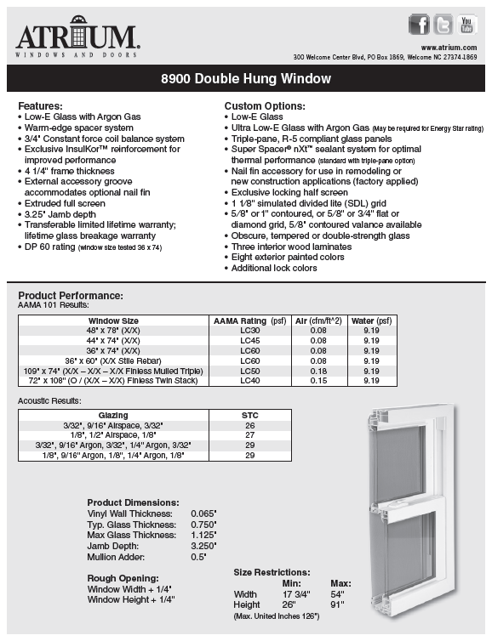
MADE IN USA
PRODUCT SPECIFICATIONS & TECHNICAL DATA SHEETS
Two page sheets including necessary information for builders and architects for replacement and new construction windows and sliding patio doors:
Technical Data Sheets

Slide 10
MADE IN USA
INDUSTRY LEADING WARRANTY
Atrium Windows & Doors have industry leading warranty coverage on all replacement and new construction products. Warranties are available for download from the Atrium media site or can be ordered via your literature request form:
Warranty
Limited Lifetime for New Construction
Transferable, Limited Lifetime for all Replacement series
LIFETIME GLASS BREAKAGE STANDARD (on 8900 Series)
Warranty ID Label on all products for easy product identification
DO NOT REMOVE
MAKE DATE: 2/1/2009 WARRANTY: 02589514
SALES ORDER: 00735962

Slide 11
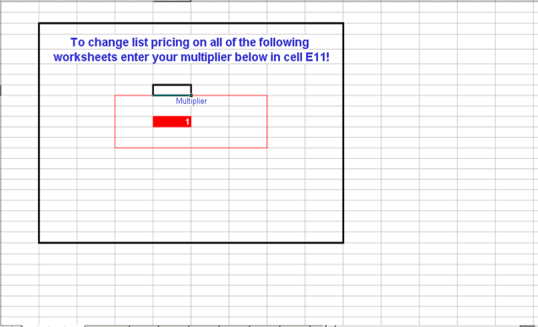
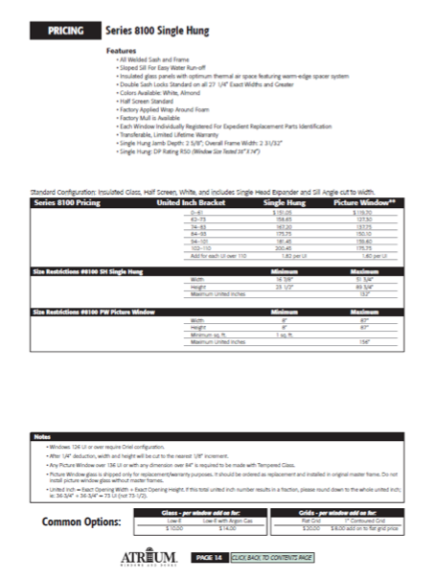
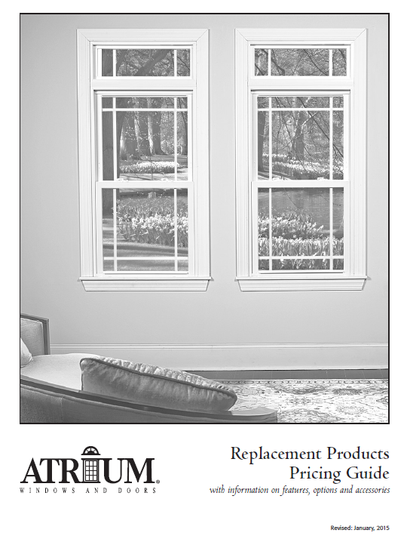
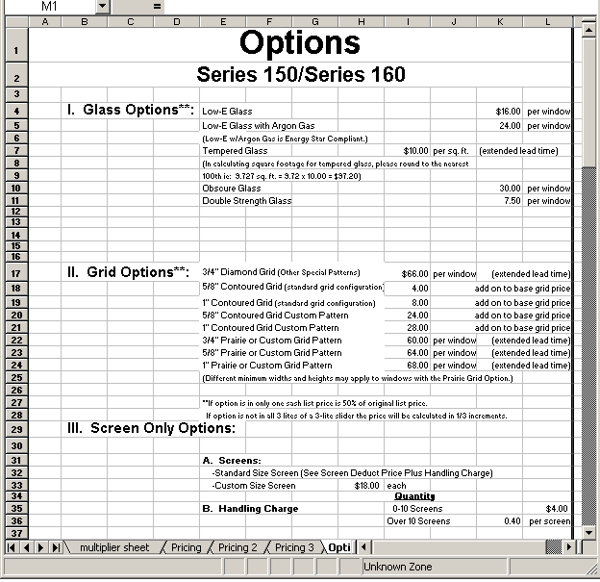
MADE IN USA
PRICE LISTS
New Construction, Replacement and Sliding Patio Door price lists are available on the media site in Excel and PDF format. The Excel document allows you to create your own net price list or adjust for retail in-the-home price quoting for your customers:
Price Lists

