Slide 1

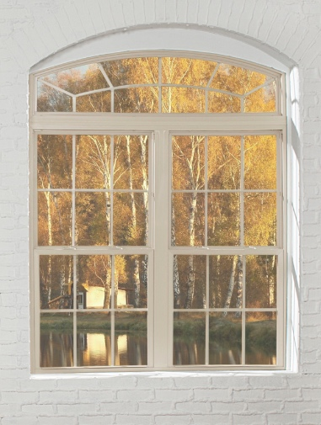
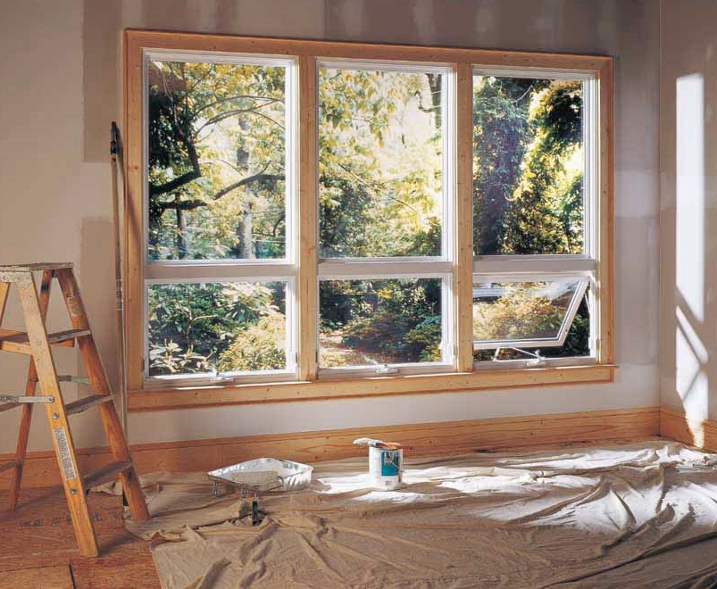

MADE IN USA
ATRIUM’S NEW CONSTRUCTION WINDOW OFFERING
A GOOD INVESTMENT

Slide 2
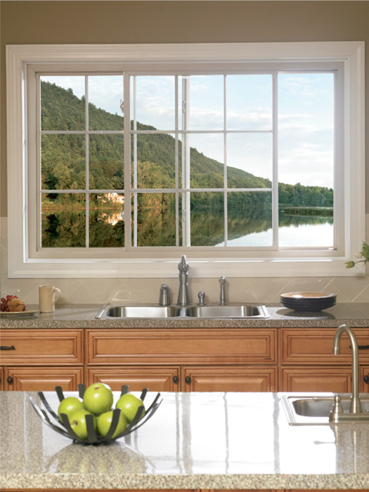
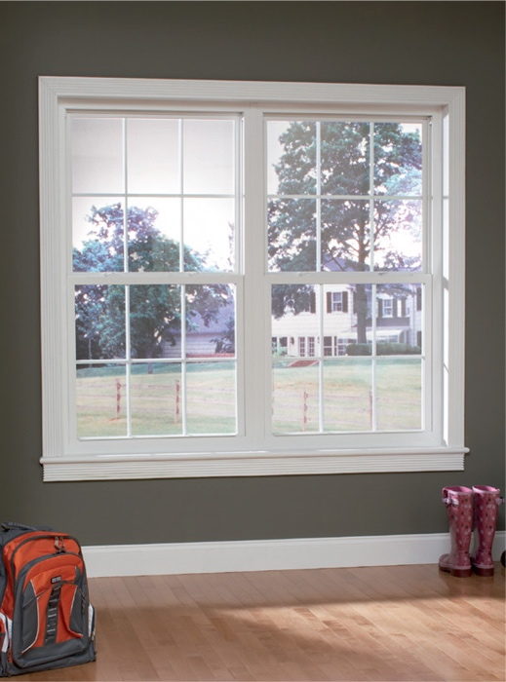
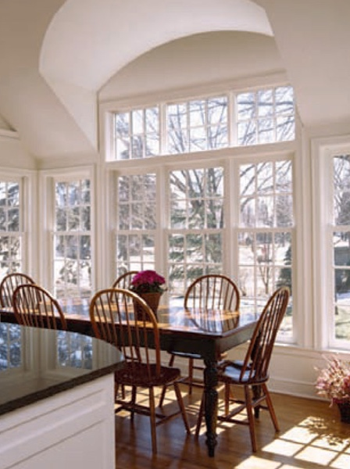
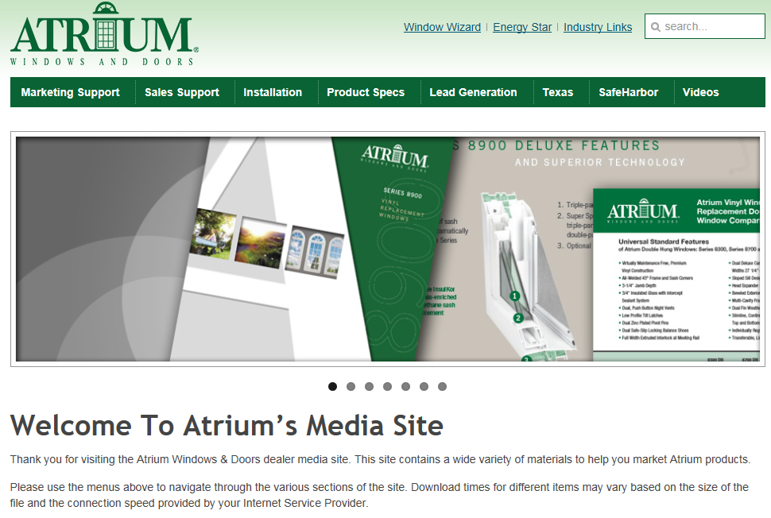

MADE IN USA
For easy to use marketing collateral with Series specific information
see our media site at
windows.com
In the following slides
we provide you with links
to specific assets
for your convenience.
Atrium Media Website

Slide 3
MADE IN USA
Atrium’s New Construction
Window Offering
Series 450 Double Hung (460 without J-Channel)
Our Double Hung window features true brick mould exterior frame, integrated j-channel and nail fin,
Limited Lifetime Warranty and has optional 3 ¼” flat casing with bull nose design
and is available in white, almond , clay and eight exterior painted colors
Series 150 Single Hung (160 without J-Channel)
Our top-of-the-line single hung features true brick mould exterior frame, integrated j-channel and nail fin,
Limited Lifetime Warranty and has optional window opening control device and paintable
and stainable wood jamb extensions

Slide 4
MADE IN USA
Atrium’s New Construction
Window Offering
Series 5700 Side-Load Single Hung
Our Series 5700 single hung features a removable bottom sash and industry leading .01 cfm/ft
air infiltration performance with optional Ultra Low-E Glass with Argon Gas and flat or contoured grid
Series 130 Single Hung (available with 4 frame types)
Our Series 130 features a step bevel design and dual sweep locks
and has optional Non-reflective Low-E Glass with Argon Gas, Commodity sizing and window opening control device

Slide 5
MADE IN USA
The BEST of our product offerings…
Series 450

Slide 6
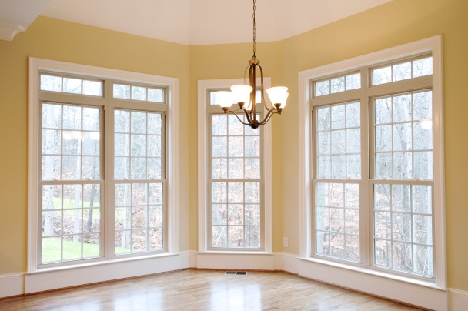
MADE IN USA
Brick mould exterior frame perimeter
Integrated J-channel and nail fin
DP 35 rating (available with DP 50 option; window size tested 36” x 74”)
Block & Tackle Balance System
¾” Insulated Glass
Half Screen
Limited Lifetime Warranty
3 ¼” flat casing with bull nose design,
almond & clay vinyl colors, 8 painted exterior colors, ¾” or 5/8” flat or 5/8” or 1” contoured grid and 1 1/8” Simulated Divided Lite and multiple Low-E Glass optional
Series 450
* see brochure for full details

Slide 7
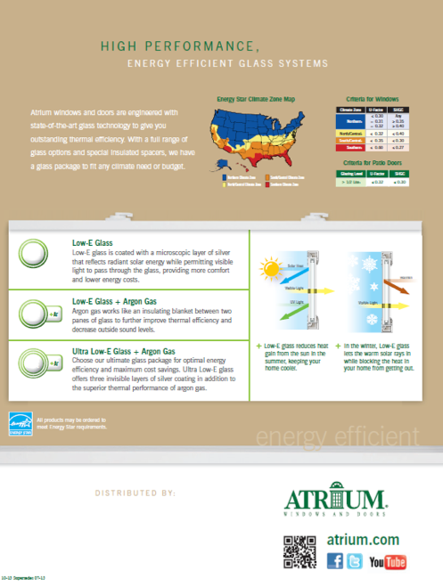
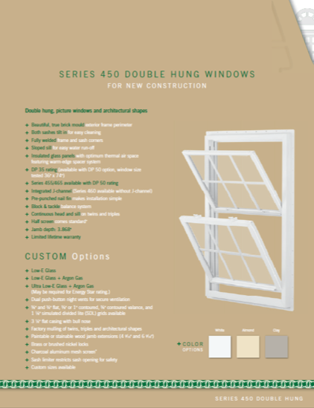

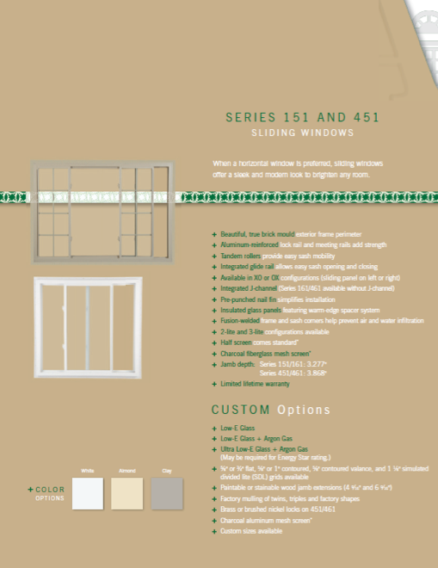
MADE IN USA
brochure
Series 450

Slide 8
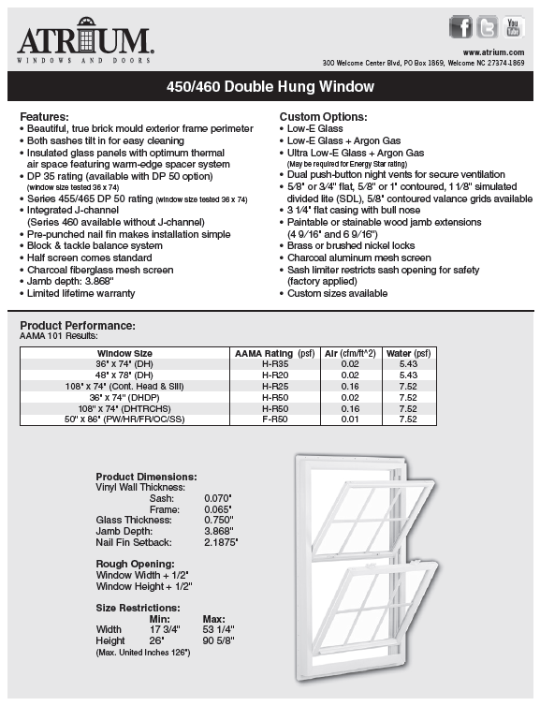
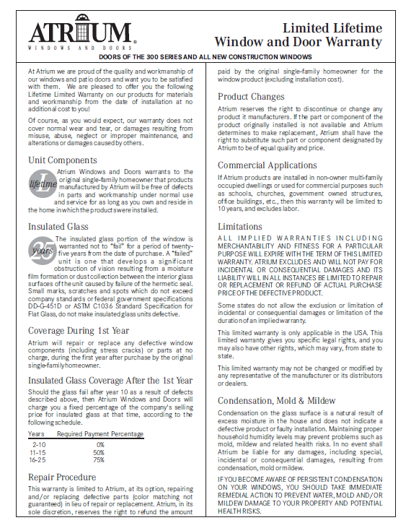
MADE IN USA
warranty
technical data sheet
(slider sheet also available)
feature sheet
(slider sheet also available)
Series 450

Slide 9
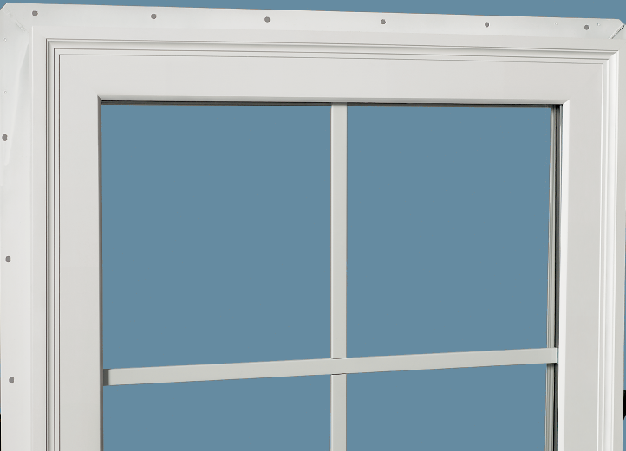
MADE IN USA
Top-of-the-Line Single Hung…
Series 150

Slide 10
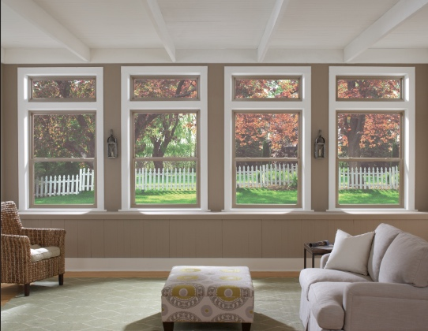
MADE IN USA
Brick mould exterior frame perimeter
Integrated J-channel and nail fin
DP 50 rating
(window size tested 37” x 74”)
Block & Tackle Balance System
¾” Insulated Glass
Half Screen
Limited Lifetime Warranty
Almond & Clay, eight painted exterior colors, ¾” or 5/8” flat or 5/8” or 1” contoured grid, multiple Low-E glass
and window opening control device
Series 150
* see brochure for full details

Slide 11

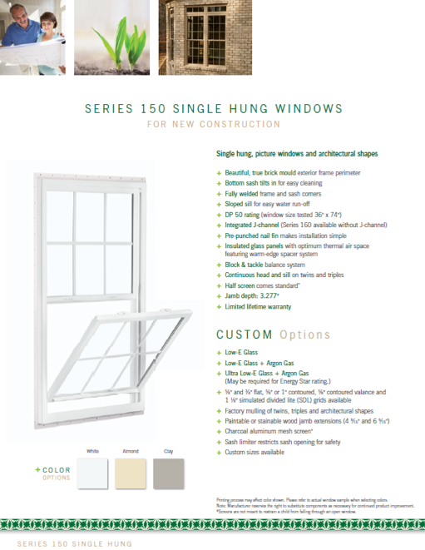
MADE IN USA
brochure
Series 150

Slide 12
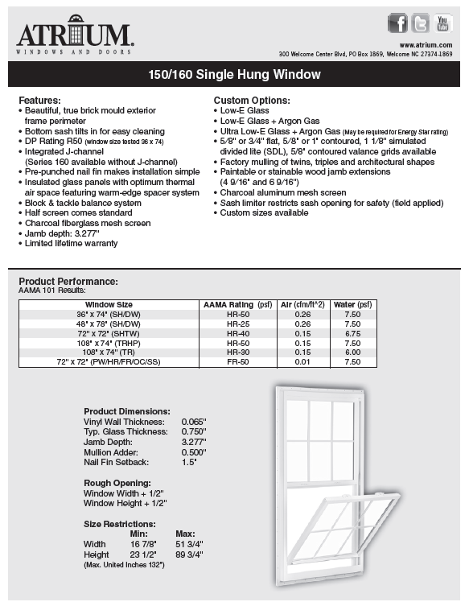
MADE IN USA
warranty
technical data sheet
(slider sheet also available)
feature sheet
(slider sheet also available)
Series 150

Slide 13
MADE IN USA
Side-load single hung
Series 5700

Slide 14
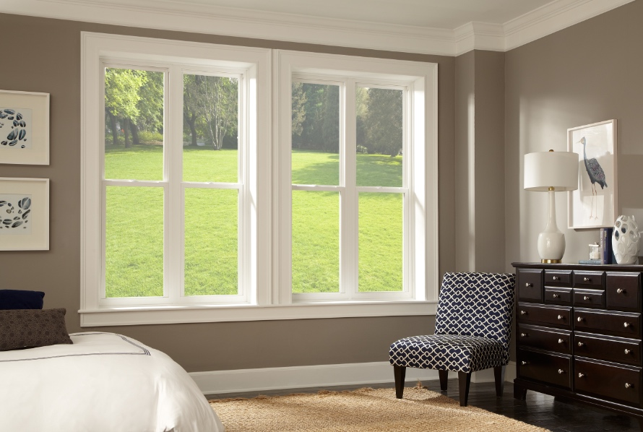
MADE IN USA
Side-load, removable bottom sash
Industry leading .01 cfm/ft
air infiltration performance
DP 50 rating
(window size tested 36” x 96”)
Block & Tackle Balance System
¾” Insulated Glass
Half Screen
Limited Lifetime Warranty
Almond, ¾” or 5/8” flat or 5/8” or 1”
contoured grid and window opening control device
Series 5700
* see brochure for full details

Slide 15
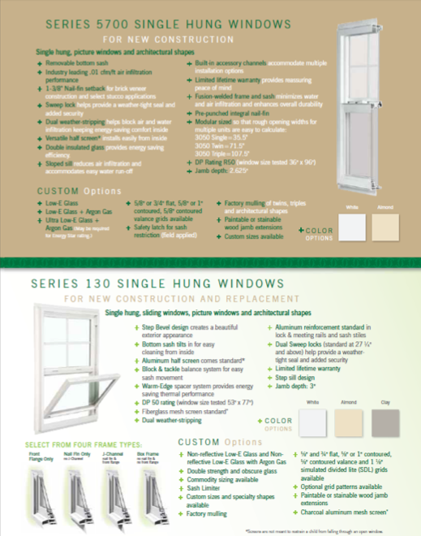
MADE IN USA
brochure
Series 5700

Slide 16
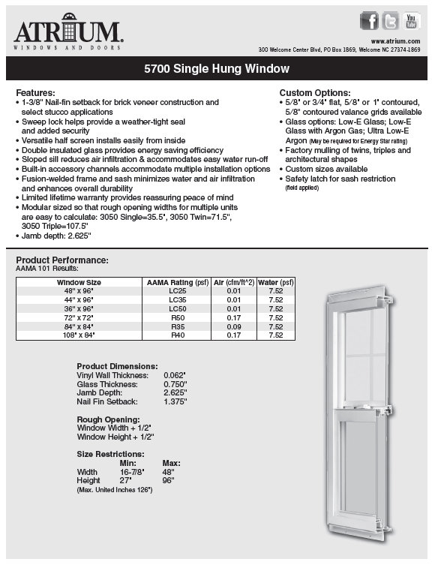
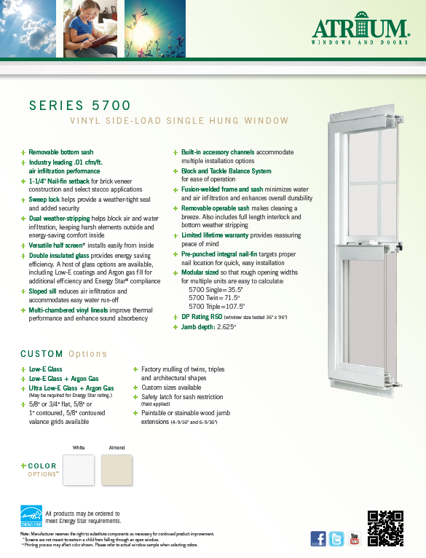
MADE IN USA
warranty
technical data sheet
(slider sheet also available)
feature sheet
(slider sheet also available)
Series 5700

Slide 17
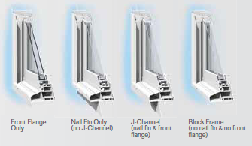
MADE IN USA
front flange window
with three additional frame options…
Series 130

Slide 18
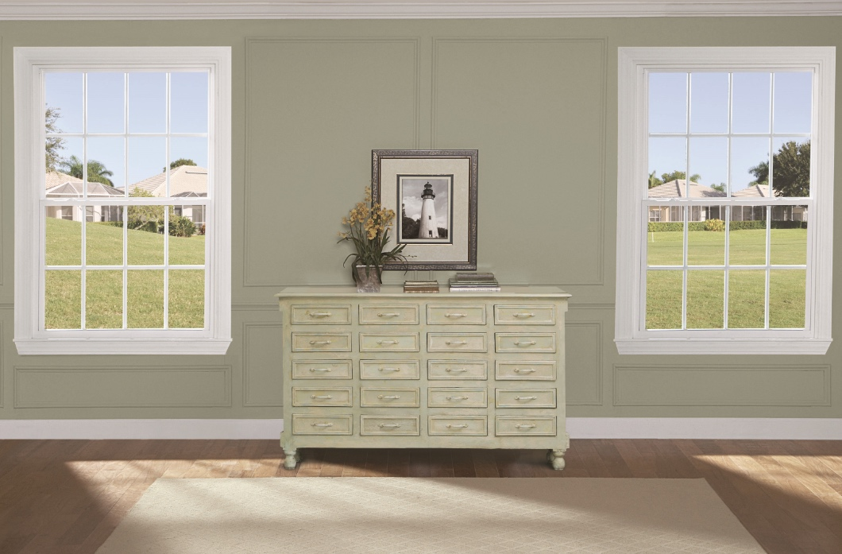
MADE IN USA
Step Bevel design
Bottom sash tilts in
DP 50 rating
(window size tested 53” x 77”)
Block & Tackle Balance System
¾” Insulated Glass
Half Screen
Limited Lifetime Warranty
Almond, ¾” or 5/8” flat or 5/8” or 1”
contoured grid, almond & clay vinyl colors, 8 painted exterior colors and window opening control device optional
Series 130
* see brochure for full details

Slide 19
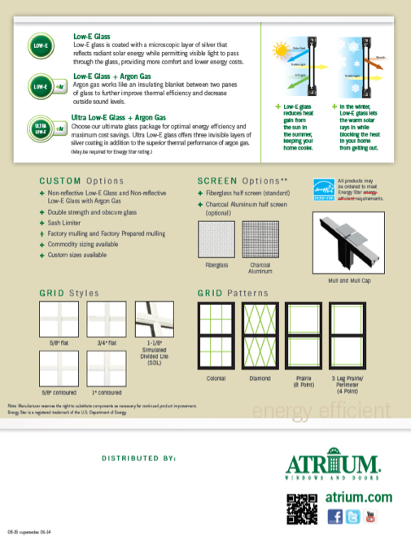
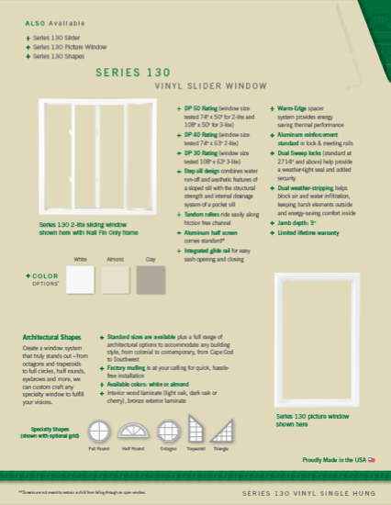
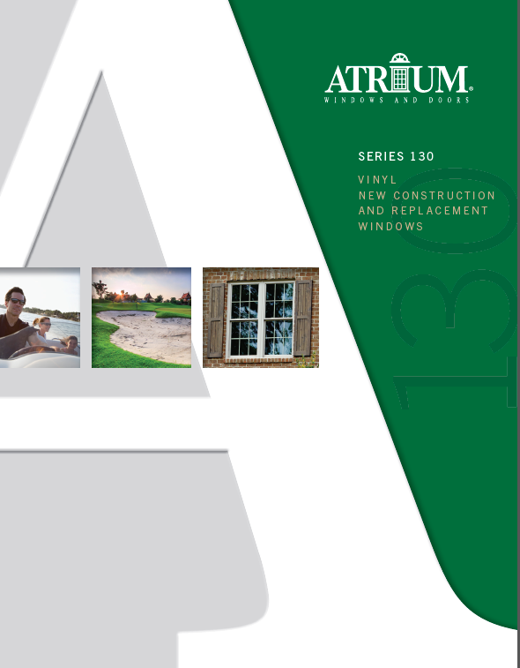
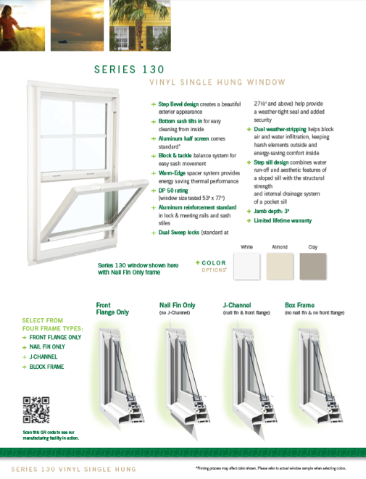
MADE IN USA
brochure
Series 130

Slide 20
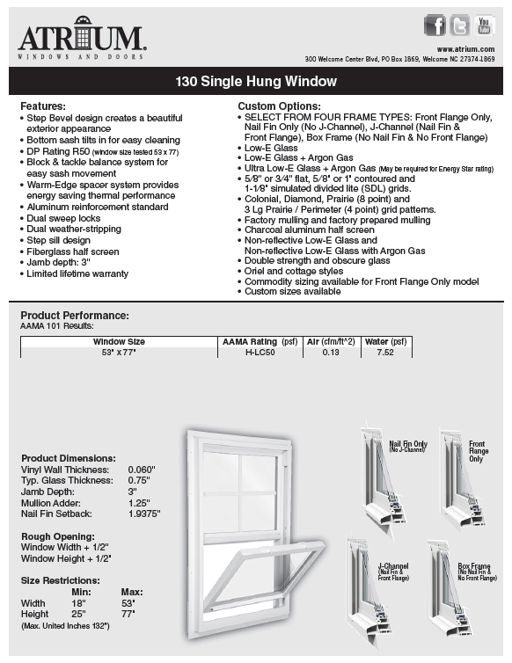
MADE IN USA
warranty
technical data sheet
(slider sheet also available)
feature sheet
(slider sheet also available)
Series 130

Slide 21
MADE IN USA
Atrium’s New Construction
Window Offering
Sliders, Picture Windows & Architectural Shapes
Each of our Double Hung and Single Hung windows have slider and picture windows that complement
them and complete the family. And, an abundance of architectural shapes are available to fit any design
Casement & Awning Windows
Casement and awning windows crank open to the outside.
Casement windows open a full 90 degrees and are a popular option over a kitchen sink.
Awning Windows open 30 degrees and are commonly selected due to their opening ease

Slide 22
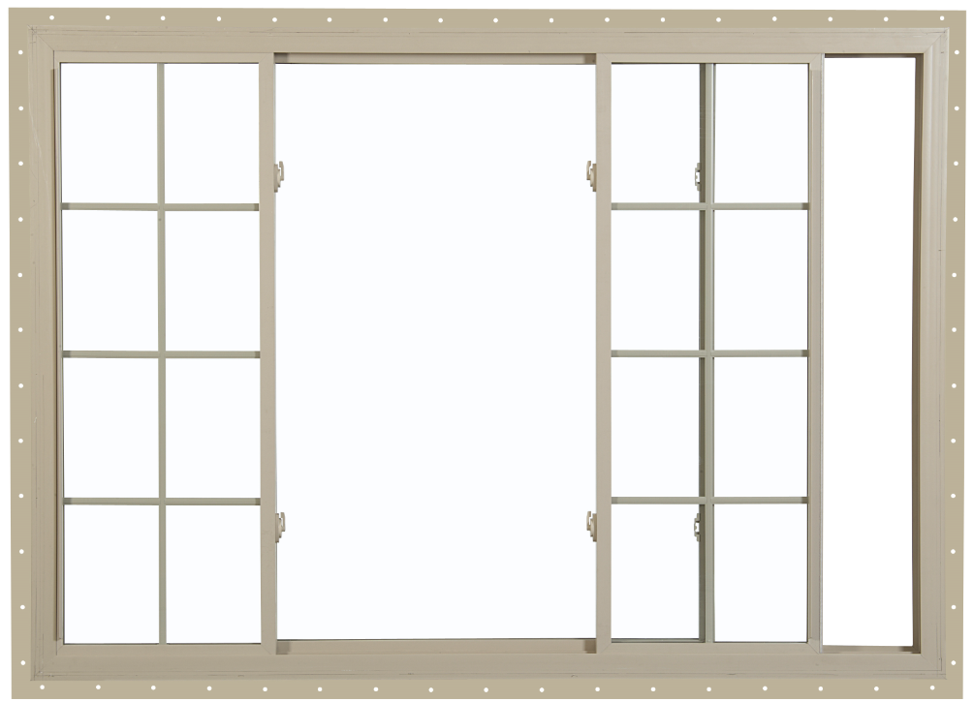
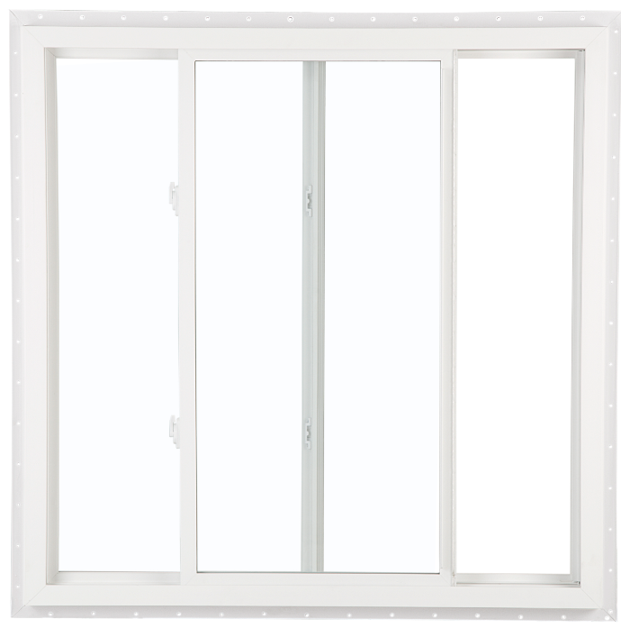
MADE IN USA
when you are looking
for a horizontal window
try one of our sliders…
Sliding Windows

Slide 23
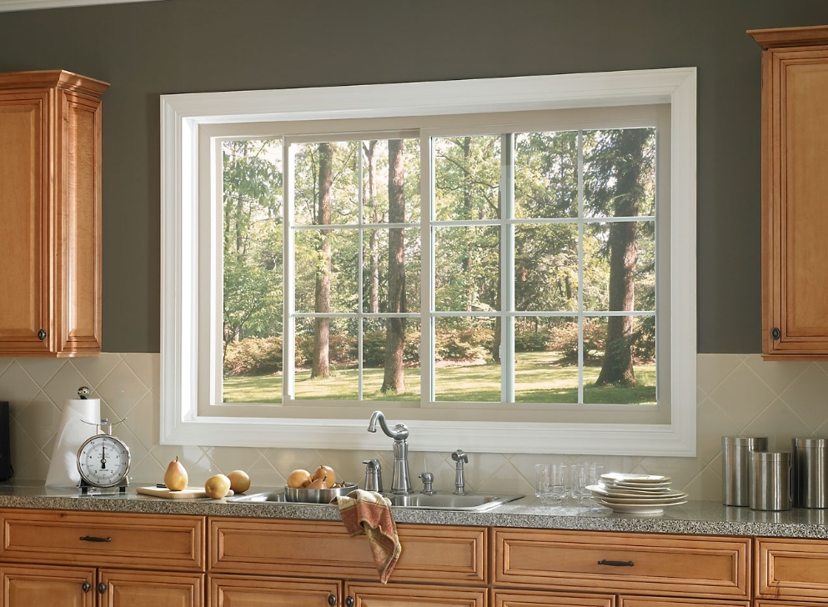
MADE IN USA
Integrated glide channel
for easy sash opening and closing
Tandem rollers ride easily
along friction-free glide channel
Available in ¼-1/2-1/4 or 1/3-1/3-1/3 configurations
XX 2-lite configuration (both sashes slide;
Series 451/461); XO or OX 2-lite configuration (one sash slides; Series 151/161, 5700 & 130)
Half screen standard
Low-E glass, Low-E glass with argon gas,
Ultra Low-E glass with argon gas, flat and contoured grids and double strength glass
are among the many options available
Sliding Windows
* see brochure for full details

Slide 24
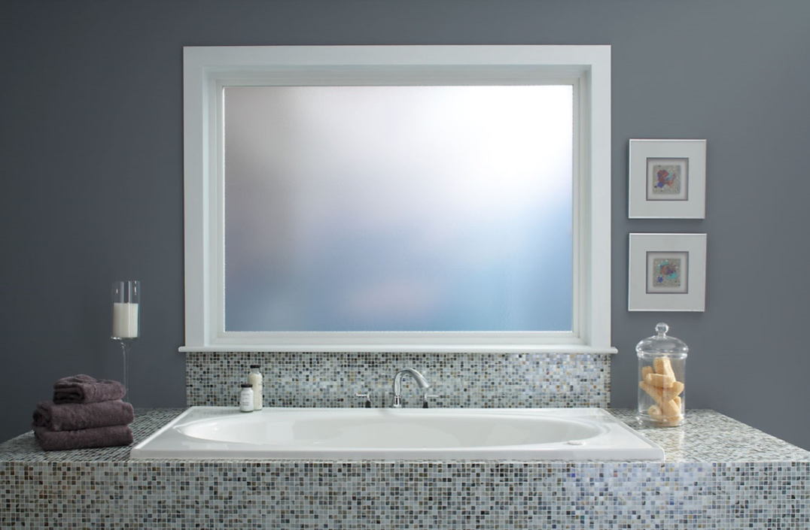
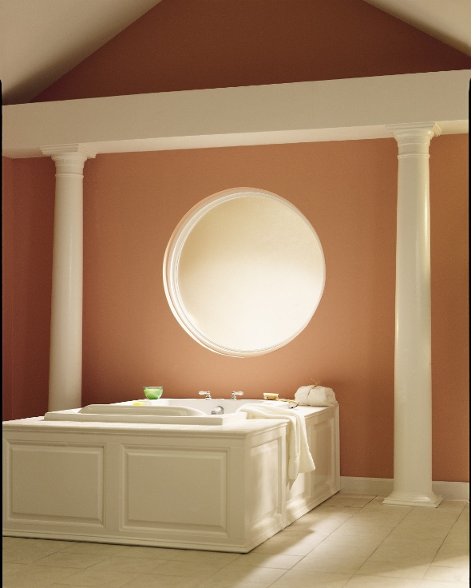
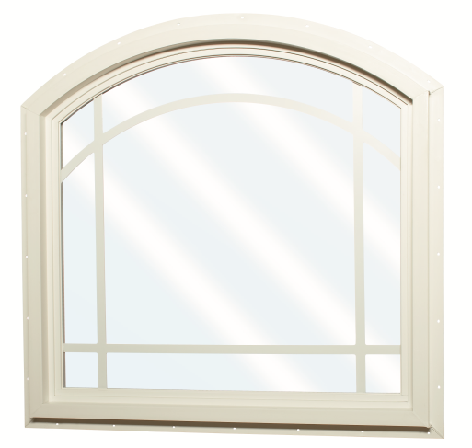
MADE IN USA
picture windows or architectural shapes
add a little more style…
Picture Windows & Shapes

Slide 25
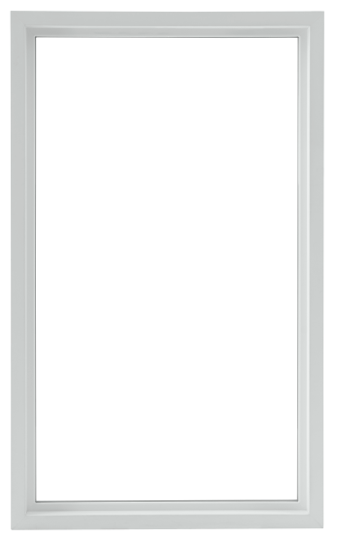
MADE IN USA
Reinforced, multi-cavity construction
provides additional thermal performance
and structural integrity
Fusion-welded frame adds strength
and boost thermal performance
Limited Lifetime Warranty
Double Strength Glass
Low-E glass, Low-E glass with argon gas,
Ultra Low-E glass with argon gas,
flat and contoured grids
are among the many options available
Picture Windows & Shapes
* see brochure for full details

Slide 26
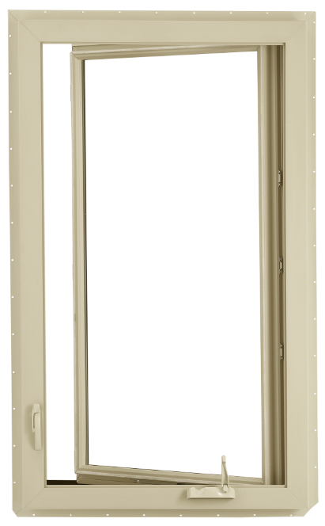
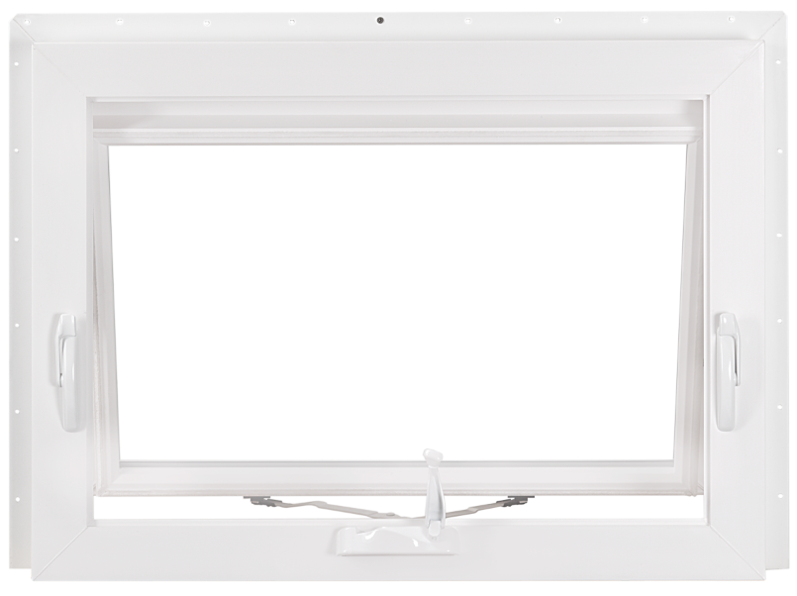
MADE IN USA
Casement windows add class and style,
Awning windows provide ventilation when
you only have a small or hard to reach area…
Casement & Awning

Slide 27
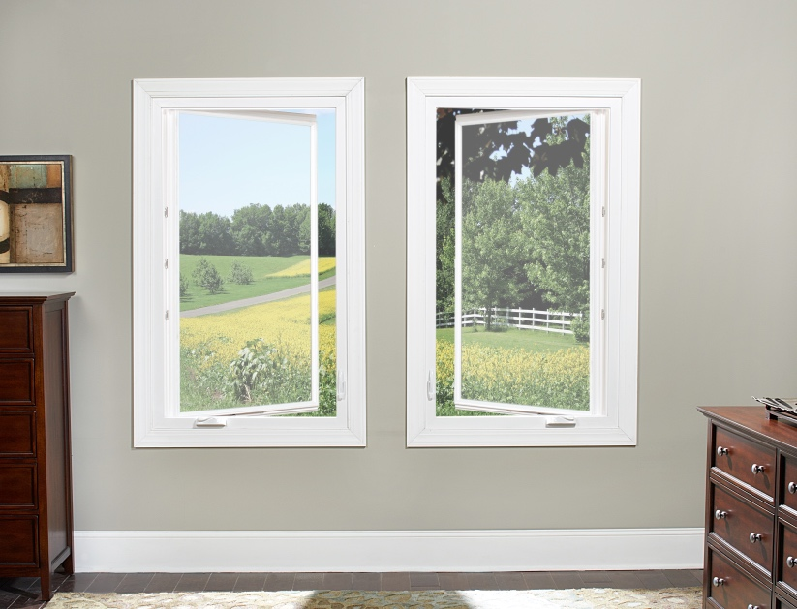
MADE IN USA
Brick mould exterior frame perimeter
Low profile handle folds in
and provides a popular aesthetic appeal
Narrow profile permits expanded viewing area
Opens 90 degrees for better ventilation
Tandem locks standard over 34” in height
Extruded full screen
Low-E glass, Low-E glass with argon gas,
Ultra Low-E glass with argon gas,
flat and contoured grids
and 2” simulated meeting rail
are among the many options available
Casement Windows
* see brochure for full details

Slide 28
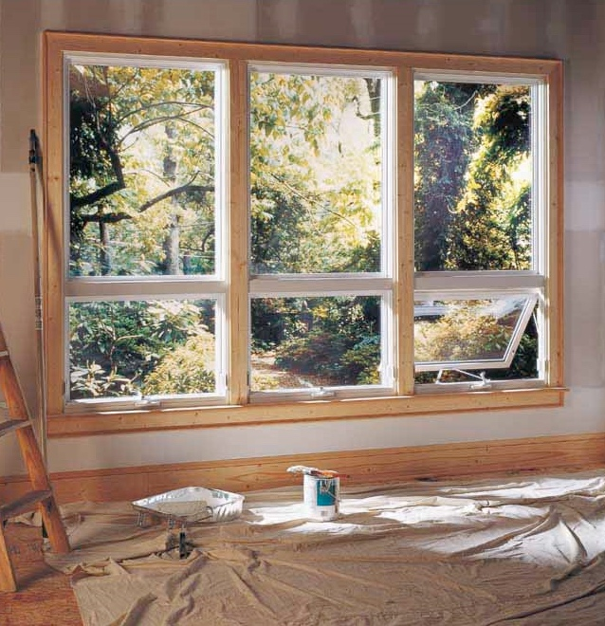
MADE IN USA
Brick mould exterior frame perimeter
Low profile handle folds in
and provides a popular aesthetic appeal
Narrow profile permits
expanded viewing area
Low-E glass, Low-E glass with argon gas,
Ultra Low-E glass with argon gas,
flat and contoured grids
are among the many options available
Awning Windows
* see brochure for full details

