Slide 1

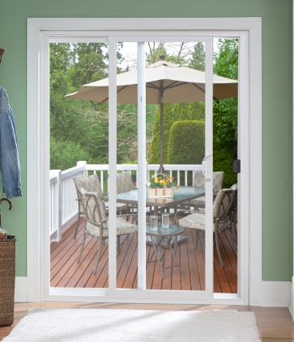
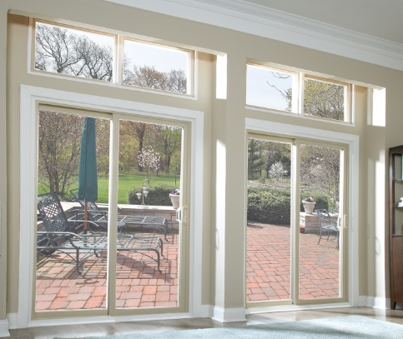

MADE IN USA
ATRIUM’S SLIDING PATIO DOOR OFFERING
FOR NEW CONSTRUCTION & REPLACEMENT

Slide 2
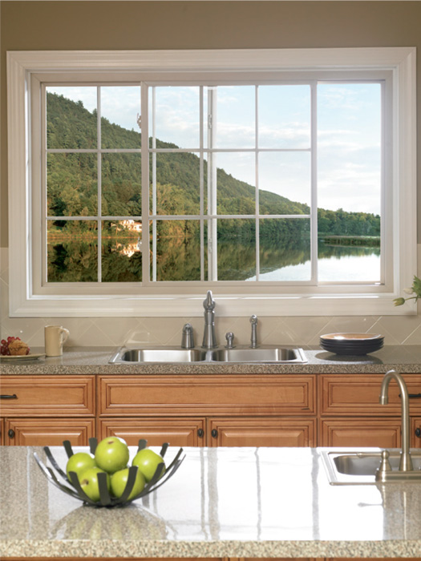
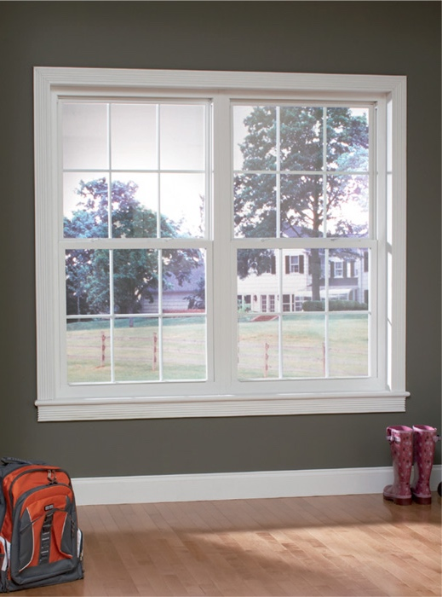
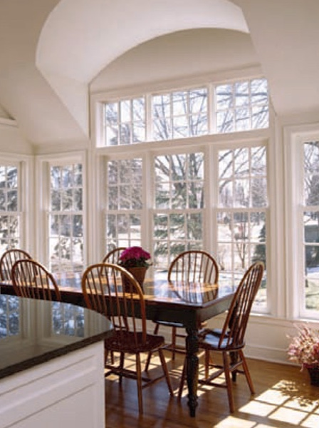
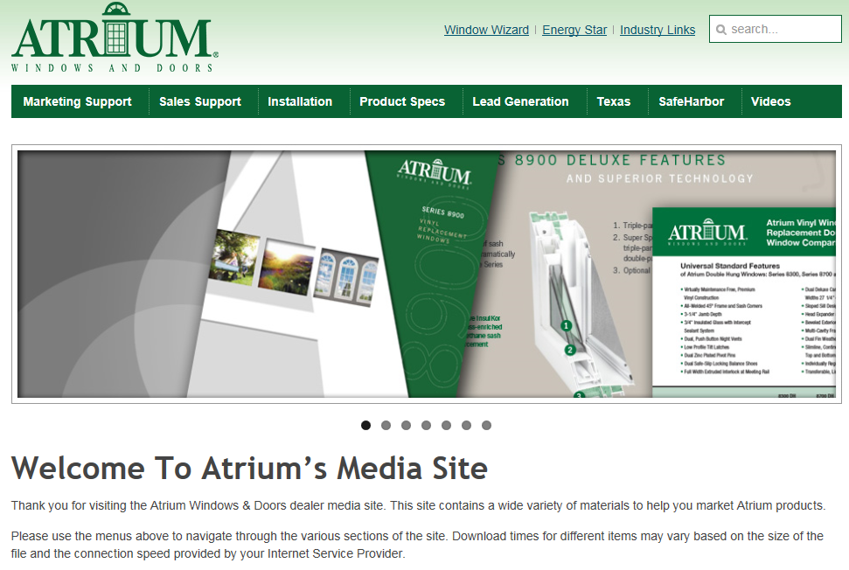

MADE IN USA
For easy to use marketing collateral with Series specific information
see our media site at
marketing.viewpoint-windows.com
In the following slides
we provide you with links
to specific assets
for your convenience.
Atrium Media Website

Slide 3
MADE IN USA
Atrium’s Sliding Patio Door
Offering
Series 332
Our Top-of-the-Line vinyl sliding patio door features a DP 50 rating, is available in 8’0” heights
and is field reversilble and options abound including snap-in brick mould and a foot bolt lock
Series 312
Our vinyl sliding door is available in 6’8” height up to 12’ wide, deluxe color match hardware
and screen come standard. Optional bronze exterior laminate and 8 exterior painted colors are available
Series 311
Our economically priced, entry level vinyl sliding patio door is available in white,
is field reversible and has grid, glass and screen options

Slide 4
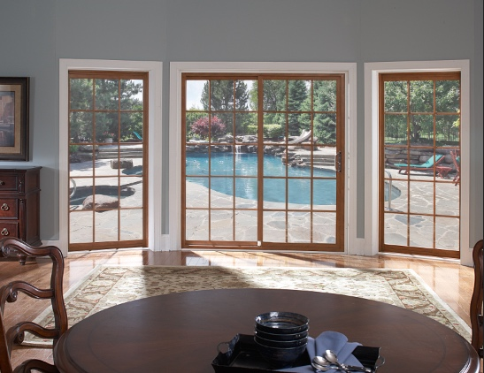
MADE IN USA
the BEST of our patio door offerings…
Series 332

Slide 5
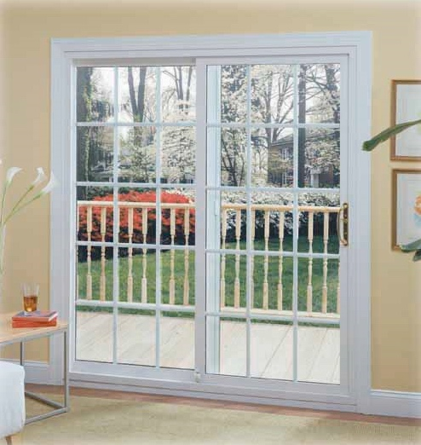
MADE IN USA
Available in 8’0” heights
DP 50 rating great for coastal applications
Field reversible (6’8” height only)
Available in 6’8” height up to 12’ wide
Deluxe color match hardware
Custom Sizes Available
Limited Lifetime Warranty
Ultra Low-E/Argon Glass, brushed nickel
or brass handles, contoured or flat grid
and simulated divided lite grid
among the many options
Series 332
* see brochure for full details

Slide 6
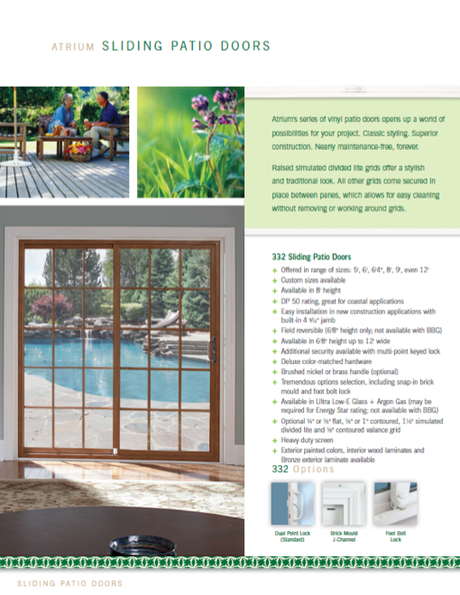

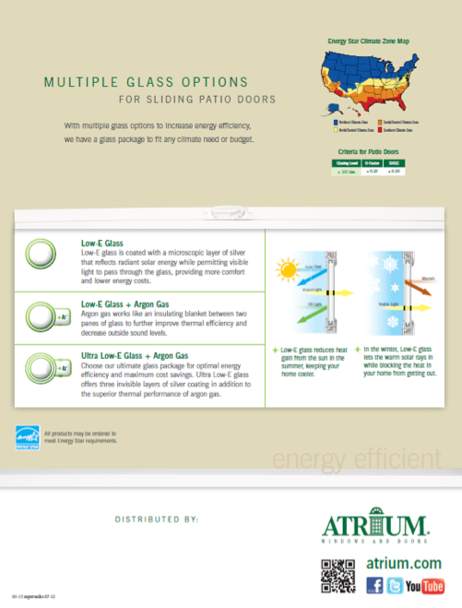
MADE IN USA
brochure
Series 332

Slide 7
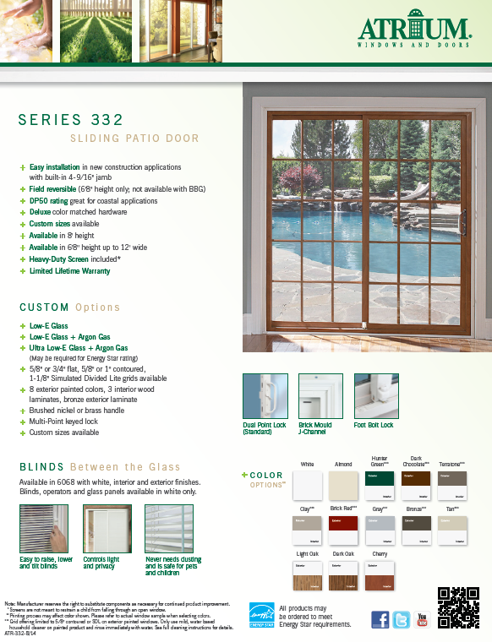
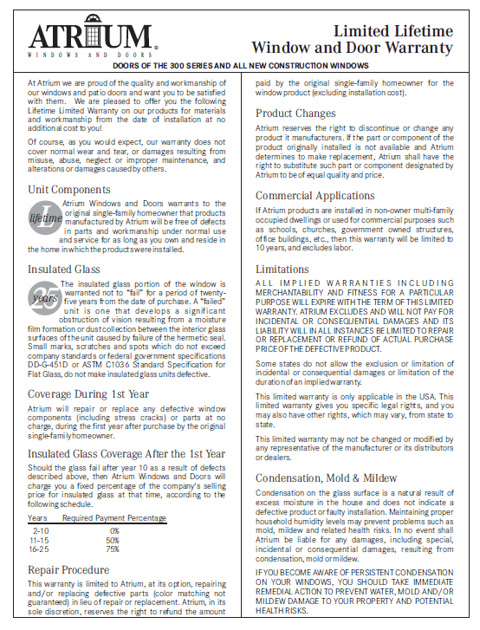
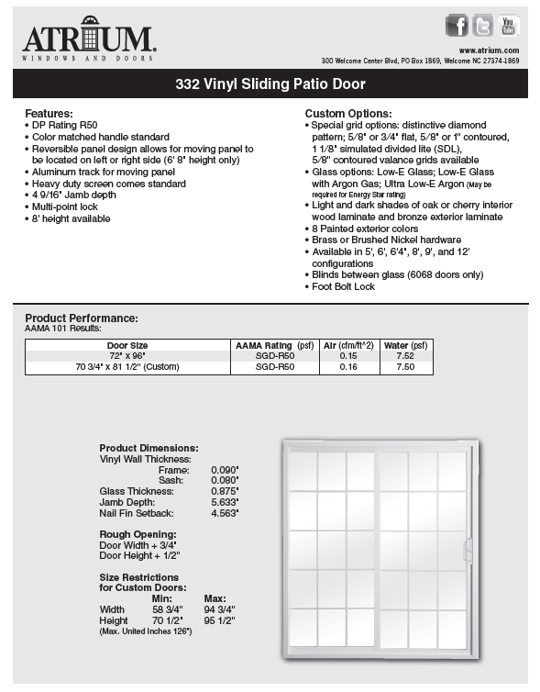
MADE IN USA
warranty
technical data sheet
feature sheet
Series 332

Slide 8
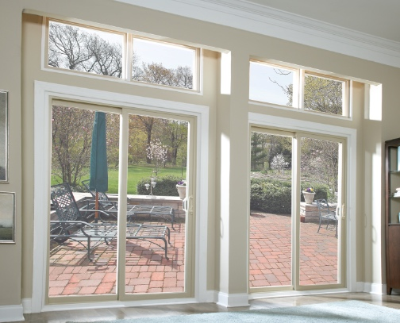
MADE IN USA
Great Value and Great Price…
Series 312

Slide 9
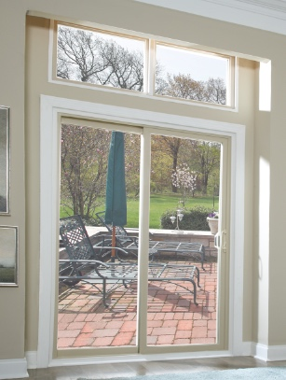
MADE IN USA
Field reversible (6’8” height only)
Available in 6’8” height up to 12’ wide
Deluxe color match hardware
Custom Sizes Available
Limited Lifetime Warranty
Ultra Low-E/Argon Glass, brushed nickel
or brass handles, contoured or flat grid
and simulated divided lite grid
among the many options
Series 312
* see brochure for full details

Slide 10
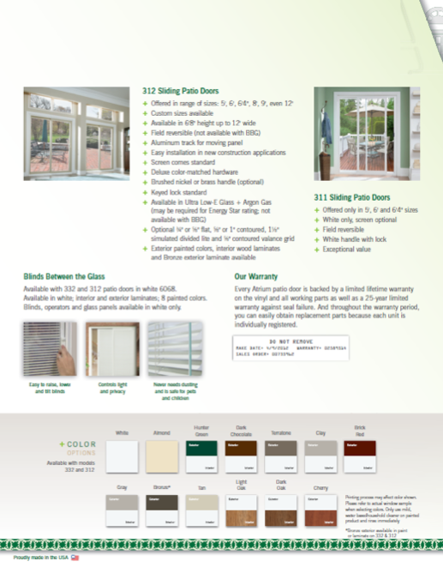
MADE IN USA
brochure
Series 312

Slide 11
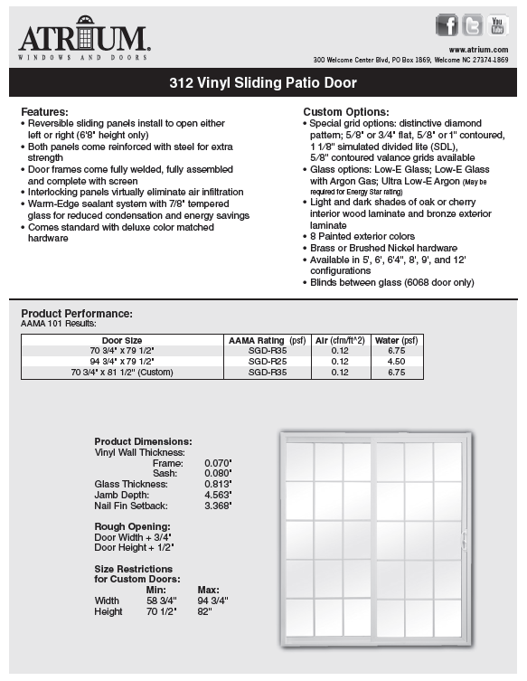
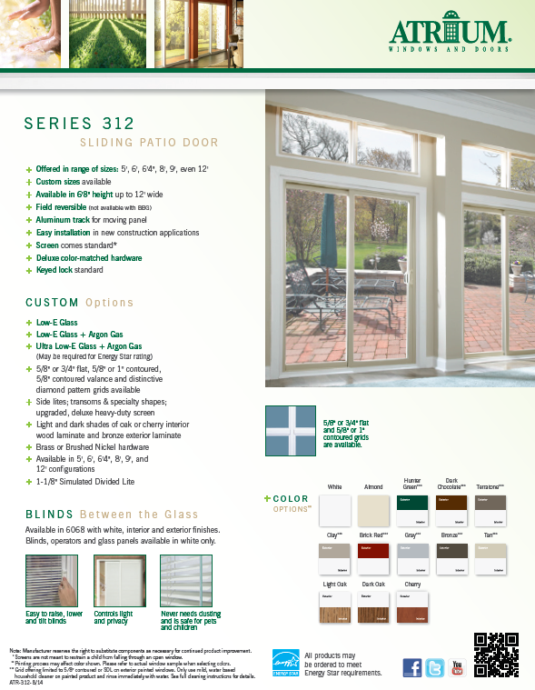
MADE IN USA
warranty
technical data sheet
feature sheet
Series 312

Slide 12
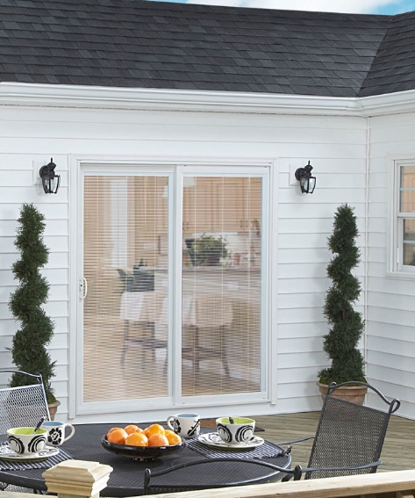
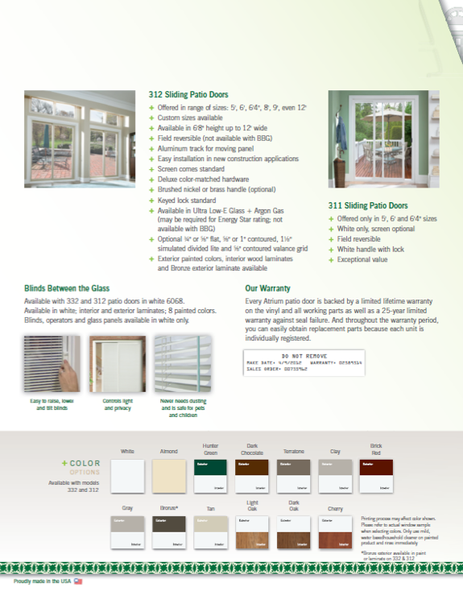
MADE IN USA
Blinds Between The Glass (BBG)
available with 312 & 332 in 6068 doors
Sealed between
the glass, the blinds
control light
and privacy.
Available in white,
interior and exterior
laminates.
Blinds, operators
and glass panels
available in white only.
BBG Option

Slide 13
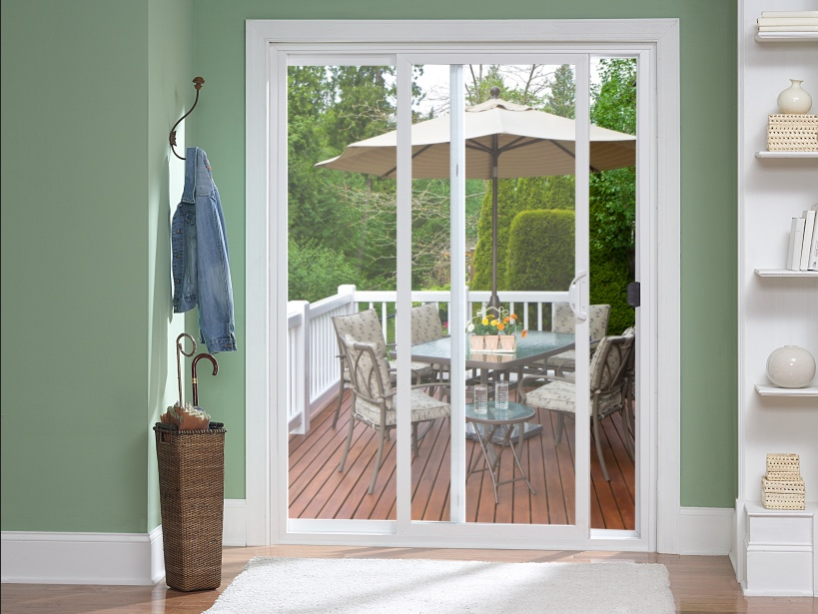
MADE IN USA
priced right looks great…
Series 311

Slide 14
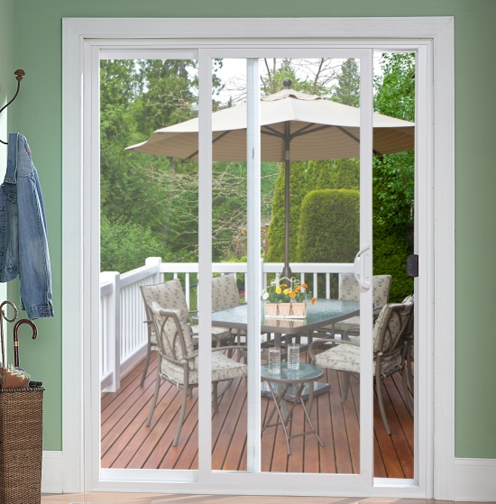
MADE IN USA
Field Reversible
Sliding panel and meeting rail
reinforced with roll-formed steel
Aluminum track for movable panel
Interlocking panels prevent air infiltration
White enameled handle
with non-keyed lock
Limited Lifetime Warranty
Low-E Glass, Low-E/Argon Glass,
Ultra Low-E/Argon Glass,
flat or contoured grid and extruded screen
are also available
Series 311
* see brochure for full details

Slide 15
MADE IN USA
brochure
Series 311

Slide 16
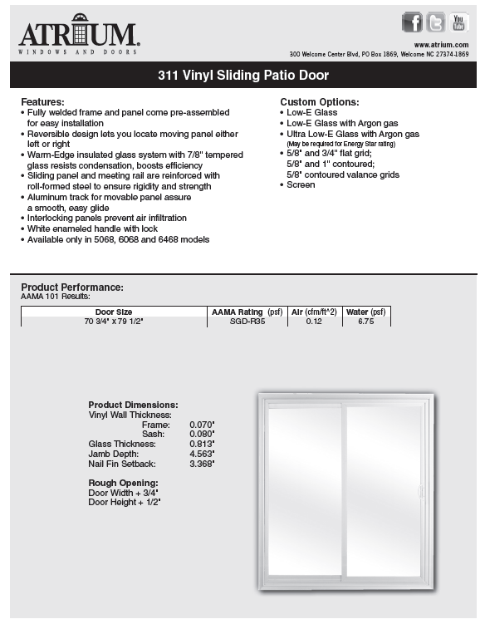
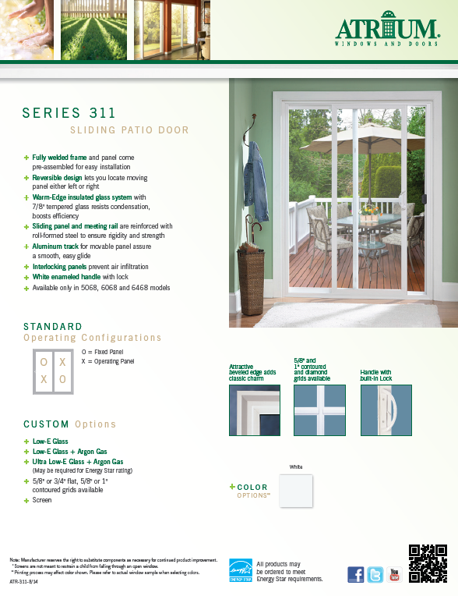
MADE IN USA
warranty
technical data sheet
feature sheet
Series 311

