Slide 1
MADE IN USA
PITCH BOOKS

Slide 2
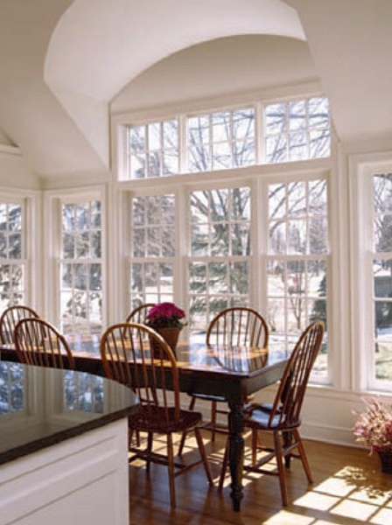
MADE IN USA
PITCH BOOKS
Available for download in Powerpoint and iPad formats.
Pitch Book PowerPoints are available for download from your media site:
These PPT’s can be found under the “Sales Support” link in the “Pitch Book” folder and are designed to help you upsell Lansing replacement windows.
Keynote presentations for iPads can also be found under the “Sales Support” link in the “iPad Downloads” folder.
Atrium Pitch Books

Slide 3
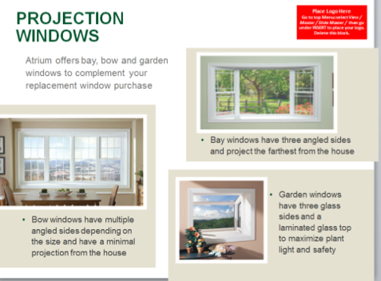
MADE IN USA
PITCH BOOKS (Microsoft Powerpoint)
There are 5 different PPT’s available in this series
Series 8900
Series 8700
Series 8300
Additional Styles & Warranty
Why Lansing, Why Vinyl

Slide 4
MADE IN USA
PITCH BOOKS (Keynote for iPad)
Here are direct links to each Keynote (for iPad)
Series 8900
Series 8700
Series 8300

Slide 5
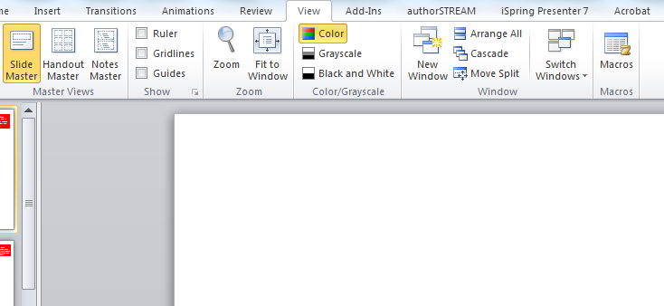
MADE IN USA
These Pitch Books are ready-to-use or can be customized to meet your needs or the needs of your customers.
(Please right click and “save as” to your computer before working in any files.)
To customize….. go to the “View” menu across the top of the page, then select “slide master”….
Step One
Step Two

Slide 6
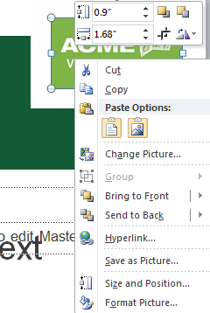
MADE IN USA
These Pitch Books are ready-to-use or can be customized to meet your needs or the needs of your customers.
(Please right click and “save as” to your computer before working in any files.)
Click on the ACME logo on the top right corner, then right click and choose “change picture”. Select another logo and hit “insert”.
New logo will appear on all slides.
(Note: In some cases you might have to add it to more than one master slide.)
Step Three
Step Four

