Slide 1
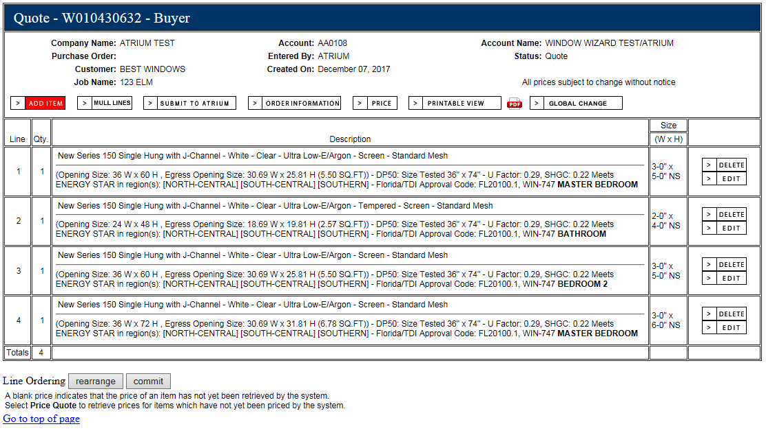
Rearrange Lines Feature
Step 1: Click Rearrange icon
Step 2: Click and hold line you wish to move

Slide 2
Rearrange Lines Feature
Step 3: Drag line to desired location on quote and release mouse button
Step 4: Click commit icon

Slide 3
Rearrange Lines Feature
Lines are now rearranged

