Slide 1

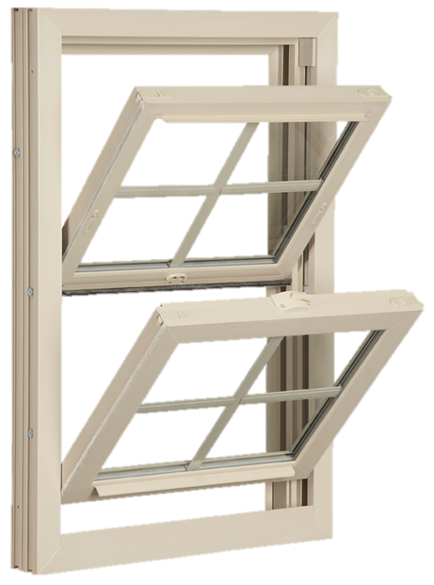
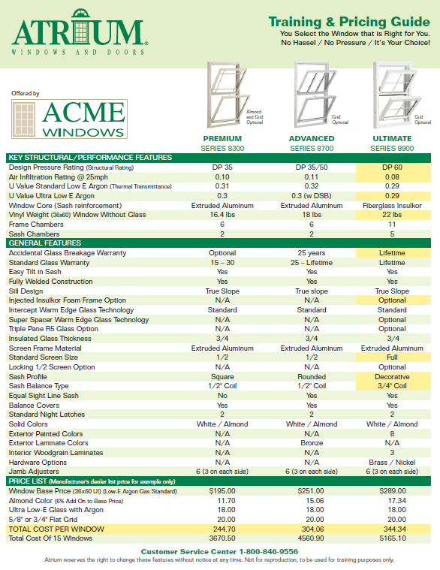

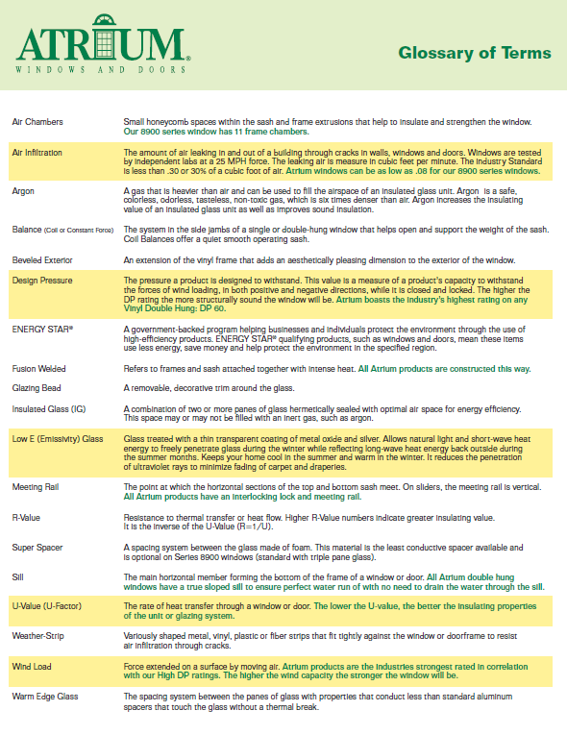
MADE IN USA
ATRIUM TRAINING & PRICING GUIDE

Slide 2



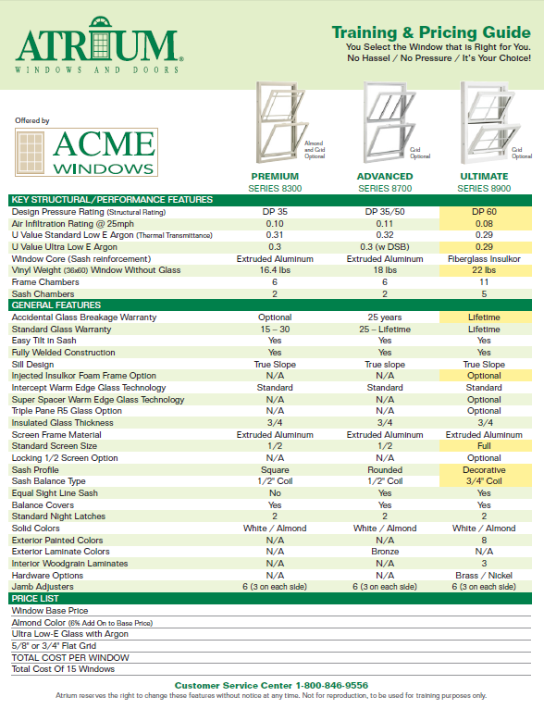

MADE IN USA
REPLACEMENT TRAINING & PRICING GUIDE
Training and Pricing Guide PDF’s are available for download
from your Atrium media site:
Training & Pricing Guide
These guides are available in PDF format for all three double hung windows individually and all three
on one sheet for comparison.
They are meant to be used out in
the field where there is no access
to a computer or for customers
who don’t have time for working
up a quote on the Quote Tool,
you can simply price on the go.
They are all available with a dealer
list pricing example or without
any pricing so that you can write in specific pricing for your customer.

