Slide 1

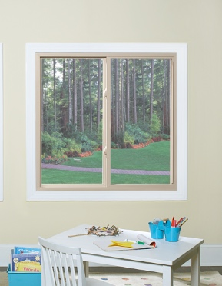
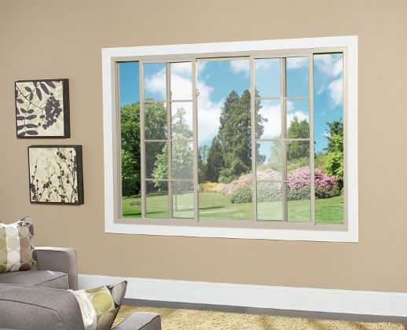

MADE IN USA
ATRIUM’S REPLACEMENT
SLIDER WINDOW OFFERING
A GOOD INVESTMENT

Slide 2
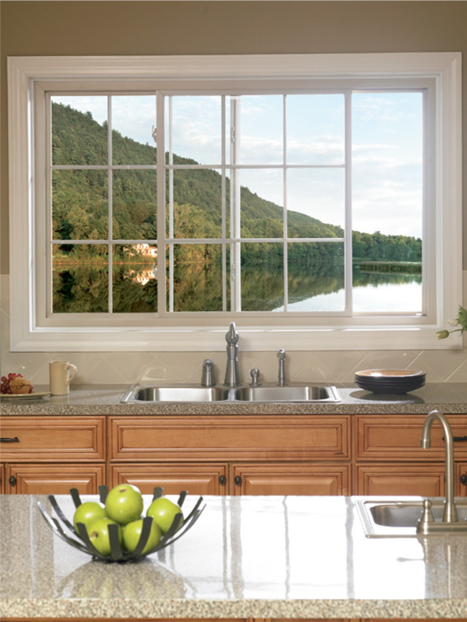
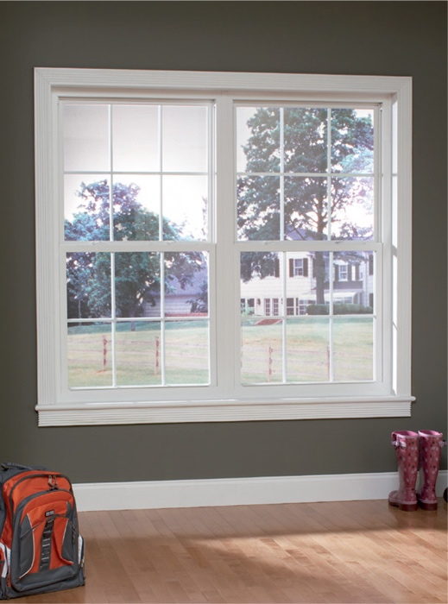
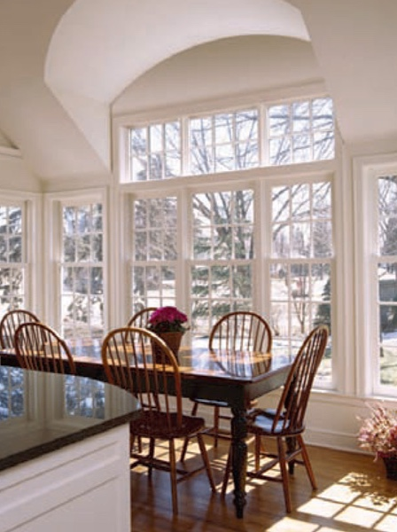
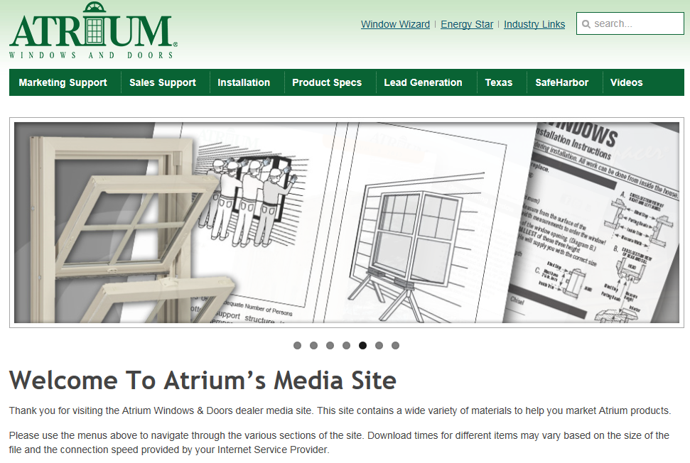

MADE IN USA
For easy to use marketing collateral with Series specific information
see our media site at
marketing.lbpwindows.com
In the following slides
we provide you with links
to specific assets
for your convenience.
Atrium Media Website

Slide 3
MADE IN USA
Atrium’s 2&3 – Lite Slider
Replacement Window Offering
Series 8900 (xx)
Our Ultimate Replacement Sliding window features Low-E Argon, a DP-50, Exclusive InsulKorTM sash reinforcement for superior thermal and structural performance and Lifetime Glass Breakage Warranty
Series 8700 (xx)
Our Advanced Replacement Sliding window features a great value without a premium price,
Low-E Argon, 25-year Glass Breakage Warranty, a DP-50 and Bronze exterior laminate
Series 8300 (xo, ox)
Our Premium Replacement Sliding window is priced right and looks great with Low-E Argon standard,
a transferable limited lifetime warranty and an optional lifetime glass breakage warranty

Slide 4
MADE IN USA
Atrium’s 2&3 – Lite Slider
Replacement Window Offering
Series 8100 (xo, ox)
It’s Back to the basics with this Slider Family available with
Factory applied wrap-around foam, Beveled exterior frame and sash,
a transferable Limited Lifetime warranty and an optional lifetime glass breakage warranty
Series 8050 (xo,ox)
Priced right and looks great with a removable sash, sweep lock, transferable limited lifetime
warranty and an optional lifetime glass breakage warranty

Slide 5
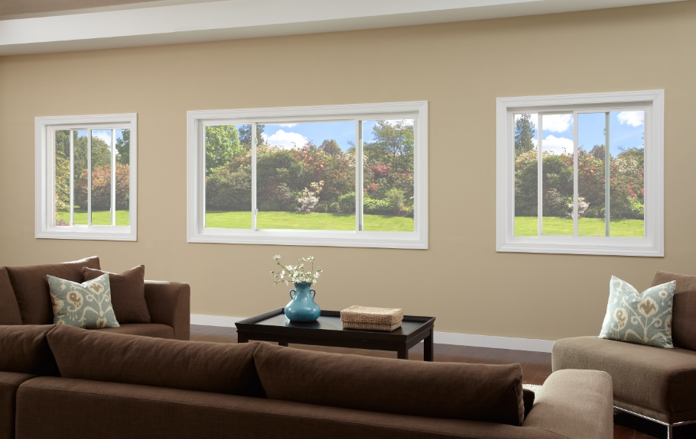
MADE IN USA
The BEST of our product offerings…
Series 8900

Slide 6
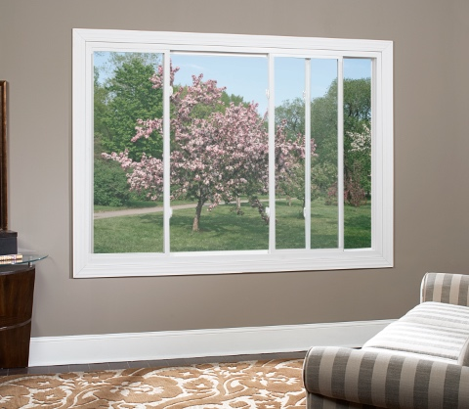
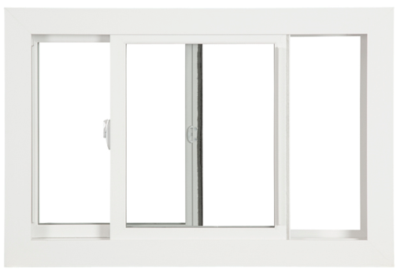
MADE IN USA
Low-E Glass with Argon Gas for enhanced
thermal efficiency
Exclusive InsulKor™ for superior thermal
and structural performance
DP 50 rating (window size 72” x 48”)
Lifetime glass breakage warranty
ensures the longevity of your windows
Tandem rollers ride easily
along friction free glide channel
Available in 1/4, 1/2, 1/4 and 1/3, 1/3, 1/3 configurations
Extruded Full Screen with Lifetime Warranty
(std on 2-lite)
Sound Transmission Control (STC) Glass,
8 painted colors, 3 interior wood laminates
and 1-1/8” Simulated Divided Lite Grid
are among the many options available
Series 8900
* see brochure for full details

Slide 7
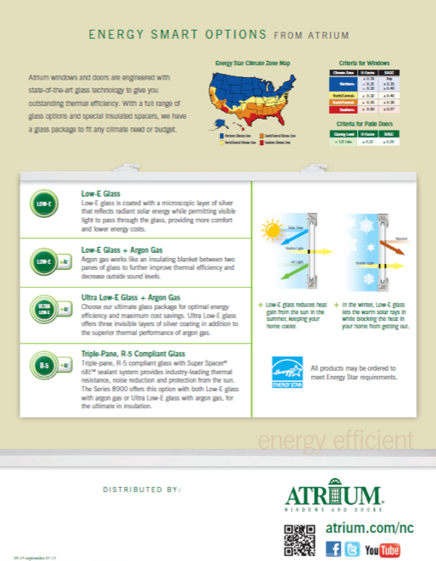
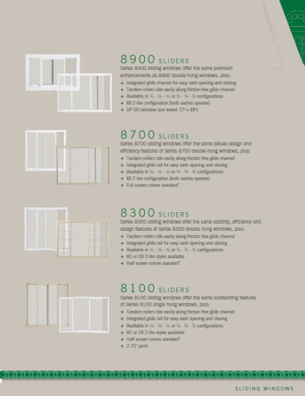

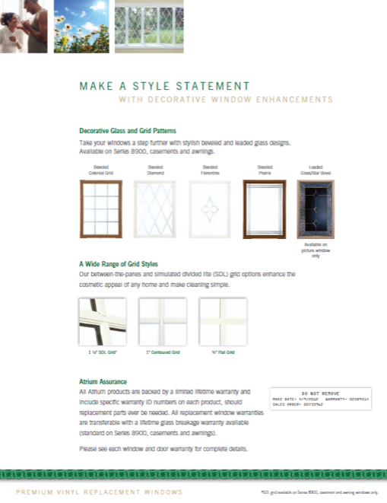
MADE IN USA
brochure
Series 8900

Slide 8
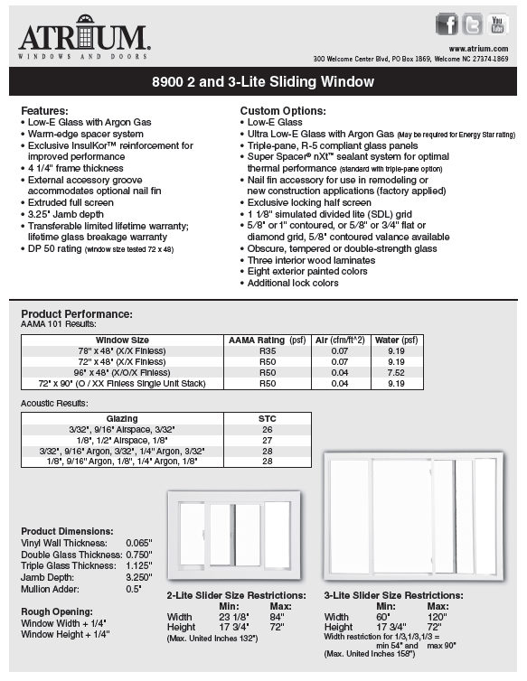
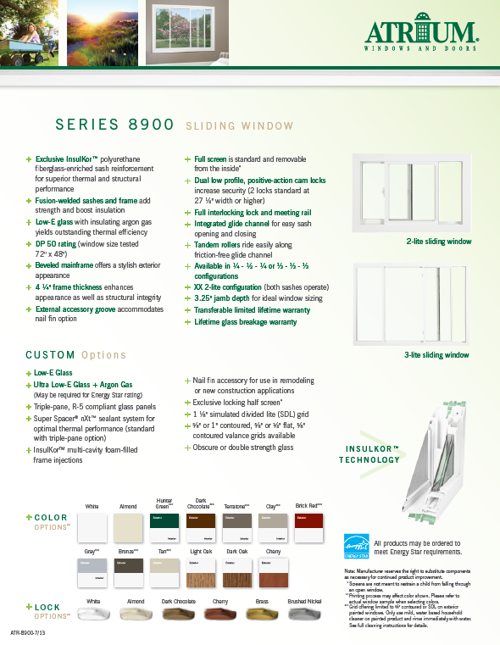
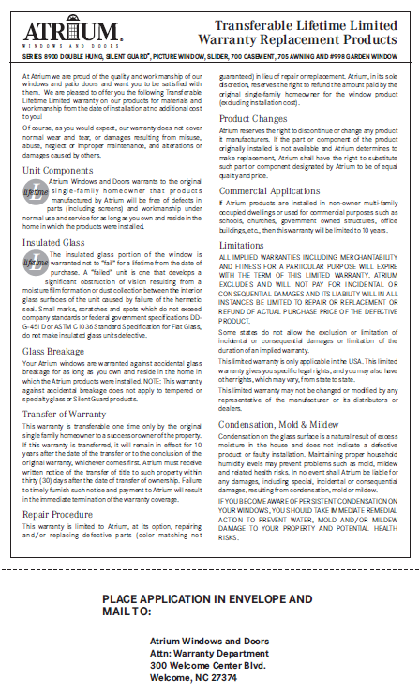
MADE IN USA
warranty
technical data sheet
(double hung sheet also available)
feature sheet
(double hung sheet also available)
Series 8900

Slide 9


MADE IN USA
Sound Transmission Control (STC) Glass
This option is specifically manufactured with our noise-reducing technology to provide the optimum performance.
STC offers advanced noise control performance for the majority of annoying sounds that routinely affect us all.
Sounds are measured in decibels (dBs). An STC rating is assigned to a window to designate its capacity to block sound.
The higher the decibel the higher the STC rating needed. Typical windows have STC ratings in the 25 – 28 range.
From loud lawn mowers to barking dogs, the STC 34 rated option is designed to control these most common nuisances.
Sound Transmission Control Option

Slide 10
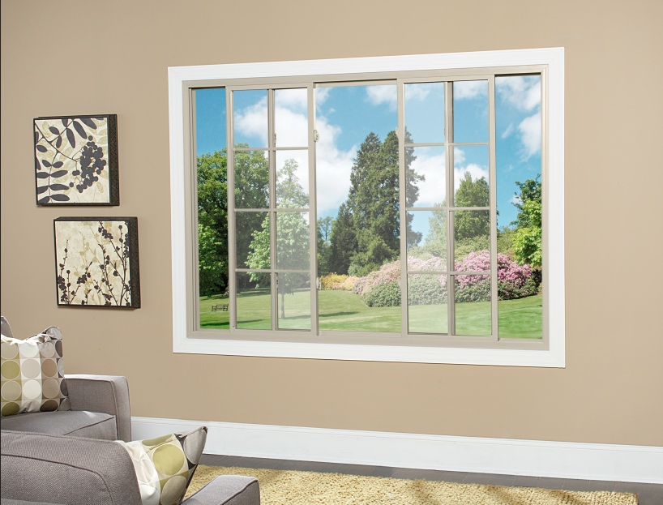
MADE IN USA
Great Value and Great Price…
Series 8700

Slide 11
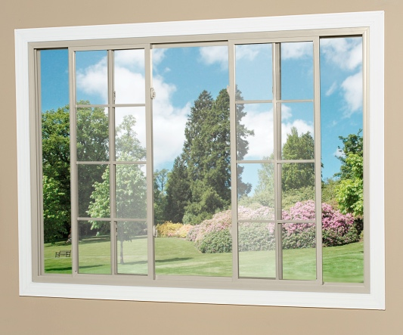
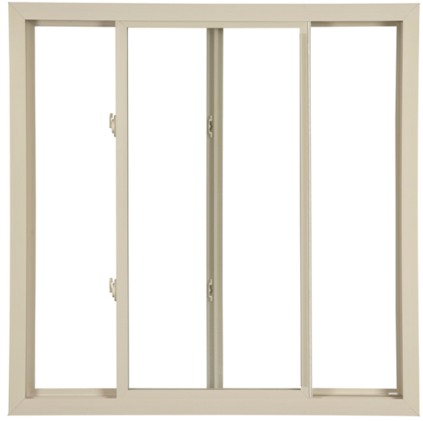
MADE IN USA
Low-E Glass with Argon Gas
for enhanced thermal efficiency
25 Year Glass Breakage
Warranty – standard (lifetime optional)
Tandem Rollers Ride Easily
along Friction Free Glide Channel
Available in ¼, ½, ¼ Configurations Available
DP 30 Rating (window size tested 78” x 48”)
Extruded Full Screen with Lifetime Warranty
(on 2-lite sliders)
Ultra Low-E Glass with Argon Gas,
flat, contoured and SDL grids are also available
Series 8700
* see brochure for full details

Slide 12
MADE IN USA
brochure
Series 8700

Slide 13
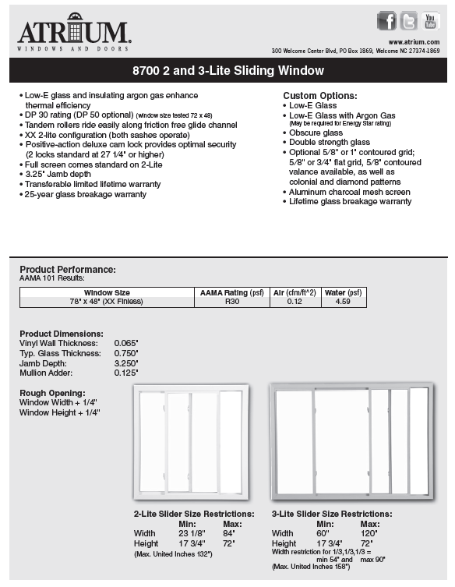
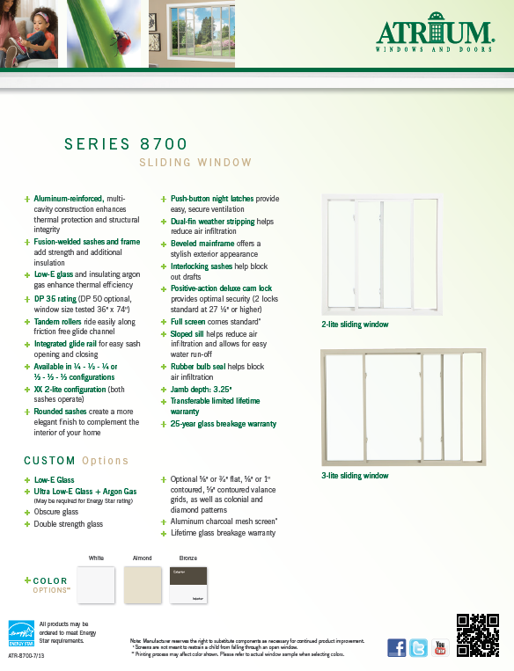
MADE IN USA
warranty
technical data sheet
(double hung sheet also available)
feature sheet
(double hung sheet also available)
Series 8700

Slide 14
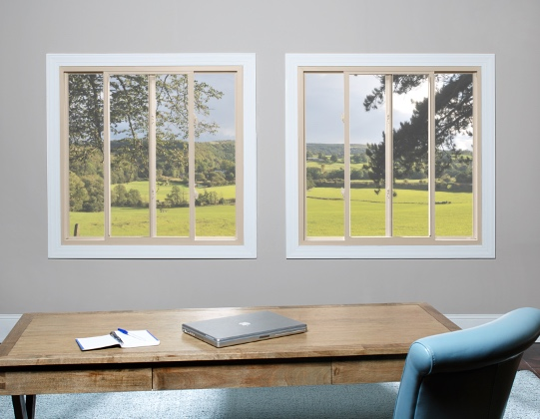
MADE IN USA
priced right and looks great…
Series 8300

Slide 15
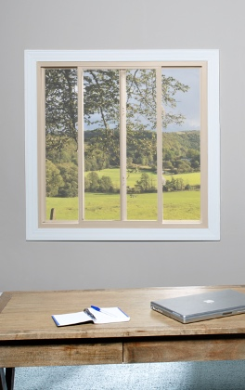
MADE IN USA
Low-E Glass with Argon Gas
for enhanced thermal efficiency
Transferable Limited Lifetime Warranty
Tandem Rollers Ride Easily
along Friction Free Glide Channel
Extruded Half Screen with Lifetime Warranty
Available in 1/4, 1/2, 1/4 and 1/3, 1/3, 1/3 Configurations
DP 40 Rating (window size tested 78” x 48”)
Ultra Low-E Glass with Argon Gas,
flat and contoured grids, almond vinyl color and 8 painted exterior colors are also available
Series 8300
* see brochure for full details

Slide 16
MADE IN USA
brochure
Series 8300

Slide 17
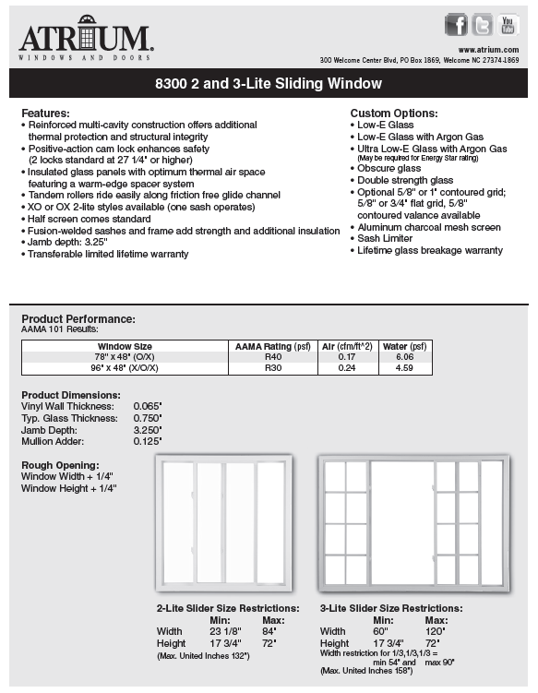
MADE IN USA
warranty
technical data sheet
(double hung sheet also available)
feature sheet
(double hung sheet also available)
Series 8300

Slide 18
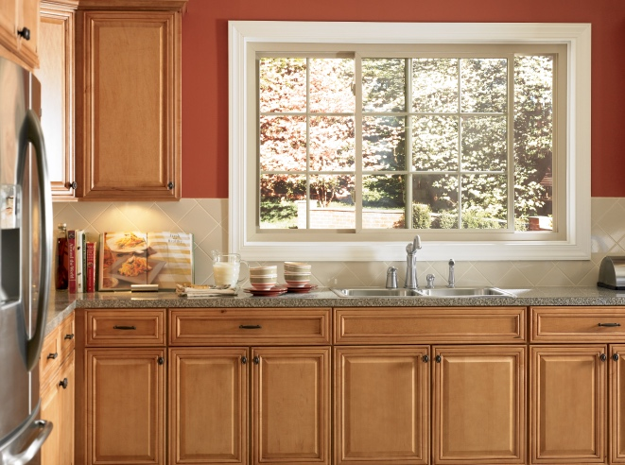
MADE IN USA
for Quality & Value choose our…
Series 8100

Slide 19
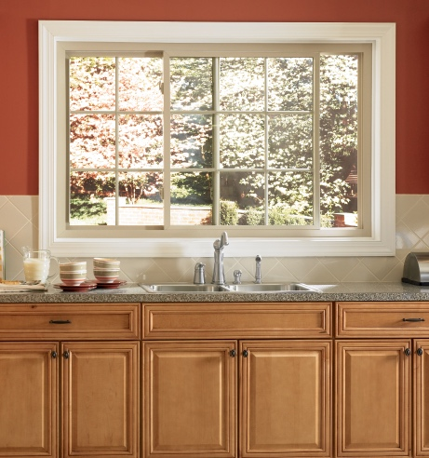
MADE IN USA
Tandem Rollers Ride Easily
along Friction Free Glide Channel
Factory applied wrap-around foam
Beveled exterior frame and sash
Transferable limited lifetime warranty with Lifetime glass breakage warranty optional
Half Screen Standard with Lifetime Warranty
Available in 1/4, 1/2, 1/4 and 1/3, 1/3, 1/3 Configurations
Low-E glass, Low-E glass with argon gas,
Ultra Low-E glass with argon gas,
flat and contoured grids
are among the many options available
Series 8100
* see brochure for full details

Slide 20
MADE IN USA
brochure
Series 8100

Slide 21
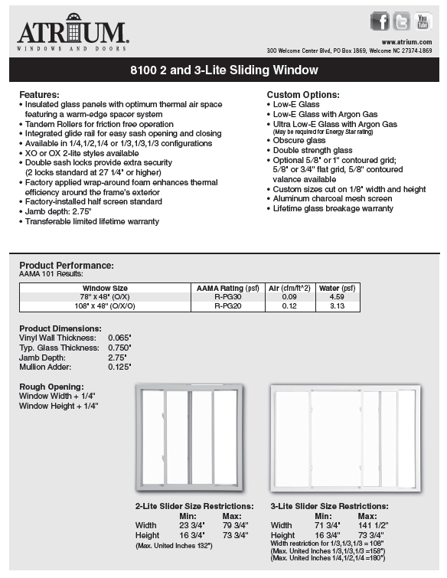
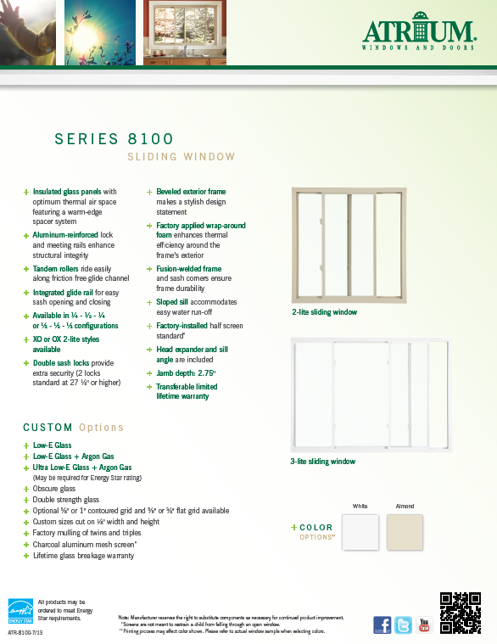
MADE IN USA
warranty
technical data sheet
(double hung sheet also available)
feature sheet
(double hung sheet also available)
Series 8100

Slide 22
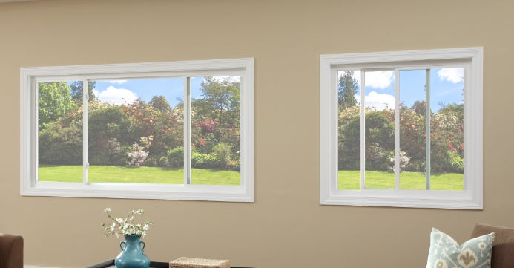
MADE IN USA
priced right and looks great…
Series 8050

Slide 23
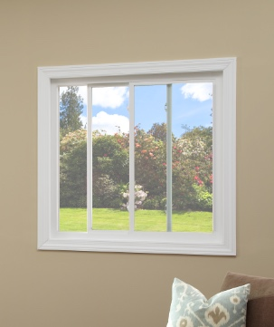
MADE IN USA
Removable Sash
Sweep Lock Helps Provide a Weather-Tight Seal
Transferable limited lifetime warranty with Lifetime Glass Breakage warranty optional
Available in 1/4, 1/2, 1/4 and 1/3, 1/3, 1/3 Configuration
DP Rating 25 (window size tested 72” x 48”)
Ultra Low-E Glass with Argon Gas,
flat and contoured grids
are also available
Series 8050
* see brochure for full details

Slide 24
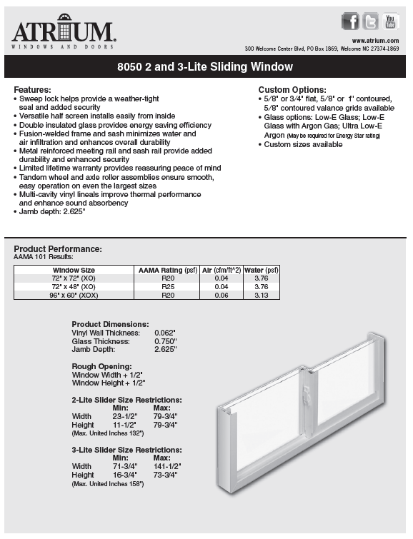
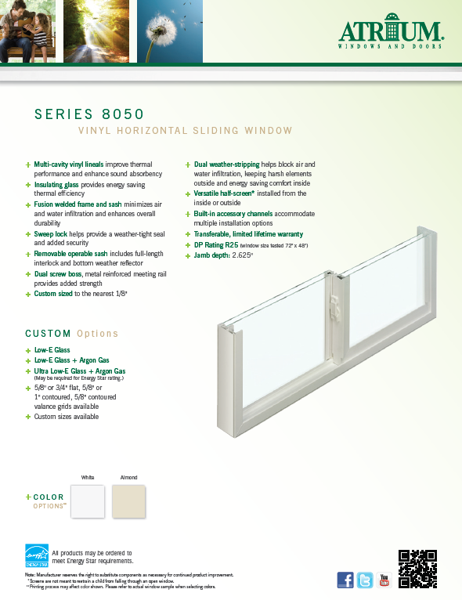
MADE IN USA
warranty
technical data sheet
(double hung sheet also available)
feature sheet
(double hung sheet also available)
Series 8050

Slide 25
MADE IN USA
Atrium’s Additional Styles
Replacement Window Offering
Casement, Awning & Hopper
Casement and awning windows crank open to the outside. The Casement window opens a full 90 degrees
and casement windows are a popular option over a kitchen sink. Hopper windows crank open
to the inside and are most commonly used in a basement or any room underground.
Bay / Bow & Garden (Projection Windows)
Bay and bow windows create a window seat adding more dimension to a room and providing a larger viewing area. These windows are available in 3-5 lite styles and you can select hung or casement flankers for ventilation.
Garden window depth provides a generous area for plants, picture frames and simply adds space to the room.

Slide 26
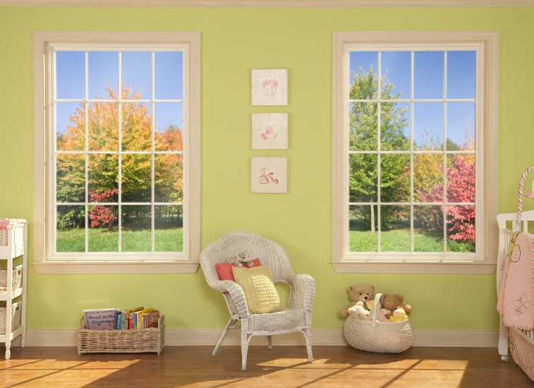
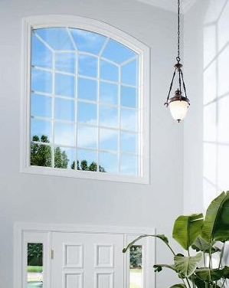
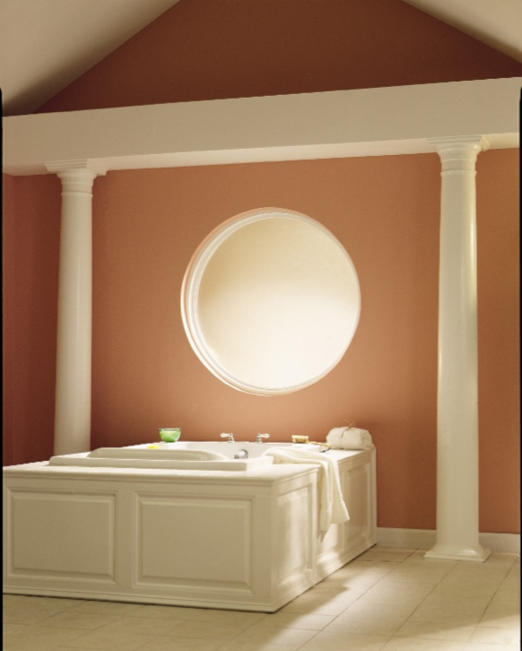
MADE IN USA
picture windows or architectural shapes add a little more style…
Picture Windows & Shapes

Slide 27
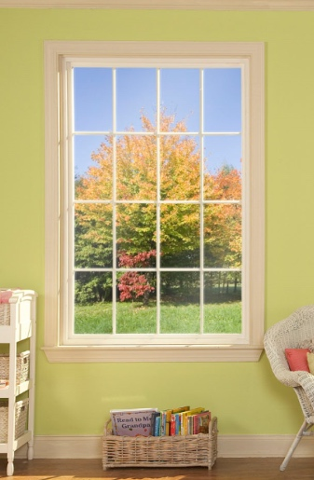
MADE IN USA
Reinforced, multi-cavity construction
provides additional thermal performance
and structural integrity
Fusion-welded frame adds strength
and boost thermal performance
Transferable limited lifetime warranty with Lifetime glass breakage warranty optional
Double Strength Glass
Low-E glass, Low-E glass with argon gas,
Ultra Low-E glass with argon gas,
flat and contoured grids
are among the many options available
Picture Windows & Shapes
* see brochure for full details

Slide 28
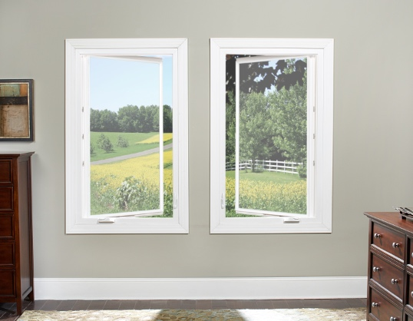
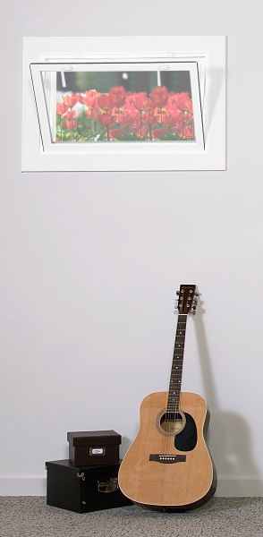
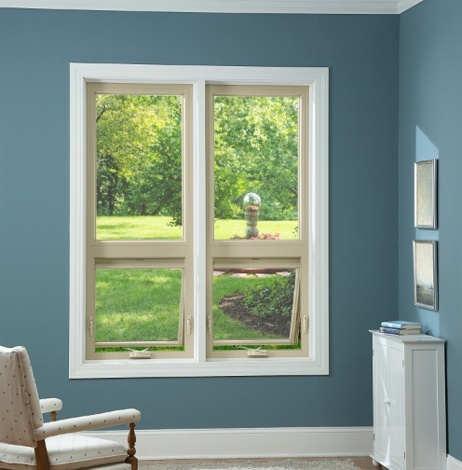
MADE IN USA
casement and awning windows provide clean, sleek lines and are found in many upscale homes.
The Hopper window allows the ability
to have an operable window even in the basement…
Casement, Awning & Hopper

Slide 29
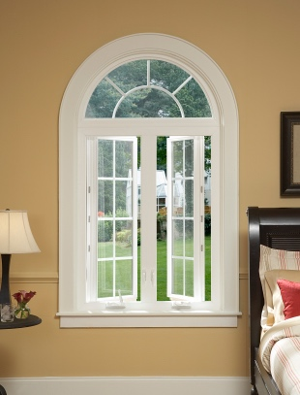
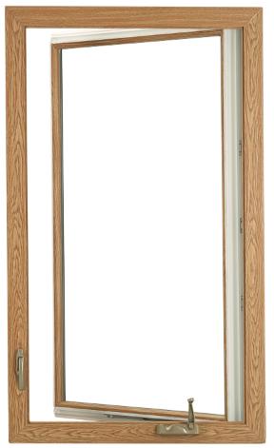
MADE IN USA
Low-E Glass with Argon Gas
Beveled exterior frame perimeter
Low profile handle folds in
and provides a popular aesthetic appeal
Narrow profile permits expanded viewing area
Opens 90 degrees for better ventilation
Tandem locks standard over 34” in height
Low-E glass, Ultra Low-E glass with argon gas,
flat and contoured grids
and 2” simulated meeting rail
are among the many options available
Casement Windows
* see brochure for full details

Slide 30
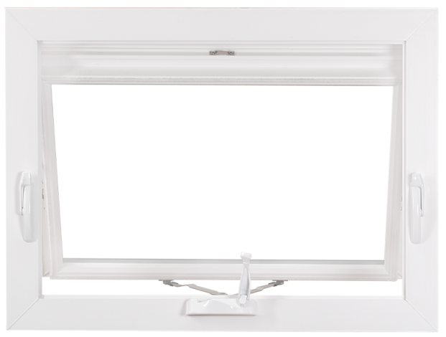
MADE IN USA
Low-E Glass with Argon Gas
Beveled exterior frame perimeter
Low profile handle folds in
and provides a popular aesthetic appeal
Narrow profile permits
expanded viewing area
Low-E glass, Ultra Low-E glass with argon gas,
flat and contoured grids
are among the many options available
Awning Windows
* see brochure for full details

Slide 31
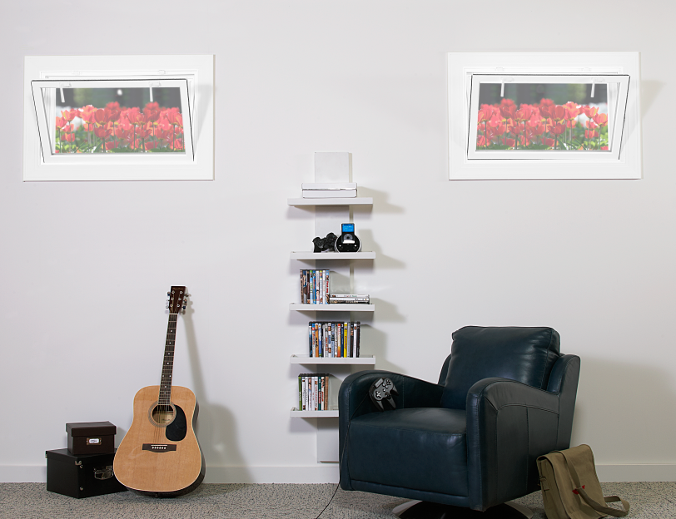
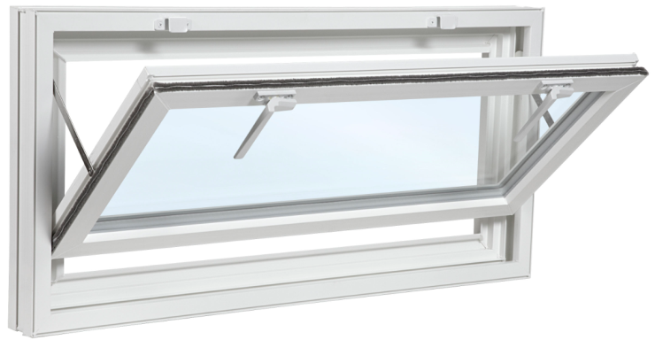
MADE IN USA
The all-welded Hopper Window
is available in white with clear glass
and features dual tilt latches.
The window is available in three stock sizes:
32” x 15 ½”
32” x 19 ½”
32” x 23 ½”
Hopper Windows
* see brochure for full details

Slide 32
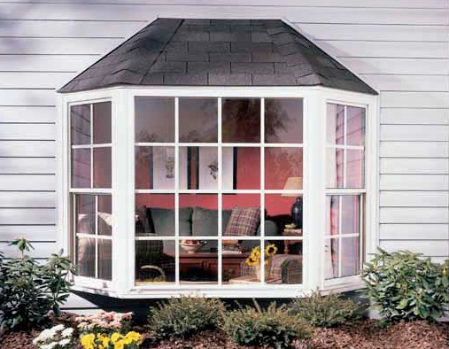
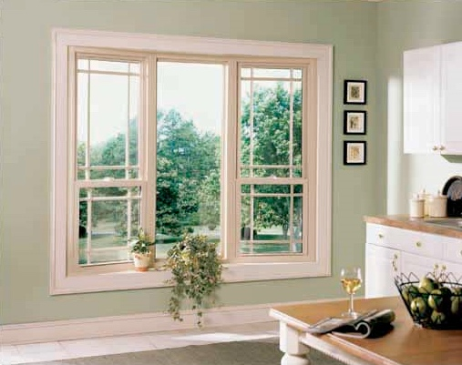
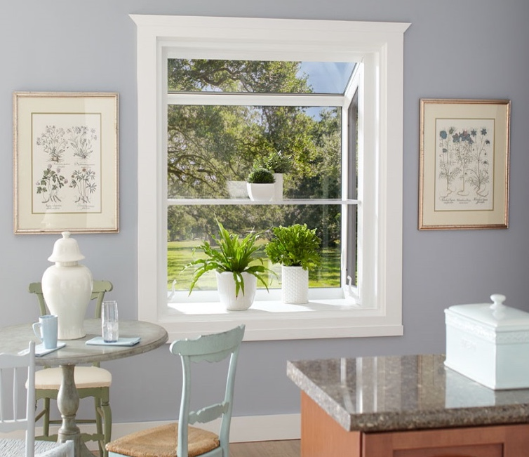
MADE IN USA
Bay & Bow windows whether you’re trying
to create another seat or add dimension
to the room and the garden window features
a 17½” depth for plants or added room space…
Bay / Bow & Garden Windows

Slide 33
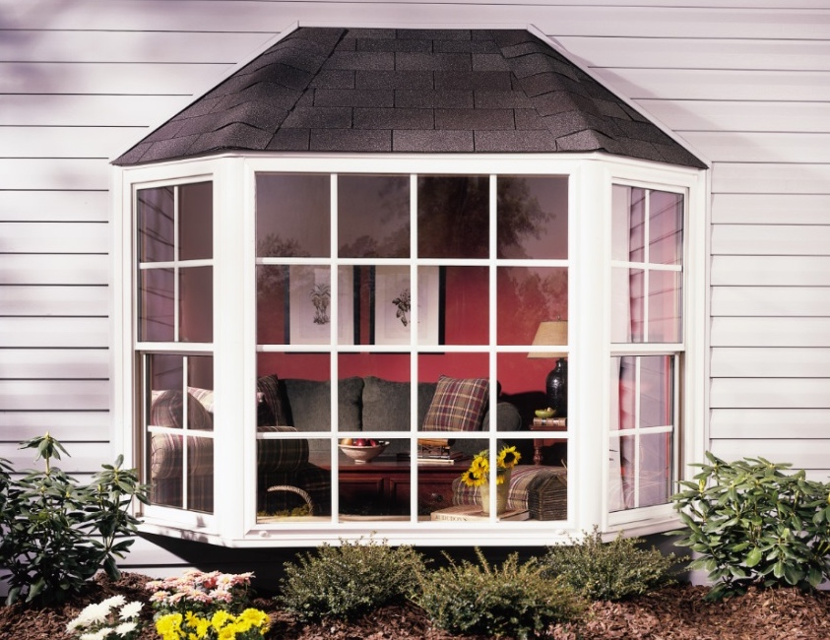
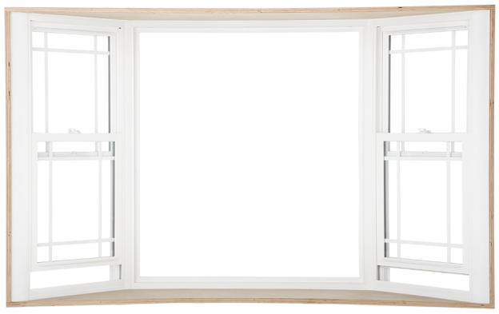
MADE IN USA
Bay & Bow windows are available
in 3, 4 and 5 –lite styles or can be
ordered with double hung or casement windows to flank a middle picture window. Flankers open to provide ventilation.
These windows arrive completely assembled and are simple
to install and customize.
They are available in white or almond, bronze exterior laminate (Series 8700)
and interior wood laminate
and 8 painted colors (Series 8900)
Bay & Bow Windows
* see brochure for full details

Slide 34

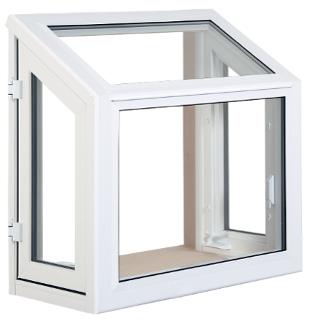
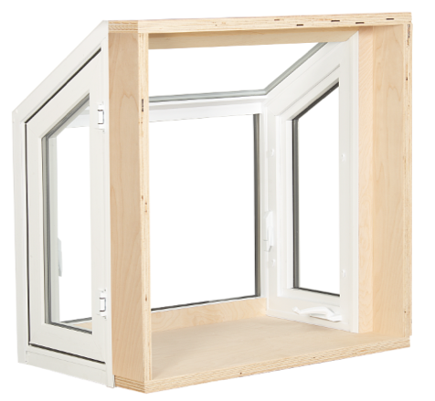
MADE IN USA
A 17½” garden window depth
provides a generous area for plants,
picture frames or added room space.
The roof glass panel features safety
laminated glass for added protection.
There is a hand-sanded 1¼” birch veneer surround and 7/8” insulated glass for maximum thermal performance. Side casement vents provide easy ventilation.
A multi-point locking system and corrosion-resistant hardware enhances window security
Available in white or almond; 5/8” flat grid,
oak hardwood surround and sill muffler complete the available options
Garden Windows
* see brochure for full details

