Slide 1

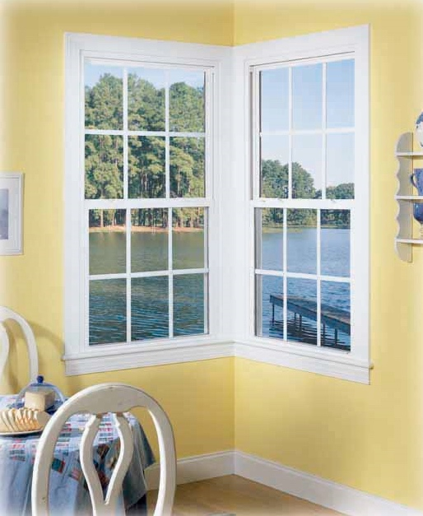
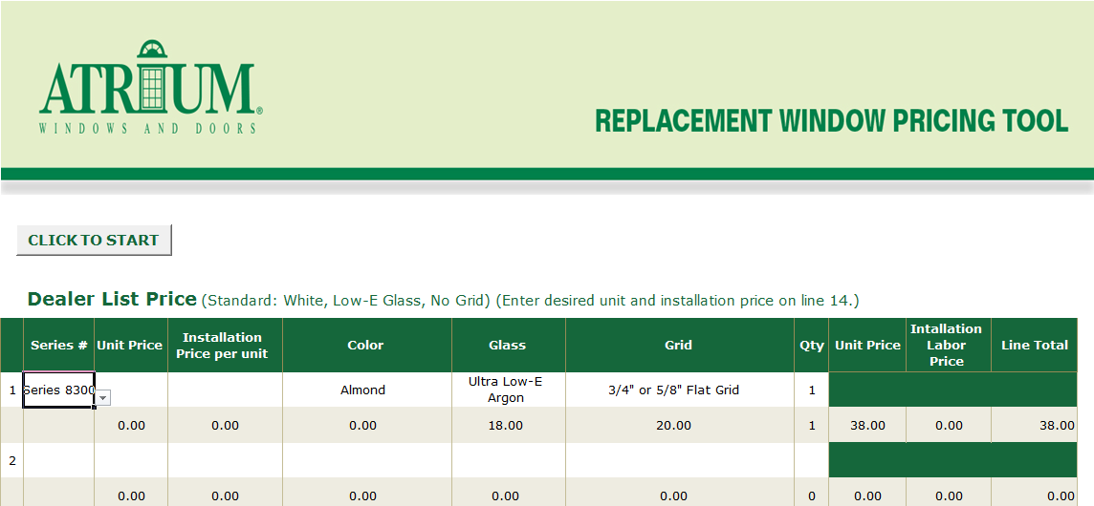

MADE IN USA
WINDOW PRICING TOOL

Slide 2
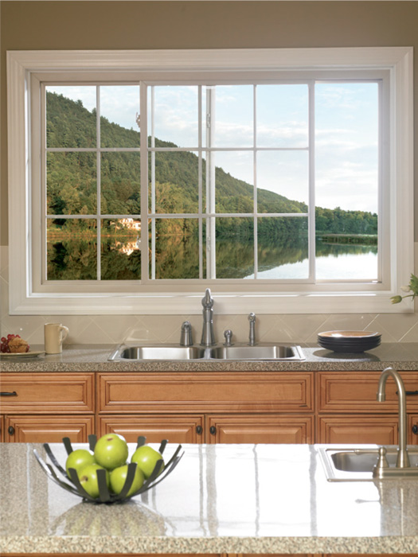
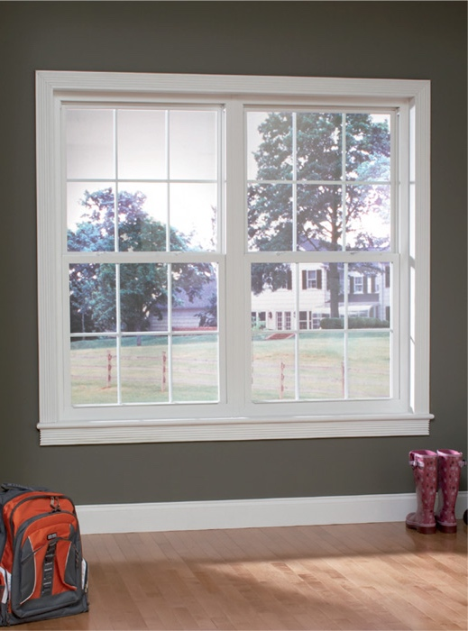
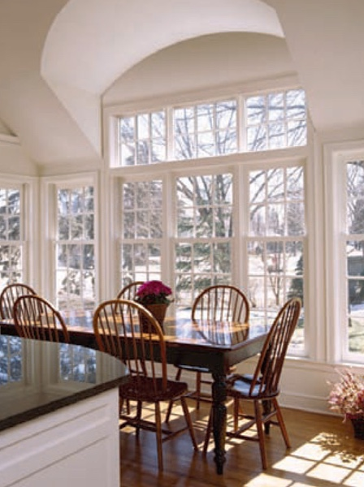
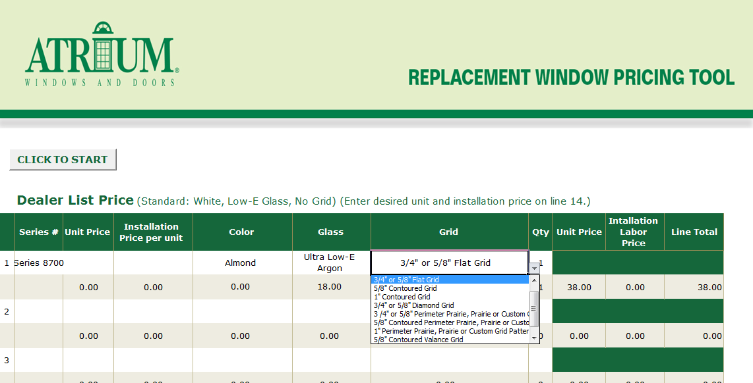

MADE IN USA
Window Pricing Tool
This Microsoft Excel formatted, quick and easy quote tool
can be found on your marketing media site:
Atrium Pricing Tool
For your convenience in pricing simple quotes we have developed the window pricing tool in Excel. The Excel file will
allow you and your customer to create
quotes on the go. Once the file is
downloaded to your computer
there is no need for internet access.
It’s all contained in an easy to use tool.
You choose the replacement window series, type in a unit price and your installation price and then select color, glass, grid from the pull down menus.
Once you have created your
quote be sure to save it to
your desktop. To begin
a new quote, click on
“CLICK TO START”
to clear the sheet.

