Slide 1
WHY THE ATRIUM
SERIES 8300?
The best value in any double hung family on the market!

Slide 2
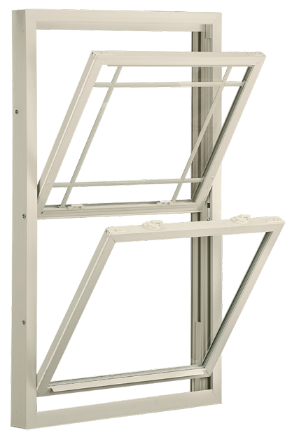
Tilt-in feature allows easy access and cleaning from the inside
PLUS …

Slide 3
FOR ULTIMATE DESIGN, PERFORMANCE
& EFFICIENCY
Features include:
DP Rating 35 (window size tested 36” x 74”)
Extruded Half screen
Beveled main frame for aesthetic appeal
Constant Force Coil Balance
PLUS …

Slide 4
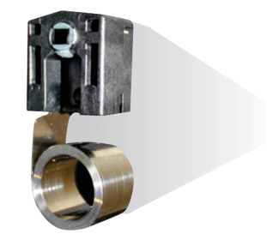
Constant force coil balance lets you easily operate sash

Slide 5
All-welded frame and sash corners
3.25” Jamb Depth
Aluminum reinforced, multi-cavity construction adds greater insulation and strength

Slide 6
Interlocking sashes reduce air infiltration

Slide 7
Two push button night latches let you easily position sash for room ventilation (Window Opening Control Device Optional)
Round locks provide peace of mind. Two locks standard on all windows over 27 ¼” and wider
Low profile tilt latches for easy sash movement

Slide 8
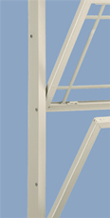
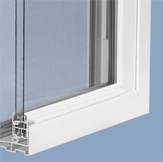
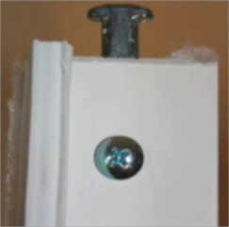
Integrated lift rail looks sleek and lets you raise and lower sashes with ease
T-Lock Pivot Pin further minimizes air infiltration
Three Jamb Adjusters ensure the window is square and plumb; most competitors use only one

Slide 9
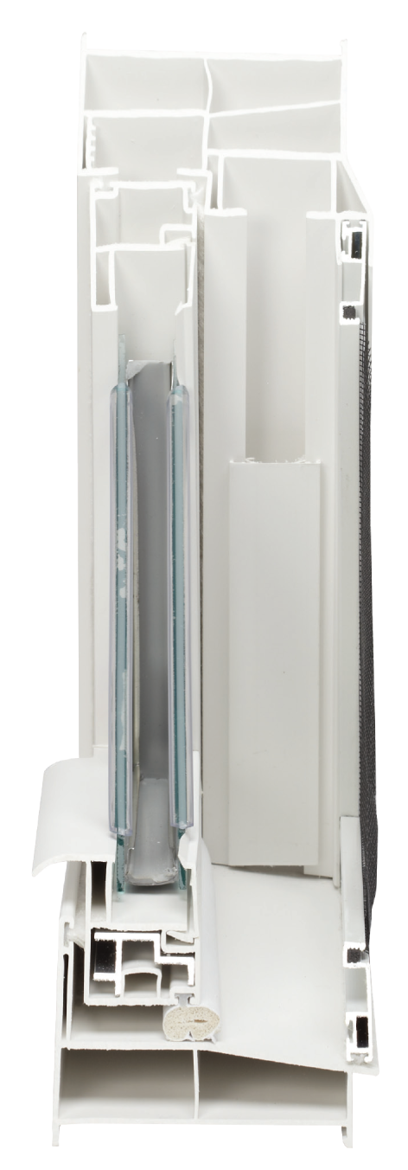
6 Dead air space chambers in jamb
6 Dead air space chambers in head
3 Dead air space chambers in sash
Sloped sill for easy water run-off

Slide 10
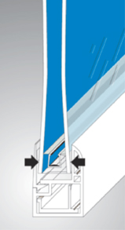
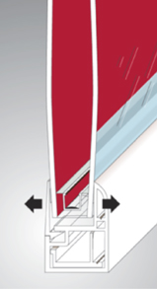
WARM EDGE GLASS SYSTEM
Insulated glass panel provides an
optimum, tightly sealed airspace
that acts as a highly effective noise
buffer and keeps inside air from
escaping and outside air from
penetrating
U-channel with thick, insulating
buffered edge insulates the glass
from the frame

Slide 11
THE 8300 DOUBLE HUNG TEST RESULTS
Outstanding in performance

Slide 12
2 & 3-Lite Sliders

Slide 13
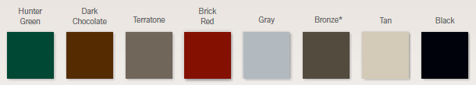
Options
Nine Painted Colors (white interior only)
Grids
Vinyl Colors

