Slide 1
WHY THE ATRIUM
SERIES 8700?
For enhanced performance and added style, there is no better vinyl double hung window available

Slide 2
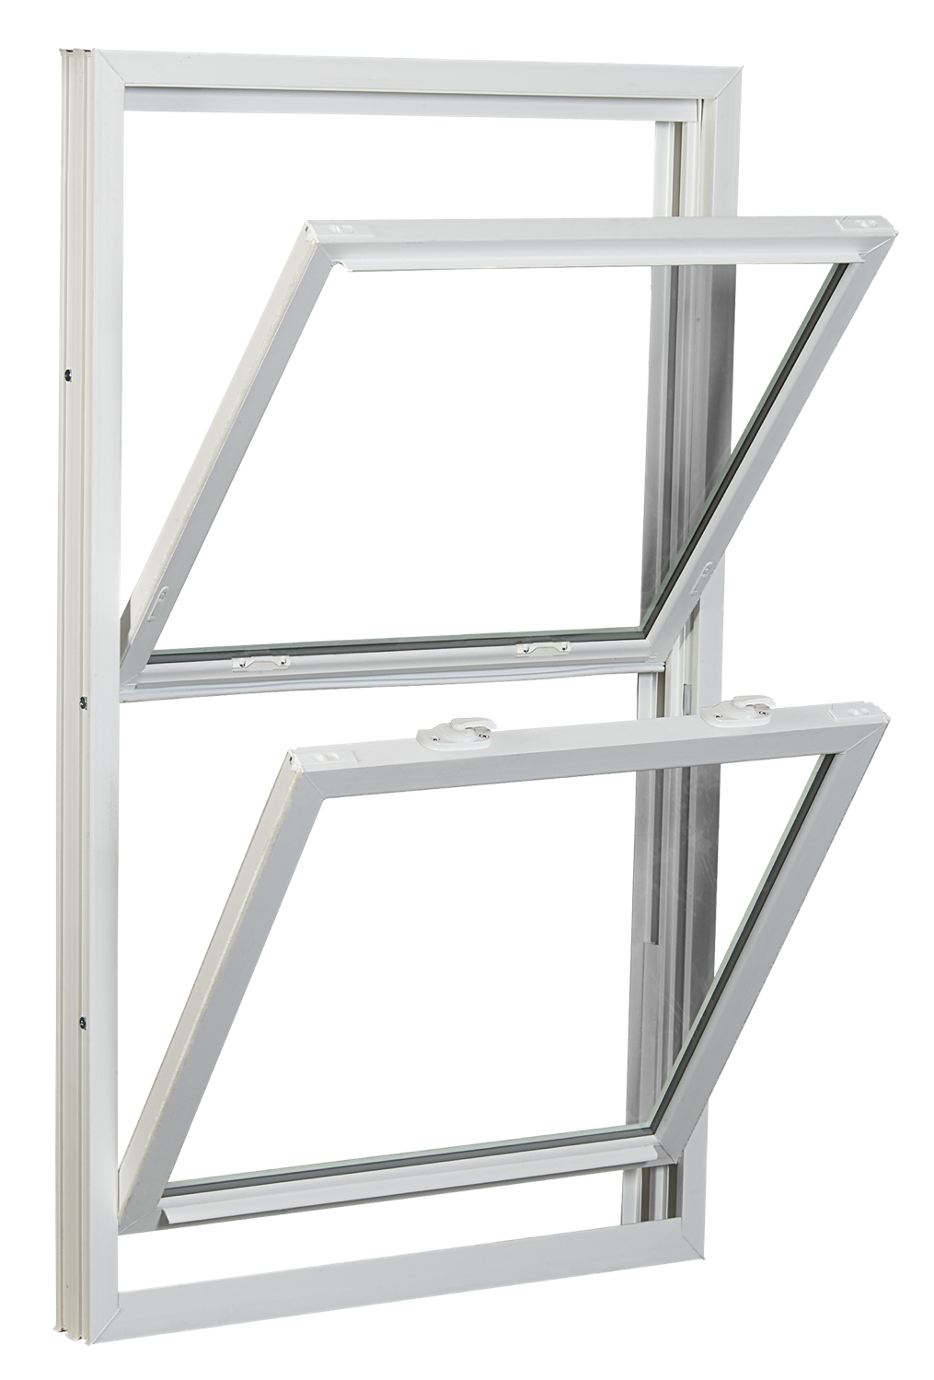
Tilt-in feature allows easy access and cleaning from the inside
PLUS …

Slide 3
FOR ULTIMATE DESIGN, PERFORMANCE
& EFFICIENCY
Features include:
Low-E Glass with Argon Gas
25-Year Glass Breakage Warranty
DP Rating 35 (window size tested 44” x 75”; DP 50 Optional)
Extruded Half screen
PLUS …

Slide 4
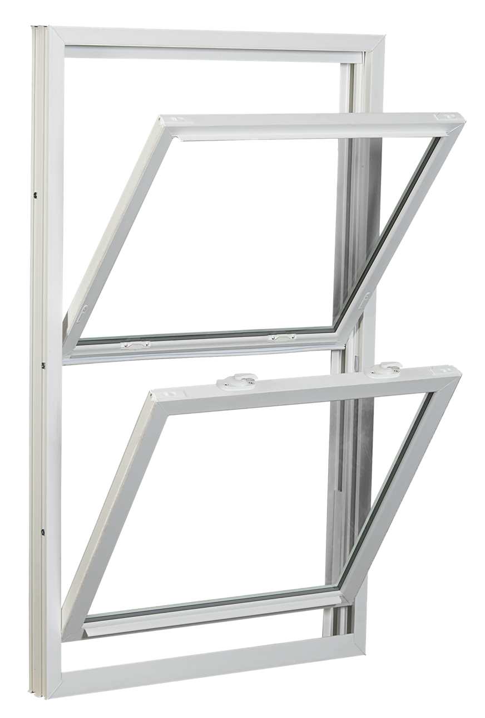
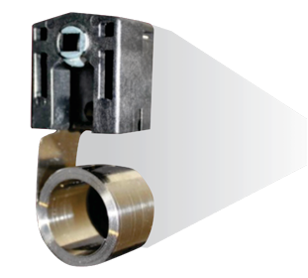
Constant force coil balance lets you easily operate sash

Slide 5
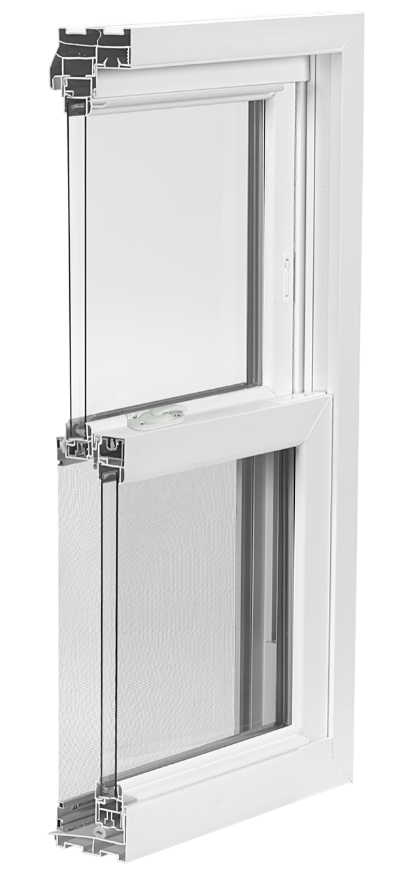
All-welded frame and sash corners
Aluminum reinforced, multi-cavity construction adds greater insulation and strength
3.25” Jamb Depth

Slide 6
Interlocking sashes reduce air infiltration

Slide 7
Two push button night latches let you easily position sash for room ventilation (Window Opening Control Device optional)
Low-Profile Deluxe Cam Locks (Two locks standard on all windows over 27 ¼” and wider)
Low profile tilt latches for easy sash movement

Slide 8
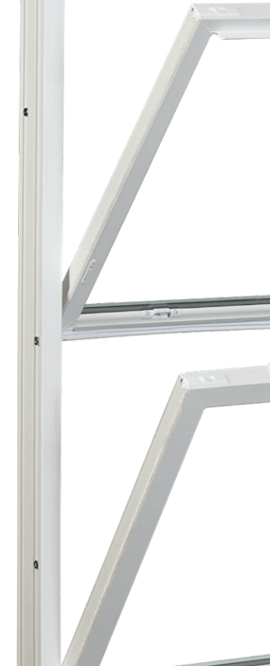
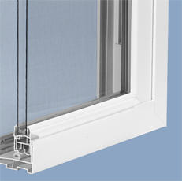
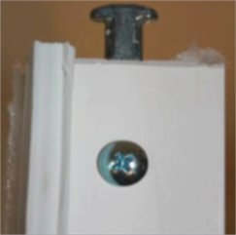
Integrated lift rail looks sleek and lets you raise and lower sashes with ease
T-Lock Pivot Pin further minimizes air infiltration
Three Jamb Adjusters ensure the window is square and plumb; most competitors use only one

Slide 9
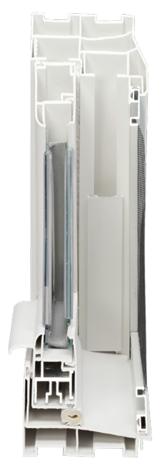
6 Dead air space chambers in jamb
6 Dead air space chambers in head
3 Dead air space chambers in sash
Sloped sill for easy water run-off

Slide 10
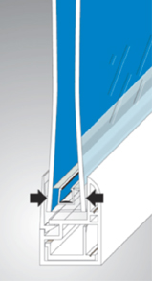
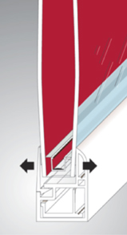
WARM EDGE GLASS SYSTEM
Insulated glass panel provides an
optimum, tightly sealed airspace that
acts as a highly effective noise
buffer and keeps inside air from
escaping and outside air from
penetrating
U-channel with thick, insulating
buffered edge insulates the glass
from the frame

Slide 11
THE 8700 DOUBLE HUNG TEST RESULTS
Outstanding in performance

Slide 12
2 & 3-Lite Sliders

Slide 13
Options
Vinyl Colors
Exterior Laminate
Grids
Lifetime Glass Breakage Warranty
And, many more!

