Slide 1
WHY THE ATRIUM
SERIES 8900?
Simply the very best vinyl replacement window available.

Slide 2
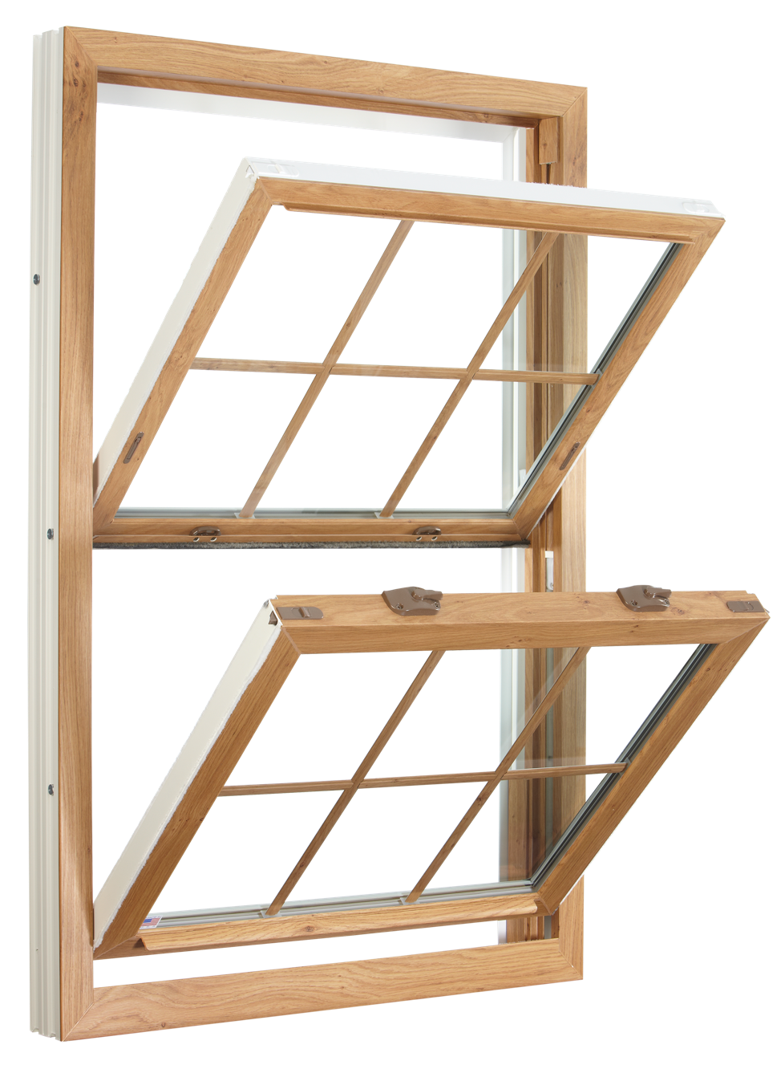
Tilt-in feature allows easy access and cleaning from the inside
PLUS …

Slide 3
FOR ULTIMATE DESIGN, PERFORMANCE
& EFFICIENCY
Features include:
Low-E Glass with Argon Gas
Lifetime Glass Breakage Warranty
DP Rating 60 (window size tested 36” x 74”)
Extruded Full screen
PLUS …

Slide 4
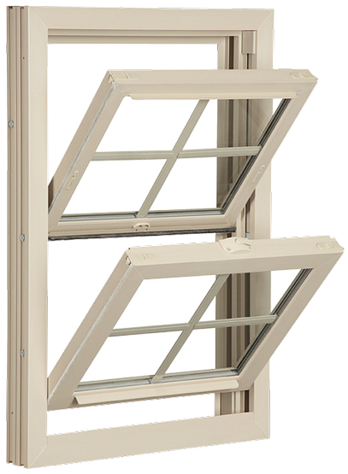
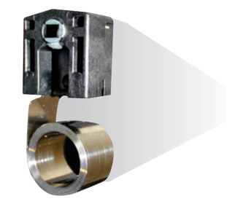
Constant force coil balance lets you easily operate sash

Slide 5
InsulKorTM polyurethane, fiberglass-enriched reinforcement
No metal in the frame of the window yields enhanced thermal performance AND unsurpassed structural integrity!
Showing optional foam fill

Slide 6
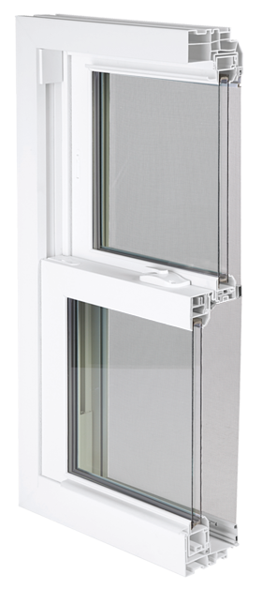
All-welded frame and sash corners
Aluminum reinforced, multi-cavity construction adds greater insulation and strength
3.25” Jamb Depth

Slide 7
Interlocking sashes reduce air infiltration

Slide 8
Two push button night latches let you easily position sash for room ventilation (Window Opening Control Device optional)
Low-Profile Deluxe Cam Locks (Two locks standard on all windows over 27 ¼” and wider)
Low profile tilt latches for easy sash movement

Slide 9
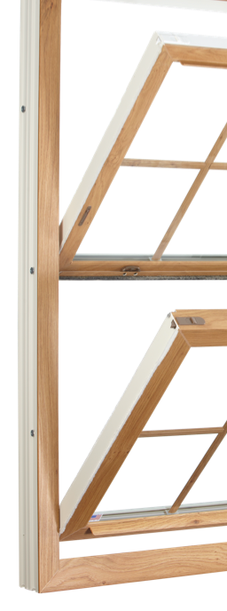
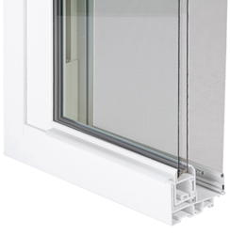
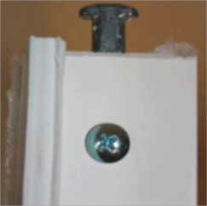
Integrated lift rail looks sleek and lets you raise and lower sashes with ease
T-Lock Pivot Pin further minimizes air infiltration
Three Jamb Adjusters ensure the window is square and plumb; most competitors use only one

Slide 10
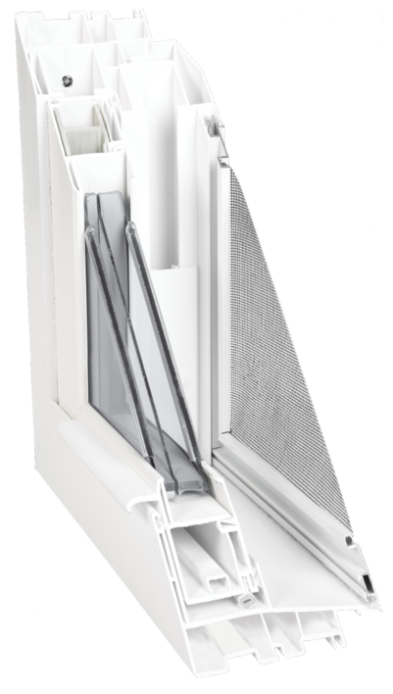
6 Dead air space chambers in jamb
6 Dead air space chambers in head
3 Dead air space chambers in sash
Sloped sill for easy water run-off

Slide 11
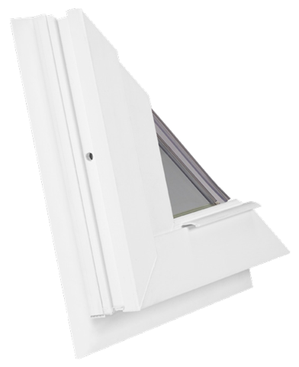
Exterior accessory groove
Allows nail fin option for use in remodeling and new construction applications

Slide 12
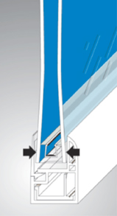
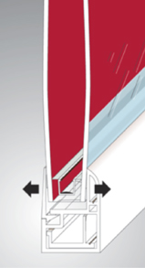
WARM EDGE GLASS SYSTEM
-Insulated glass panel provides an
optimum, tightly sealed airspace that
acts as a highly effective noise
buffer and keeps inside air from
escaping and outside air from
penetrating
-U-channel with thick, insulating
buffered edge insulates the glass
from the frame

Slide 13
THE 8900 DOUBLE HUNG TEST RESULTS
Outstanding in performance
0.08 cfm/ft is an industry leading air infiltration performance mark!

Slide 14
2 & 3-Lite Sliders

Slide 15
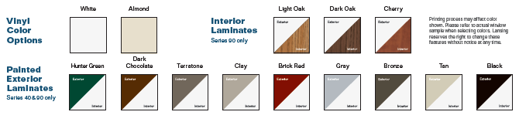
Options

Slide 16
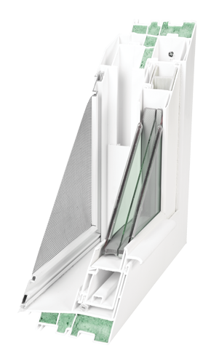
Options
Triple Pane Glass for superior energy efficiency
R-5 Thermal performance
Super Spacer standard on triple glaze options
InsulKor multi-cavity foam filled frame
Ultra Low-E glass with argon gas

