Slide 1

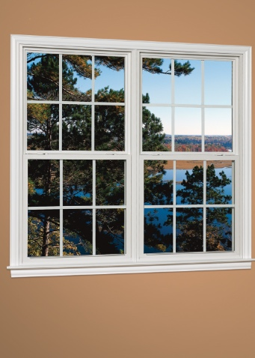
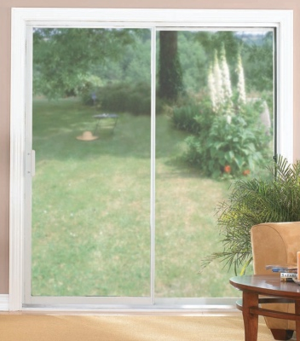

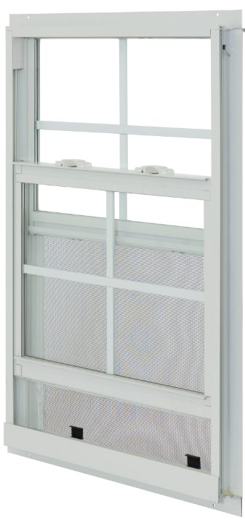
MADE IN USA
ATRIUM’S TEXAS VINYL & ALUMINUM
NEW CONSTRUCTION PRODUCT OFFERING
A GOOD INVESTMENT

Slide 2
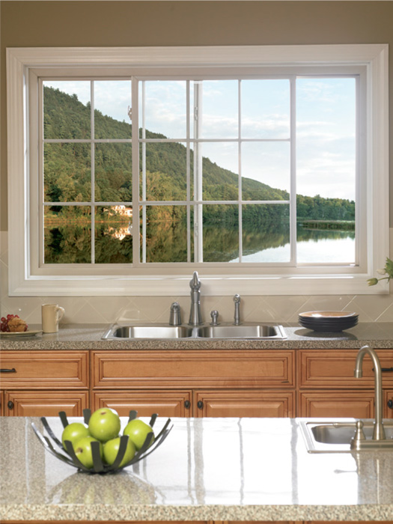
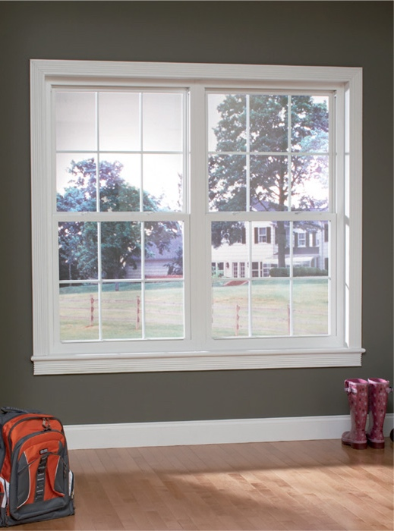
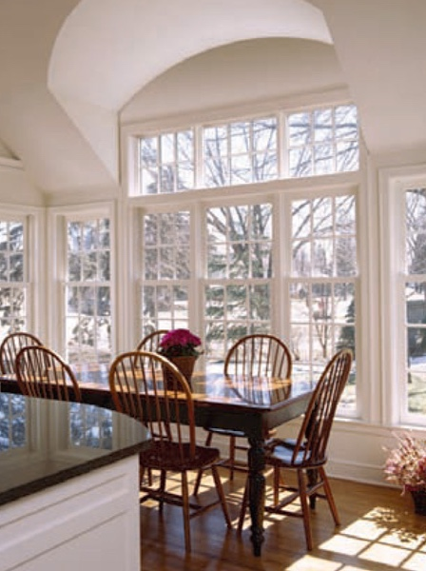
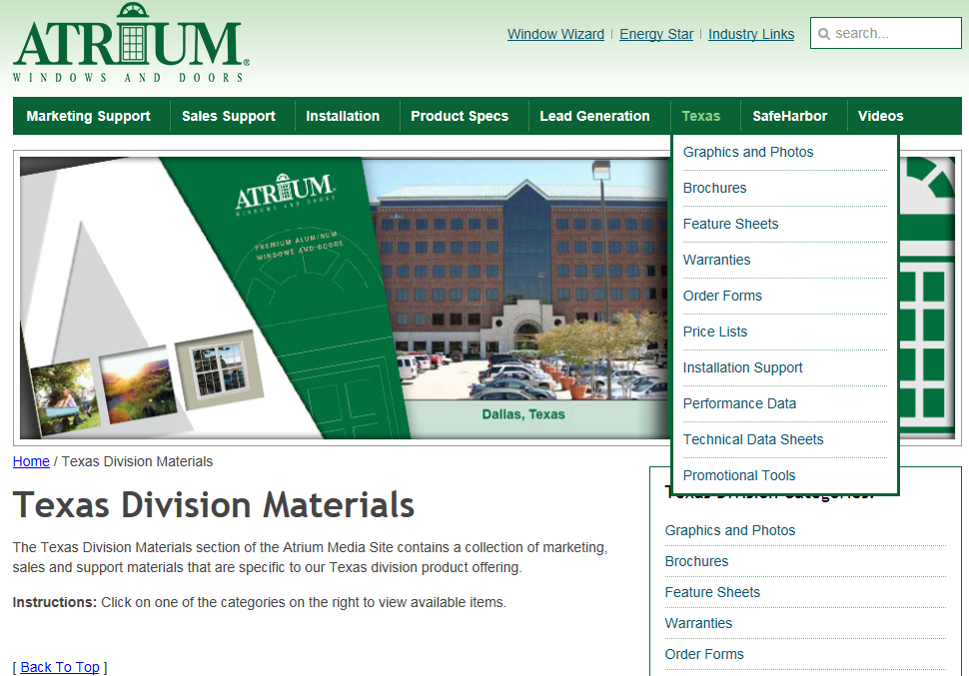

MADE IN USA
For easy to use marketing collateral with Series specific information
see our media site at
marketing.viewpoint-windows.com
In the following slides
we provide you with links
to specific assets
for your convenience.
Atrium Media Website

Slide 3
MADE IN USA
Atrium’s Texas Vinyl
New Construction Window Offering
Series 120 Single Hung
Our Series 120 single hung windows offer enhanced energy-efficient glass, outstanding strength
and the style you demand with a 1-3/8” nail fin setback for brick veneer and select stucco applications

Slide 4
MADE IN USA
Atrium’s Texas Aluminum
New Construction Window Offering
Series 300 Single Hung
Our Series 300 single hung windows offer enhanced energy-efficient glass,
outstanding strength and the style you demand with several color and grid options available
Series 375 Single Hung Tilt-Sash
Our Series 375 single hung tilt-sash windows offer great reliability and the bottom sash
tilts inward to enable easy cleaning from inside your home

Slide 5
MADE IN USA
Atriums’s Texas Aluminum
New Construction Sliding
Patio Door Offering
Series 4000 Sliding Patio Door
The model 4000 Sliding Patio Door is equipped with Energy Star® compliant, tempered Low-E glass panels
with Argon gas for enhanced thermal performance and is available in an array of colors

Slide 6
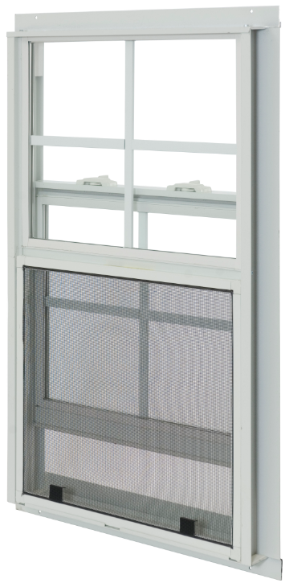
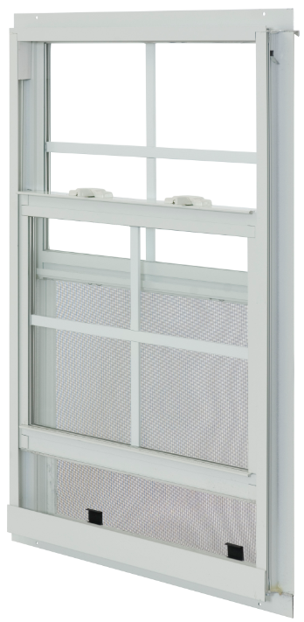
MADE IN USA
1-3/8” nail-fin setback for brick veneer construction and select stucco applications
Sweep lock helps provide
a weather-tight seal and added security
Warm-edge insulated glass
reduces condensation
DP-50 rating (window size tested 48” x 84”)
Block & Tackle Balance System
Modular sized so rough opening widths
for multiple units are easy to calculate
Half Screen
Limited Lifetime Warranty
Almond & Clay colors optional;
flat & contoured grids available
Series 120
* see brochure for full details

Slide 7
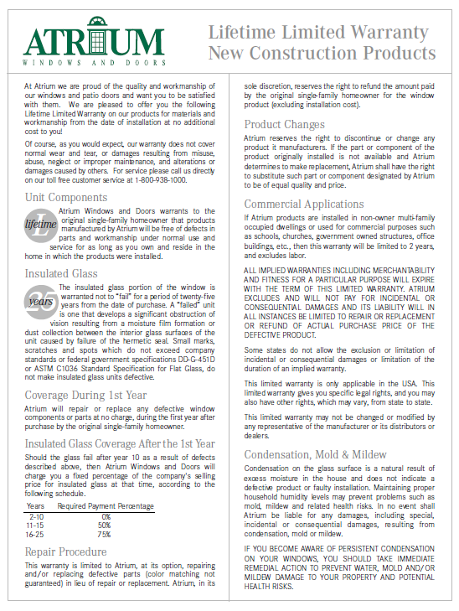
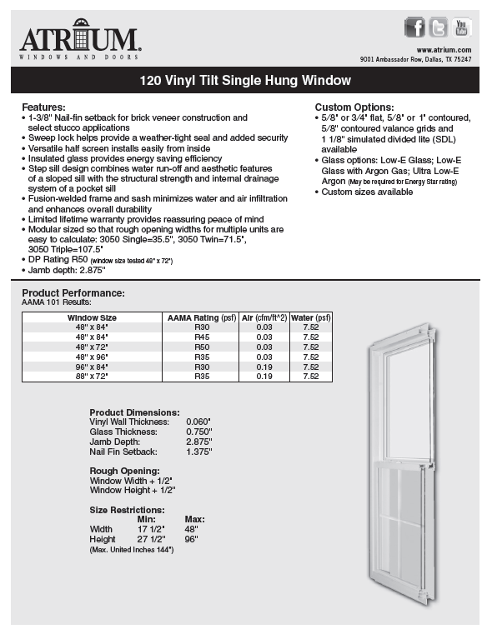
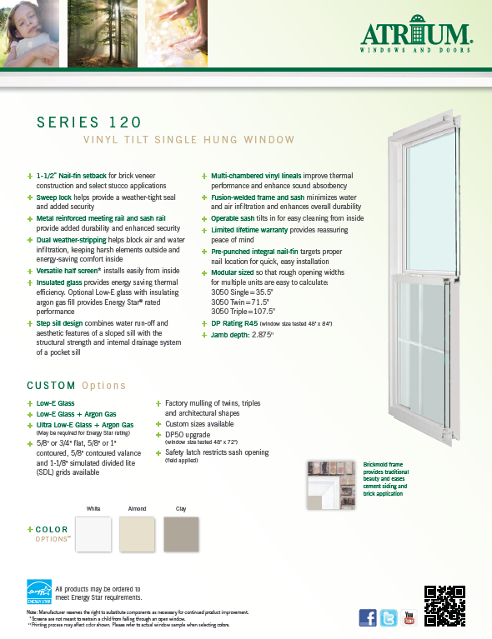
MADE IN USA
warranty
technical data sheet
(slider sheet also available)
feature sheet
(slider sheet also available)
Series 120

Slide 8
MADE IN USA
Low-E glass for optimal thermal performance
Warm-edge insulated glass
reduces condensation
DP-40 rating on windows in-stock
Block & Tackle Balance System
Positive action lock provides security
Half Screen
Limited Lifetime Warranty
Bronze, Sandstone and Mill colors optional;
5/8” and 13/16” flat grid available
Series 300
* see brochure for full details

Slide 9

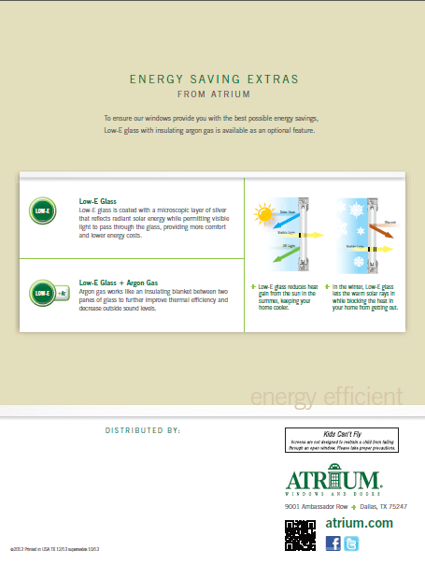
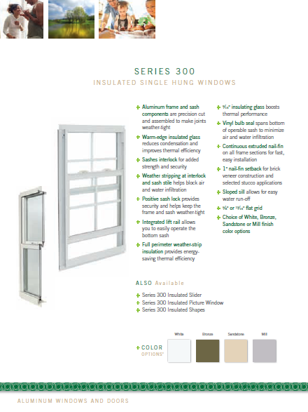
MADE IN USA
brochure
Series 300

Slide 10
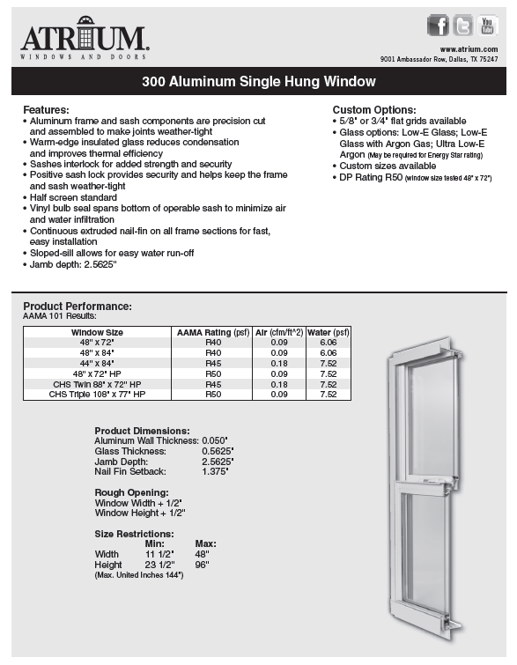
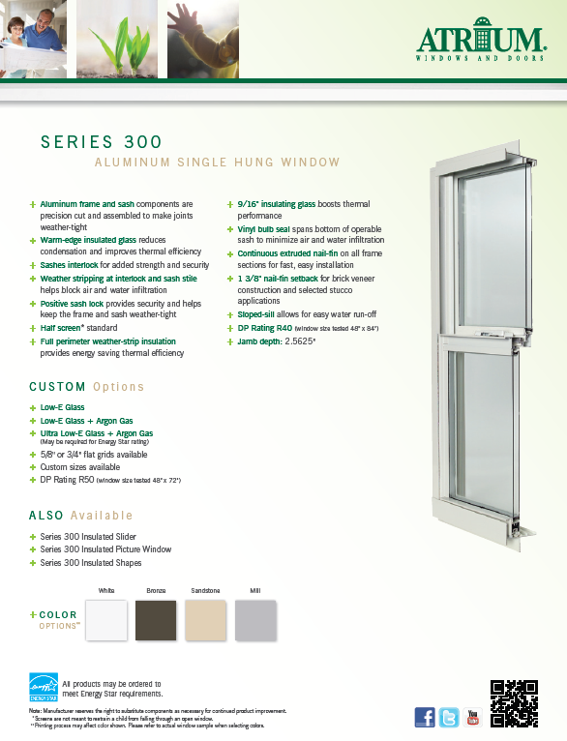
MADE IN USA
warranty
technical data sheet
(slider sheet also available)
feature sheet
(slider sheet also available)
Series 300

Slide 11
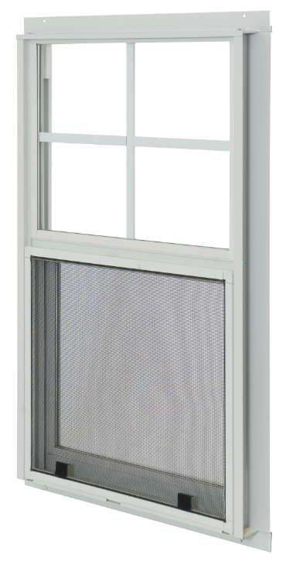
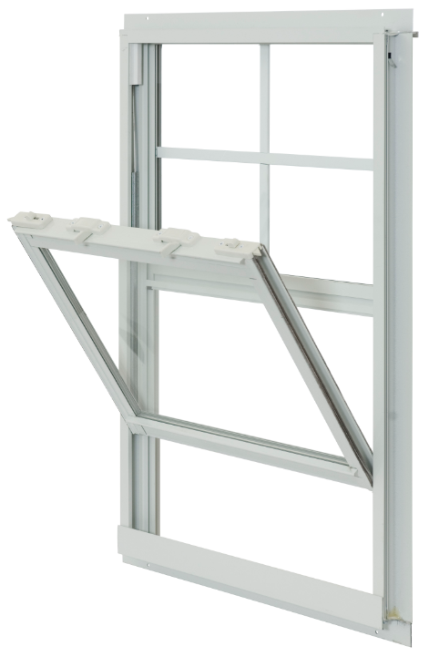
MADE IN USA
Tilt-Sash Single Hung
Low-E glass for optimal thermal performance
Warm-edge insulated glass
reduces condensation
DP-40 rating on windows in-stock
Block & Tackle Balance System
Positive action lock provides security
Half Screen
Limited Lifetime Warranty
Bronze and Sandstone colors optional;
5/8” and 13/16” flat grid available
Series 375
* see brochure for full details

Slide 12
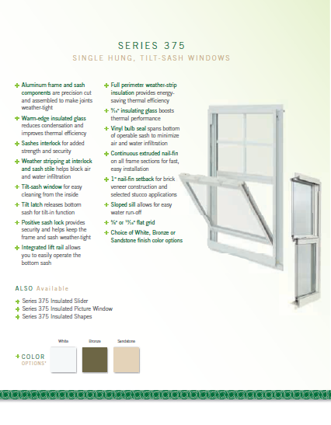
MADE IN USA
brochure
Series 375

Slide 13
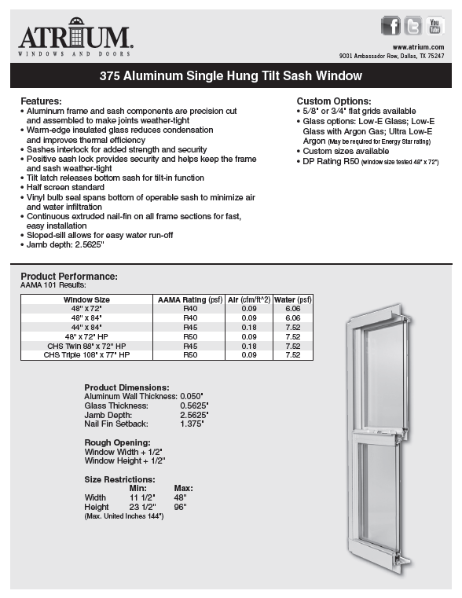
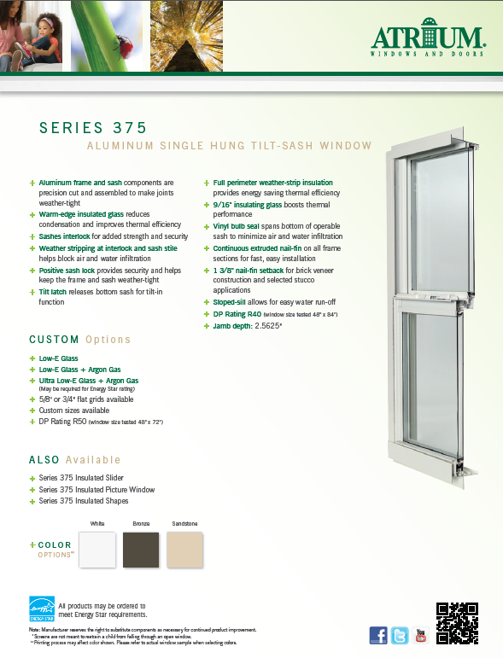
MADE IN USA
warranty
technical data sheet
(slider sheet also available)
feature sheet
(slider sheet also available)
Series 375

Slide 14
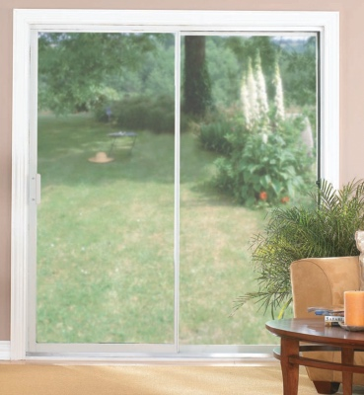
MADE IN USA
Reversible design lets you locate
moving panel either left or right
Adjustable ball-bearing rollers
ensure smooth movement
Tubular construction on lock stile
and interlocking stiles for greater strength
Integral nail-fin on jambs and head
ensures ease of installation
Low profile threshold for better water run-off
Inside slide/outside screen
Limited Lifetime Warranty
Options include:
keyed cylinder lock, insulated Low-E glass,
stainless steel track, and multiple colors
Series 4000
* see brochure for full details

Slide 15
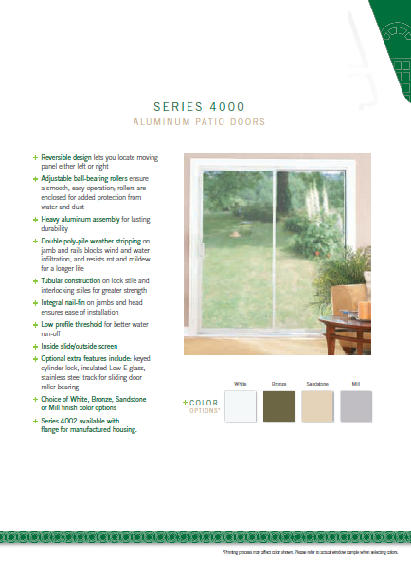
MADE IN USA
brochure
Series 4000

Slide 16
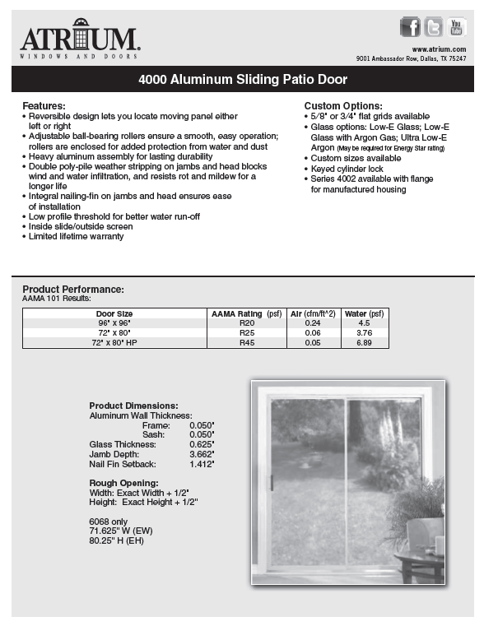
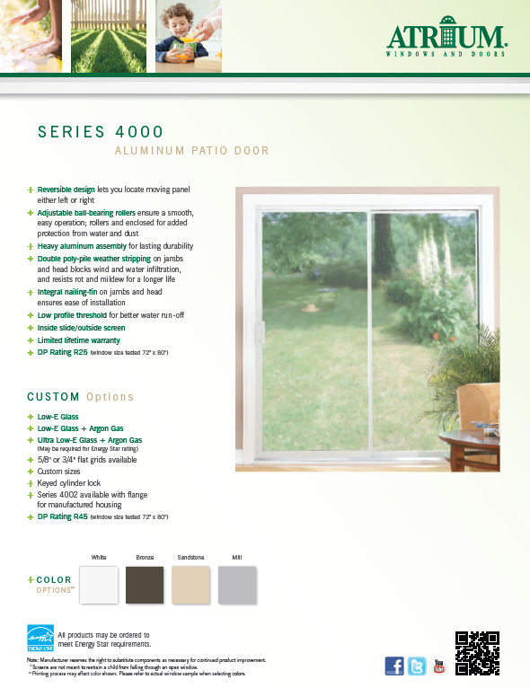
MADE IN USA
warranty
technical data sheet
(slider sheet also available)
feature sheet
(slider sheet also available)
Series 4000

