Slide 1

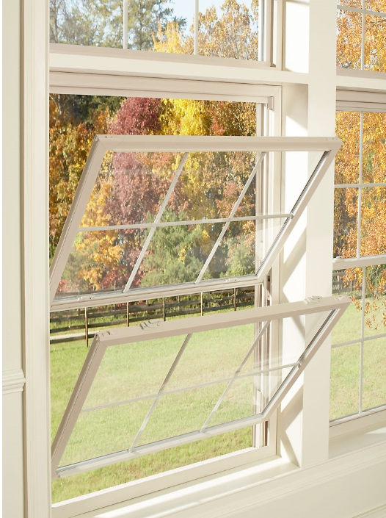



MADE IN USA
Experience
the Magic
of Online
Ordering

Slide 2
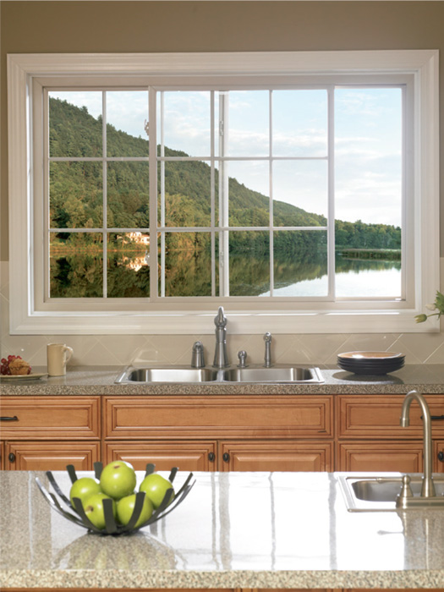
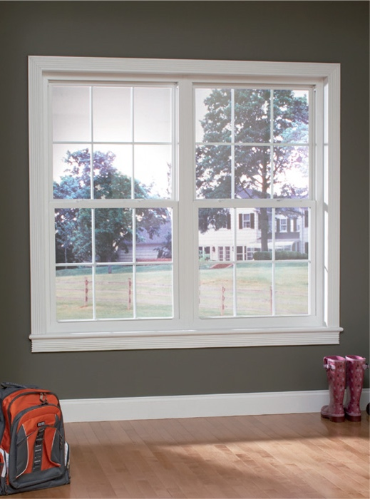
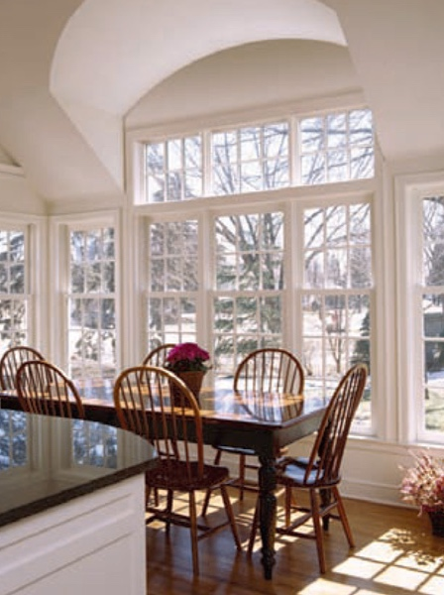
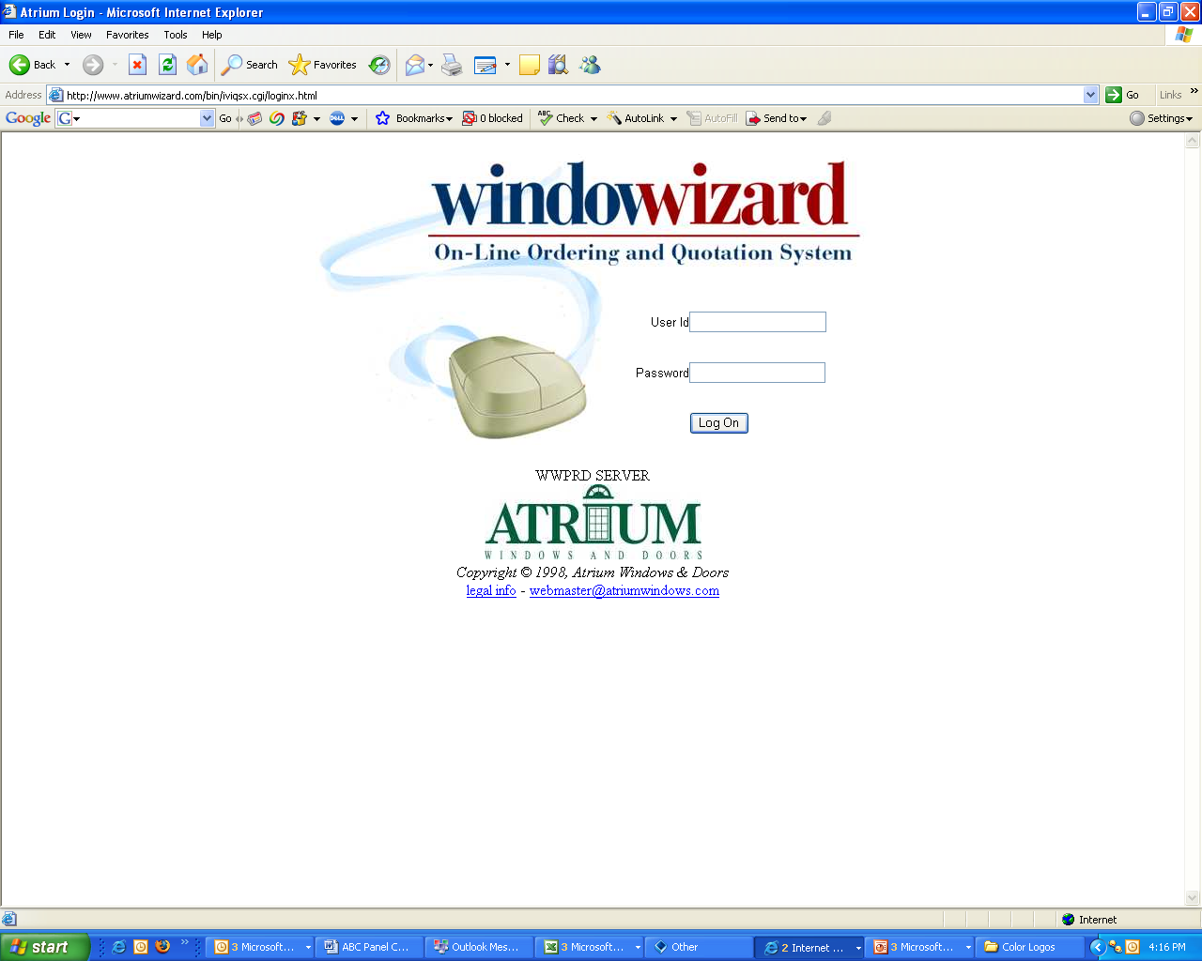

MADE IN USA
The WindowWizard, an online quote-generating system for top-quality windows and patio doors
All you need is a computer with internet access
There are no disks or downloads to worry over
WindowWizard available
24 hours a day, 7 days a week
Only users with a proper password
can enter the Wizard’s domain
Your customer can use the Wizard
Atrium calls this the “Customer’s Customer”
Atrium provides your customer
with a log-in and password on an account
that is linked to your location
Your customer can enter orders and do quotes
You control cost and order submission
a great way to do business

Slide 3
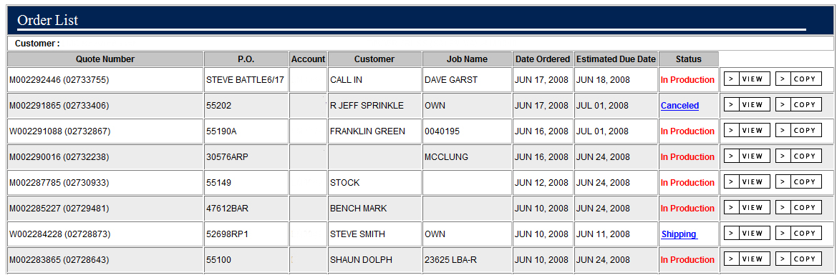
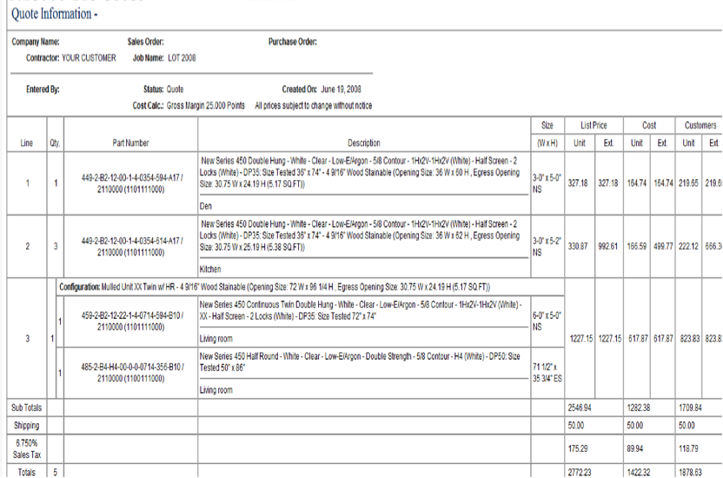
MADE IN USA
You will know exactly where your order is
in our system at all times:
real time order status

Slide 4
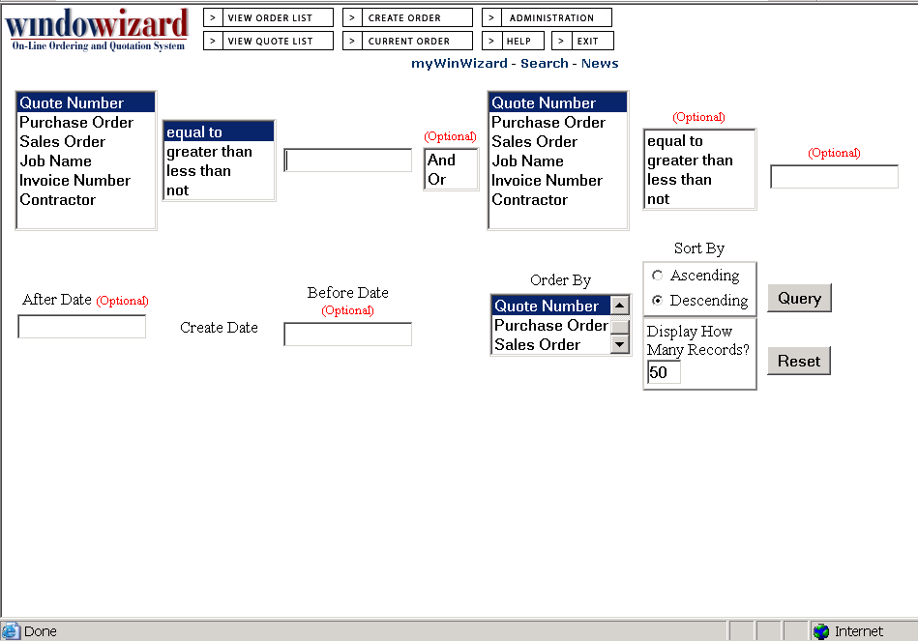
MADE IN USA
Reduce time
in finding original orders by sorting various categories
See orders placed on the Wizard
since 1999
search engine

Slide 5
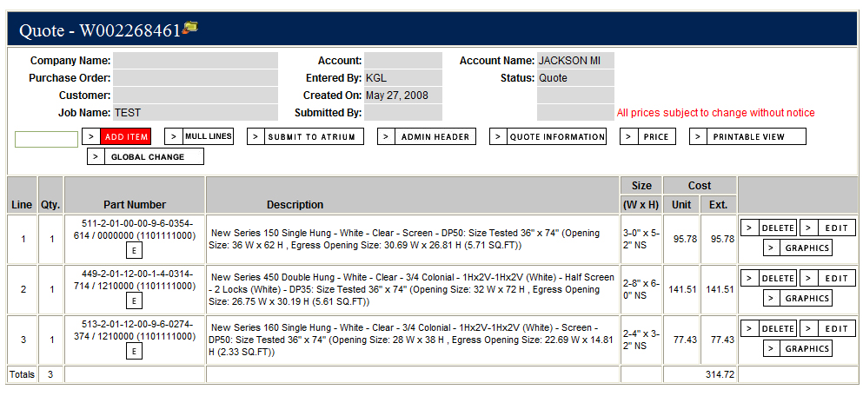
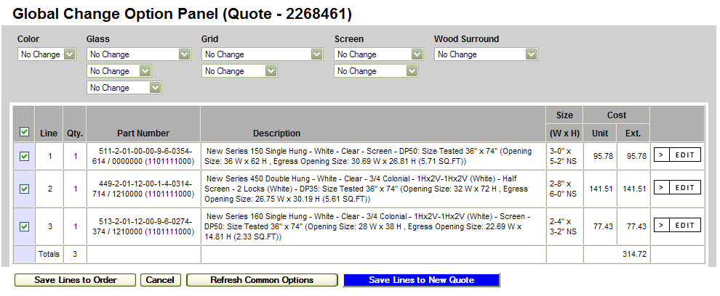
MADE IN USA
Quote multiple options without duplicating entries via Global Change functionality
Save selection
and receive
new quote
global change

Slide 6
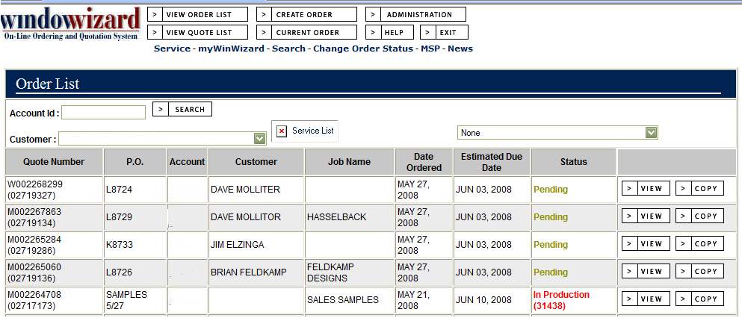
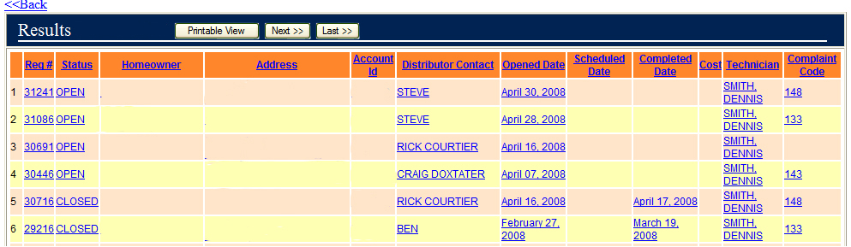
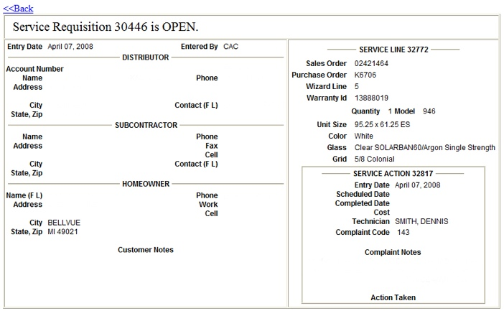
MADE IN USA
Real time tracking of service request status
displaying service

Slide 7
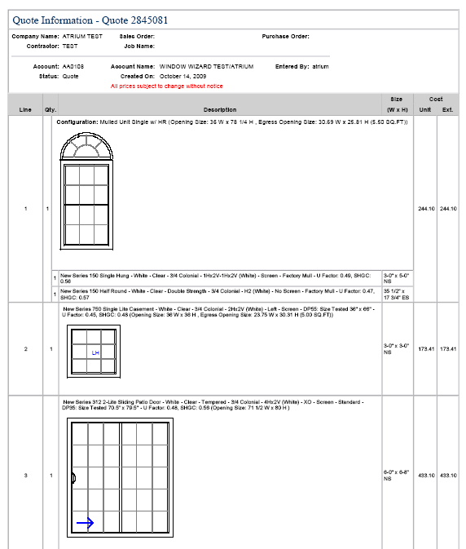
MADE IN USA
The Wizard offers printable graphics
showing mulled units and special shapes
multiple units with shapes

Slide 8
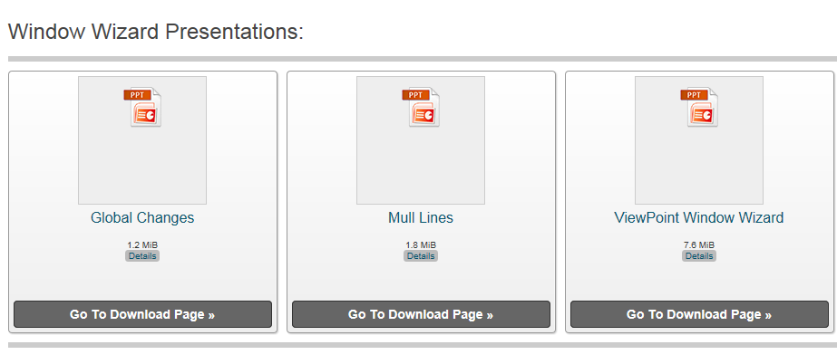
MADE IN USA
WindowWizard
For a more extensive review of
WindowWizard capabilities,
visit your media site.

